Slide 1
Activities and Equipment Kits for More Individualized Physical Health Education at School or at Home Grades 7+
Dr. John Byl
JOHNBYL50@gmail.com
While we wait, sign up for weekly activity postings on:
Twitter or Instagram
@canadago4sport

Slide 2
Key Considerations
Equipment Sharing
Do not share equipment—unless the equipment is kicked (soccer balls for example).
Do not pick up equipment with your hands, and if you do pick up equipment, make sure the equipment has been properly disinfected and not touched by others after disinfection.
Physical Distancing
Try to create playing spaces for each player with the use of poly spots or half-cones…
Masks
Think through wearing of masks in line with safety and school policies…

Slide 3
Target Activities Hula Hoop Horseshoe—Repeat from previous grades https://youtu.be/c-mKFTRXOS8 https://www.canadago4sport.com/Target1/Hula-Hoop-Horseshoes

Slide 4
Hula Hoop Horseshoe Race— Repeat from previous grades https://youtu.be/D-lAsMyun3M https://www.canadago4sport.com/Target1/Hula-Hoop-Horseshoes-Race

Slide 5
Disc Golf
https://www.canadago4sport.com/Target1/Disc-Golf-with-Natural-Goals
https://www.canadago4sport.com/Target1/Disc-Golf-with-Mobile-Goals

Slide 6
Kickpar https://www.canadago4sport.com/Target1/Kickpar

Slide 7
Pickleball—Other Racquet Sports
Identify a pickleball (or use pickleballs from two different companies).
Play solo against a wall
One player picks up a pickleball with his hands, and the other player picks up the other pickleball with his hands. Players can flip or kick opponent’s pickleball to their side and keep their pickleball out of play, when not serving, by rolling their ball to the wall behind them.

Slide 8
Pickleball https://www.canadago4sport.com/Net/Racquet-to-Wall

Slide 9
Manipulative Retain How Far Can We Roll—Individually https://www.canadago4sport.com/Target1/How-Far-Can-we-Roll

Slide 10
Tape Roll Rolling https://www.canadago4sport.com/Target1/Tape-Roll-Bowling
No video yet

Slide 11
Manipulative Retain Balance a Ball https://www.canadago4sport.com/Manipulative-Retain/Balance-Two-Ball

Slide 12
Double Dribble https://www.canadago4sport.com/Manipulative-Retain/Double-Dribble

Slide 13
Soccer Juggle with 360 https://www.canadago4sport.com/Manipulative-Retain/Soccer-Juggle-with-360

Slide 14
Throw to a Wall Timed Race https://www.canadago4sport.com/Manipulative-Send/Throw-to-a-Wall-Relay https://www.canadago4sport.com/Manipulative-Send/Toss-and-Catch-to-Wall
But make an individual or team (2-3 players) race of it.

Slide 15
Bird/Ball Juggle https://www.canadago4sport.com/Manipulative-Send/-Bird%2FBall-Juggle

Slide 16
Two Players Sharing Equipment?
The PHE Canada document does not encourage the sharing of any equipment. For those teachers in other countries, you may wish to consider the following thoughts.
On May 19, 2020 the United States’ Centers for Disease Control and Prevention (CDC) changed its guidelines to state https://www.cdc.gov/coronavirus/2019-ncov/prevent-getting-sick/how-covid-spreads.html:
The virus that causes COVID-19 is spreading very easily and sustainably between people. Information from the ongoing COVID-19 pandemic suggest that this virus is spreading more efficiently than influenza, but not as efficiently as measles, which is highly contagious.
The virus does not spread easily in other ways

Slide 17
Two Players Sharing Equipment? Con’t
COVID-19 is a new disease and we are still learning about how it spreads. It may be possible for COVID-19 to spread in other ways, but these are not thought to be the main ways the virus spreads.
From touching surfaces or objects. It may be possible that a person can get COVID-19 by touching a surface or object that has the virus on it and then touching their own mouth, nose, or possibly their eyes. This is not thought to be the main way the virus spreads, but we are still learning more about this virus.
Based on the CDC guidelines, a school and instructor’s wisdom, you may decide to engage students where there is limited sharing of equipment. How might we do that? Permit a couple of examples if you can still reduce equipment contact if you decide it is wise to go in this direction.

Slide 18
Two Players Sharing Equipment? Con’t
Net Games
Have players share a bird, table tennis ball, or tennis ball.
Playing other two-player games:
Width and Depth https://www.canadago4sport.com/Net/Width-and-Depth
Two Square https://www.canadago4sport.com/Net/Two-Square-Stability-Ball
Striking
Use a different ball for each baseball/cricket inning and for each new pitcher.
There is no unnecessary passing of the ball (tossing the ball around the bases after a strike out…)—but I would rarely (never?) do a full-sized baseball/softball game in a Physical Education class.

Slide 19
Manipulative Send and Receive Noodle Toss Pairs [at home] (but use Rubber Band Ball instead or scoops) Repeat from Previous Grades https://www.canadago4sport.com/Manipulative-Send/Noodle-Toss-Pairs

Slide 20
Backwards Partner Bowling [at home] https://www.canadago4sport.com/Target1/Backwards-Partner-Bowling

Slide 21
Net/Wall Activities Two Square With a Target https://www.canadago4sport.com/Target1/Ace-Chase-Two-Square

Slide 22
Width and Depth [at home] https://www.canadago4sport.com/Net/Width-and-Depth

Slide 23
Scoops with a partner or solo against a wall https://www.canadago4sport.com/Manipulative-Send/Scoop-to-Wall

Slide 24
Toss in the Towel (use a soccer ball instead of stability ball) https://www.canadago4sport.com/Manipulative-Send/Toss-in-the-Towel

Slide 25
Two Player Juggle [at home] (use any three larger balls—soccer, basketball…) https://www.canadago4sport.com/Manipulative-Send/Two-Player-Juggle

Slide 26
Feet to Feet Hockey [at home] (use any small ball (tennis) or bean bag) https://www.canadago4sport.com/Manipulative-Receive/Feet-to-Feet-Hockey

Slide 27
Kaboom (use a larger ball (basketball or soccer ball) and a smaller ball (tennis) or bean bag [do solo or at home] https://www.canadago4sport.com/Manipulative-Receive/Kaboom

Slide 28
Wobbly Balloon [at home] https://www.canadago4sport.com/Manipulative-Receive/Woobly-Balloon

Slide 29
Active Brain Activities Active Checkers https://www.canadago4sport.com/Numeracy/Active-Checkers

Slide 30
Connect Four Up (use checker board) https://www.canadago4sport.com/Numeracy/Connect-Four-Up

Slide 31
Fitness
Ladder activities—for over 60 different activities, download the Ladder workshops at
https://www.canadago4sport.com/conferences-and-workshops

Slide 32
Topple Three Up https://www.canadago4sport.com/Locomotor/Topple-Three-Up

Slide 33
Anerobic Beanbag Race (could use any four objects like, handkerchiefs, pieces of foam, plastic cups…) https://www.canadago4sport.com/Locomotor/Anaerobic-Beanbag-Race

Slide 34
Tic-Tac-Toe Double Three in a Row [at home] (9 cups) https://www.canadago4sport.com/Numeracy/Topple-Double-Tic-Tac

Slide 35
Planks till Odd Use own dice and beanbag https://www.canadago4sport.com/Numeracy/Planks-till-odd

Slide 36
Noodle Toe Tap with Pool Noodle Each https://www.canadago4sport.com/Combative/Noodle-Toe-Tap

Slide 37
Push up Hockey in Pairs [at home] https://www.canadago4sport.com/Warmups/Push-Up-Hockey-in-Pairs

Slide 38
One Handed Push Up https://www.canadago4sport.com/Warmups/One-Hand-Push-Up

Slide 39
Seated Toss [at home or solo against a wall] https://www.canadago4sport.com/Stability-Ball1/Butt-Sit-Pass

Slide 40
Round the One Minute Clock Seated https://www.canadago4sport.com/Stability-Ball1/Round-the-One-Minute-Clock

Slide 41
Round the One Minute Clock Standing https://www.canadago4sport.com/Stability-Ball1/Round-the-One-Minute-Clock-Standing

Slide 42
Fitness Activities can be done well by using body weight for activities
Encourage students to design their own workout using 4-8 activities that develop balanced muscle development for strength and/or endurance.

Slide 43
Abdominals, Deltoids, Pectoralis, and Tricep https://www.canadago4sport.com/Warmups/Push-Ups--Two-Active-Versions
Pushups off knees, off toes, toes on first, second… step on a staircase
https://greatist.com/move/sliders-workout#lower-body
High Plank Double Knee
High Plank Mountain Climber

Slide 44
Triceps, Pectoralis, and Trapezius Triceps Dips Can be done on the first rung of a staircase or a chair.

Slide 45
Quadriceps, Hamstrings, Glutes, and Calves Lunges https://www.canadago4sport.com/Warmups/Lunge-Three-Versions

Slide 46
Squats https://www.canadago4sport.com/Warmups/Squats--Two-Versions

Slide 47
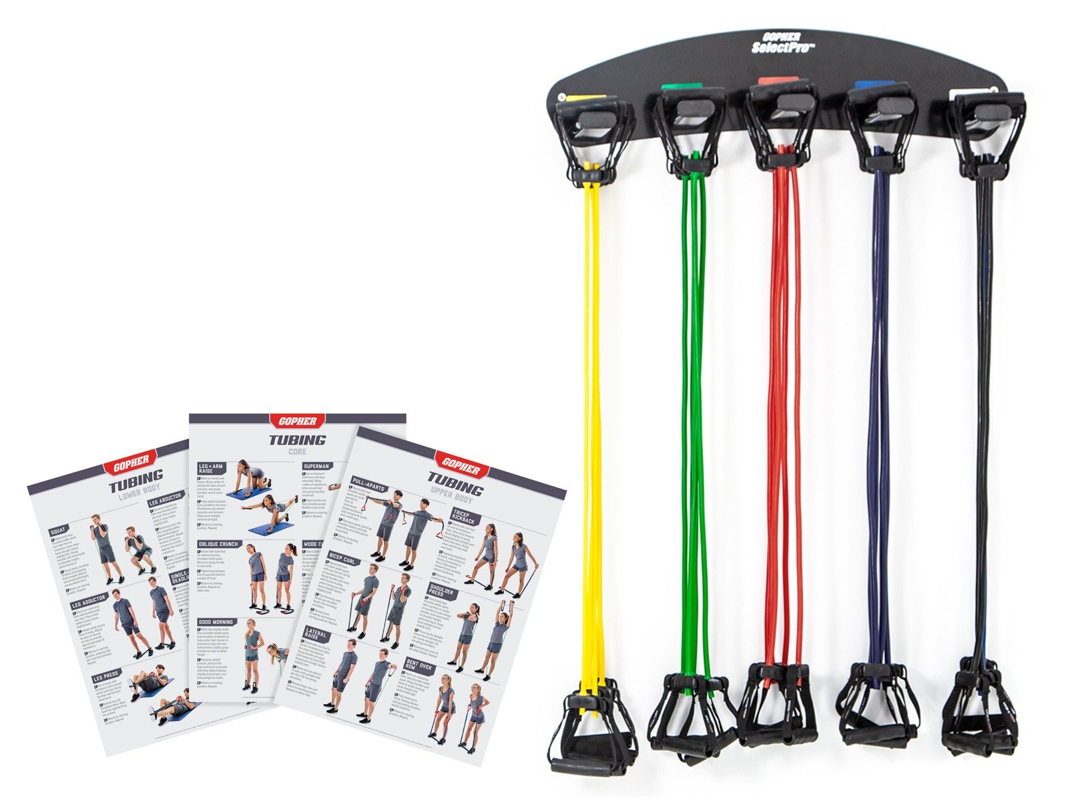
Biceps
Curls by being seated, placing one hand under opposite leg.
Simple version is to lift leg with no resistance.
Make curl more demanding by exerting downward pressure with the leg.
Empty plastic containers containing different amounts of water to change the amount of weight in each container or backpacks with some cans or books in them to change the weight.
Resistance Tubing
https://www.gophersport.com/fitness/resistance/prostretch-tube-plastic-handles?item=10440

Slide 48
Biceps Con’t—Resistance Tubing https://www.canadago4sport.com/Warmups/Resistance-Tubing--Three-exercises

Slide 49
Ladder Activities
For about 50 different ways (use chalk to mark on pavement)
https://www.canadago4sport.com/agility-ladders

Slide 52
Web Resources
Canadago4sport:
600+ game docs and 250+ game videos
www.canadago4sport.com
Nearly 50 different ladder activities
https://www.canadago4sport.com/agility-ladders
Gopher Sport:
Order from over 12 different ladders
https://www.gophersport.com/fitness/saq?tag=agility
Order from hundreds of equipment ideas.
https://www.gophersport.com/
Unconditional 100% satisfaction guarantee
Your satisfaction is our #1 concern! If you are not satisfied with any product you buy from us, we'll simply replace it or refund your money. No questions. No hassles. No exclusions. No kidding!

Slide 53
Pinterest and YouTube
Pinterest:
23 boards, and 600+ pins
Follow at https://www.pinterest.ca/canadago4sport/
YouTube:
330+ videos
Subscribe at https://www.youtube.com/c/canadago4sport/

Slide 54
Social Media and Further Questions
Twitter & Instagram:
Tuesday (sometimes other days) posts
Follow at @canadago4sport
Love to hear from you:
JOHNBYL50@gmail.com

Slide 55
With thanks
To all of the wonderful people
who inspire each other
at conferences and other places!
To Gopher Sport
for their innovative products
and high quality equipment!

Slide 56
Download slides at:
https://www.canadago4sport.com/conferences-and-workshops

