Slide 1
Innovative Agility Ladder Fitness Challenges With Feet and Hands
Dr. John Byl
JOHNBYL50@gmail.com
While we wait, sign up for weekly activity postings on:
Twitter or Instagram
@canadago4sport

Slide 2
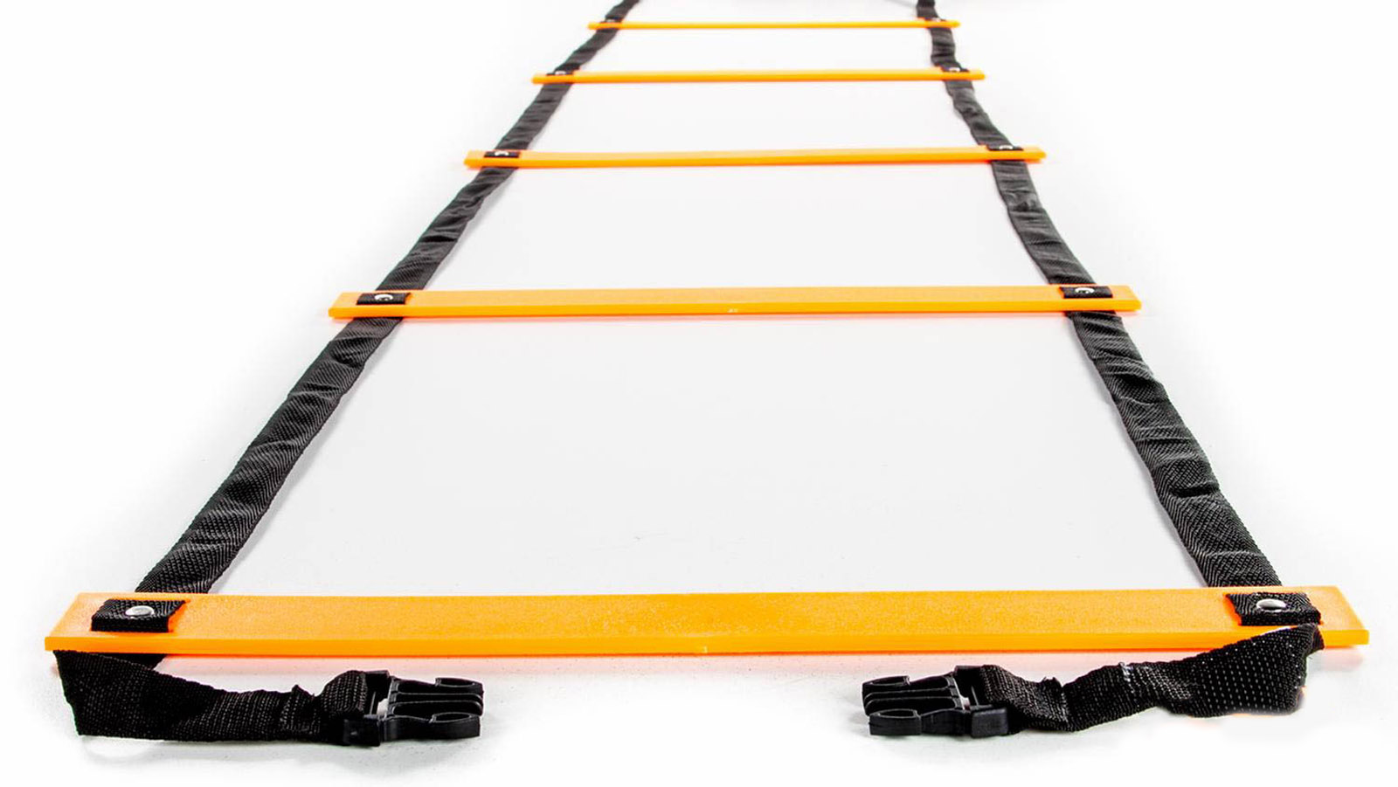
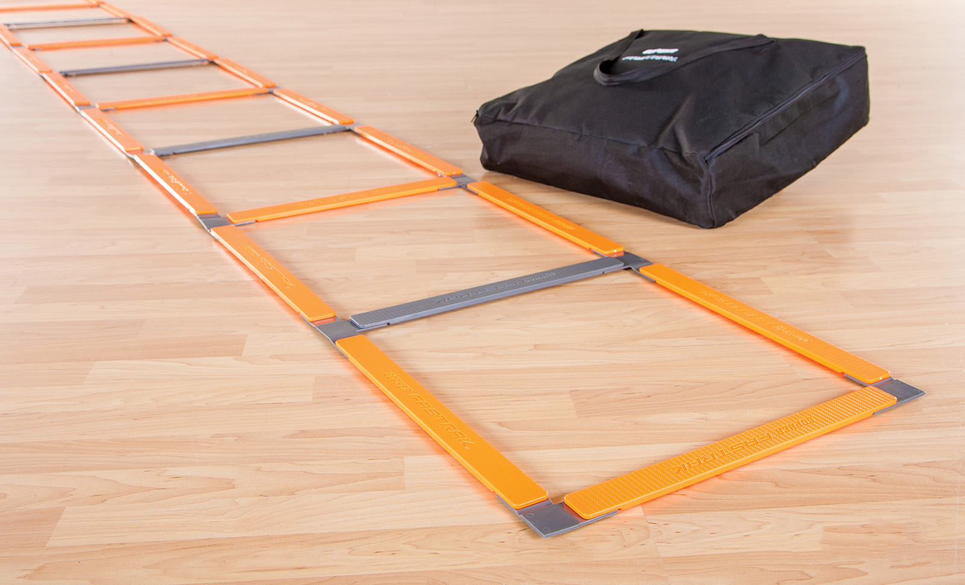
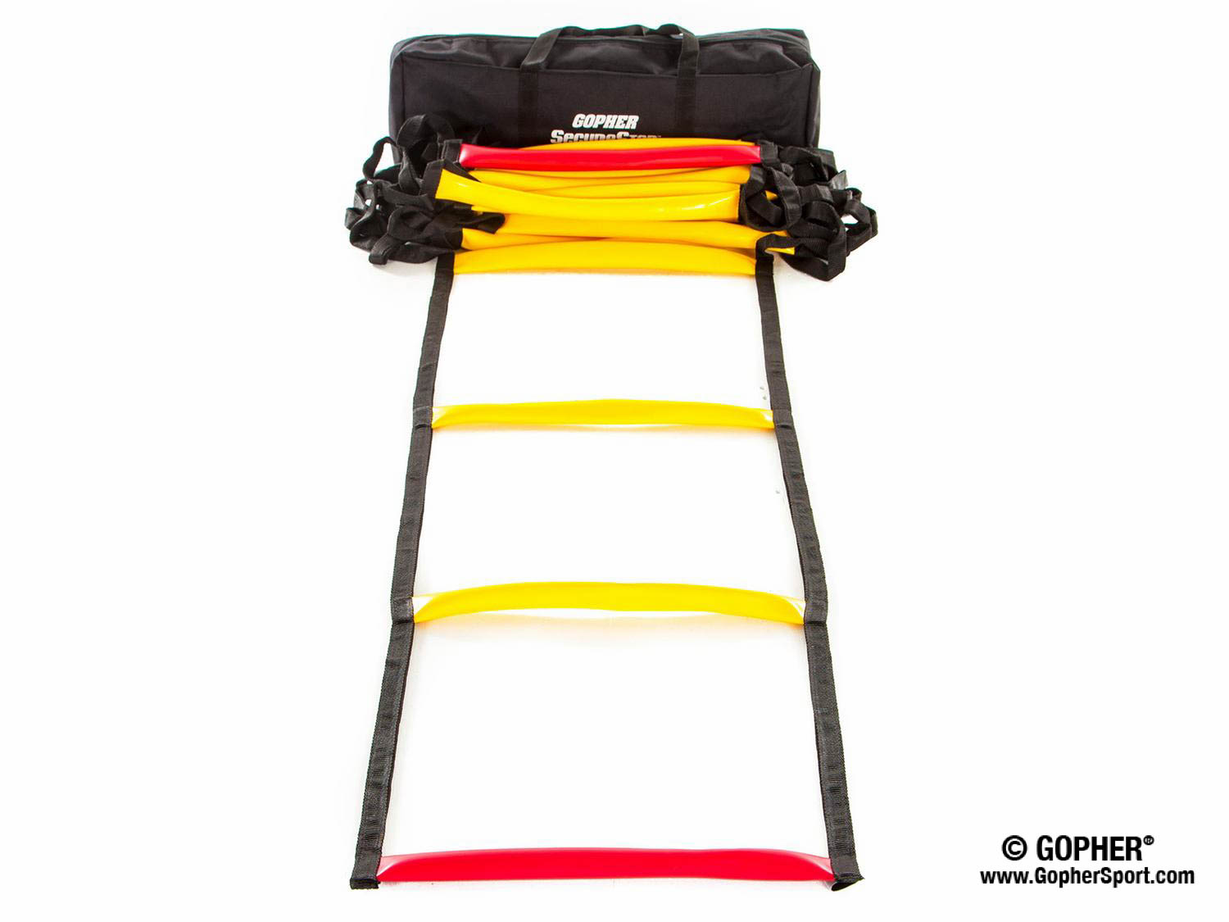
Ladders Used 1 (Click on Pics to go to Website)
Screamin Orange Agility Ladder
Inexpensive
Great for beginners
Fast Trak Agility Ladder
Safe flat design
Never gets tangled
SecureStep Agility Ladder
Ruberized treads will not slip on floor
Extremely durable

Slide 3
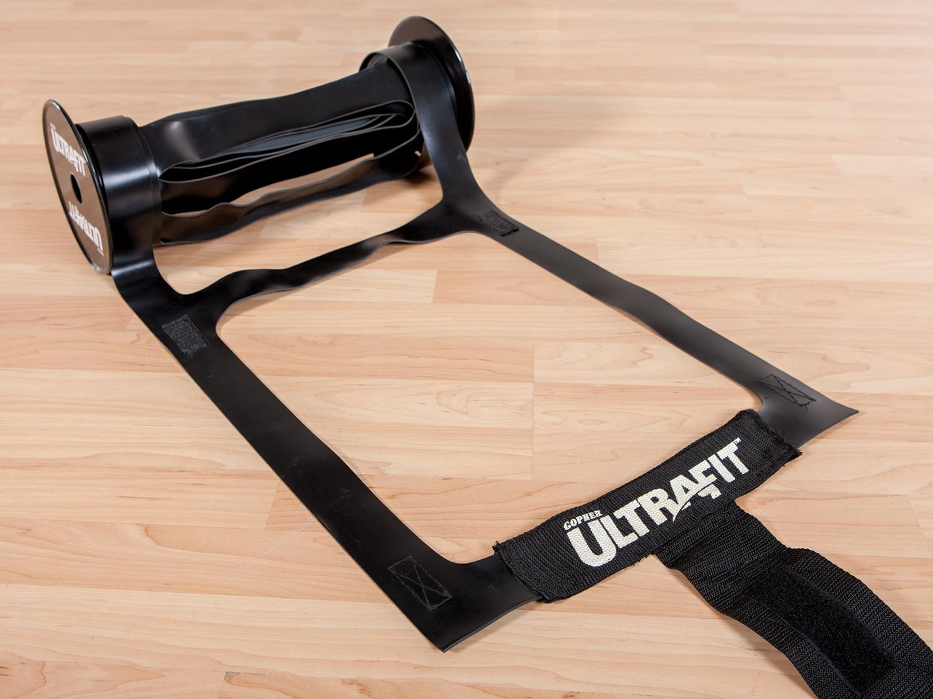
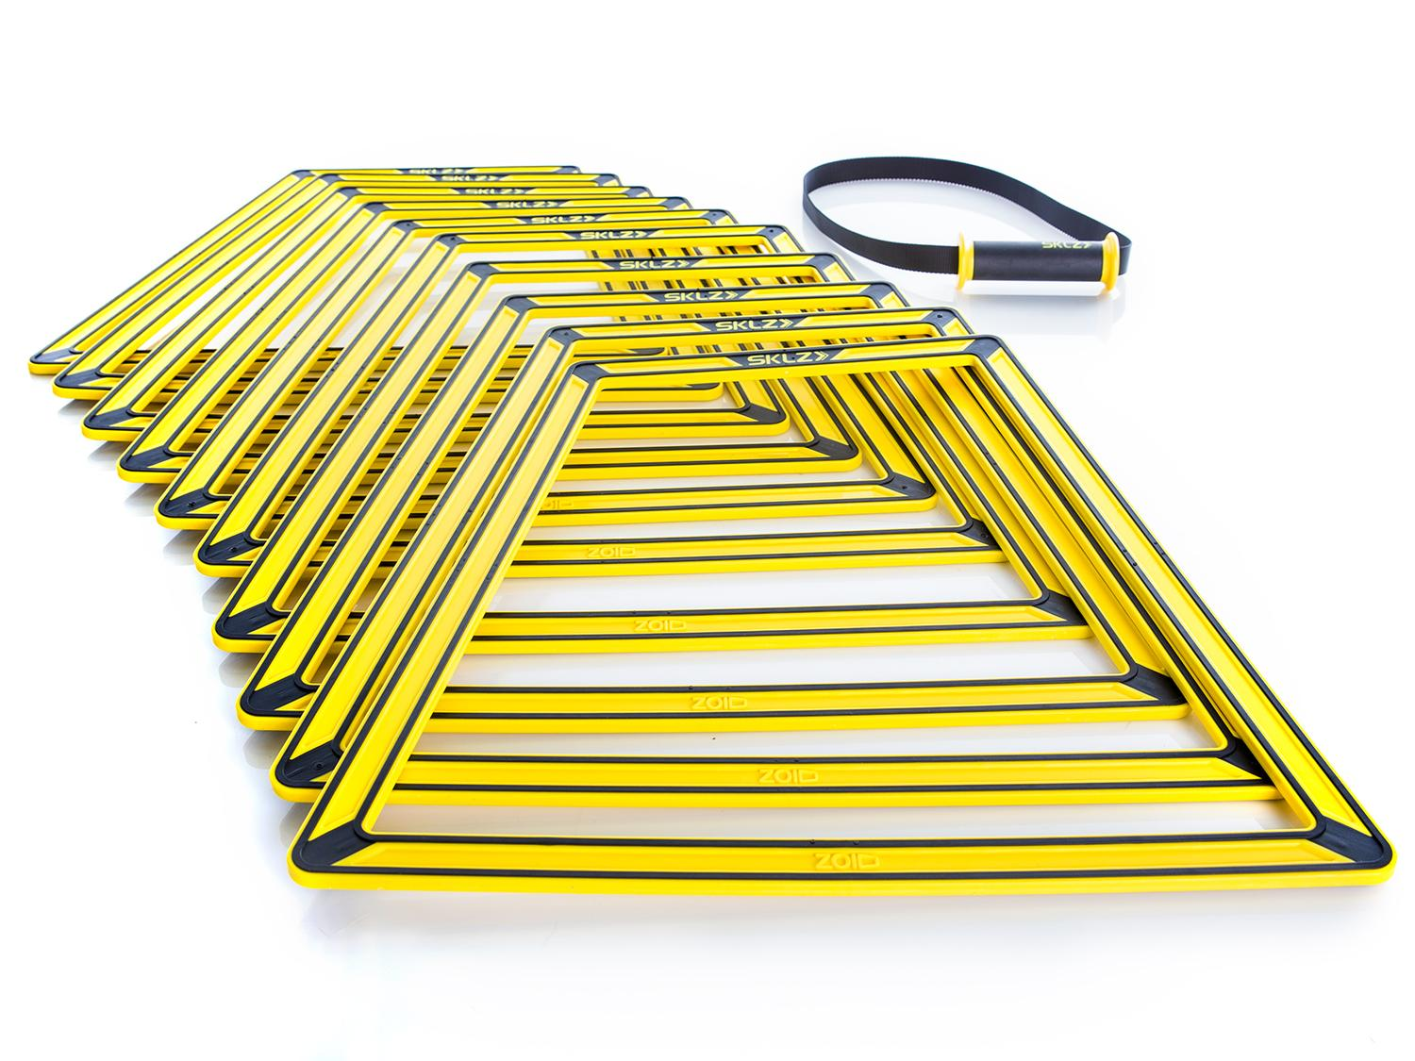
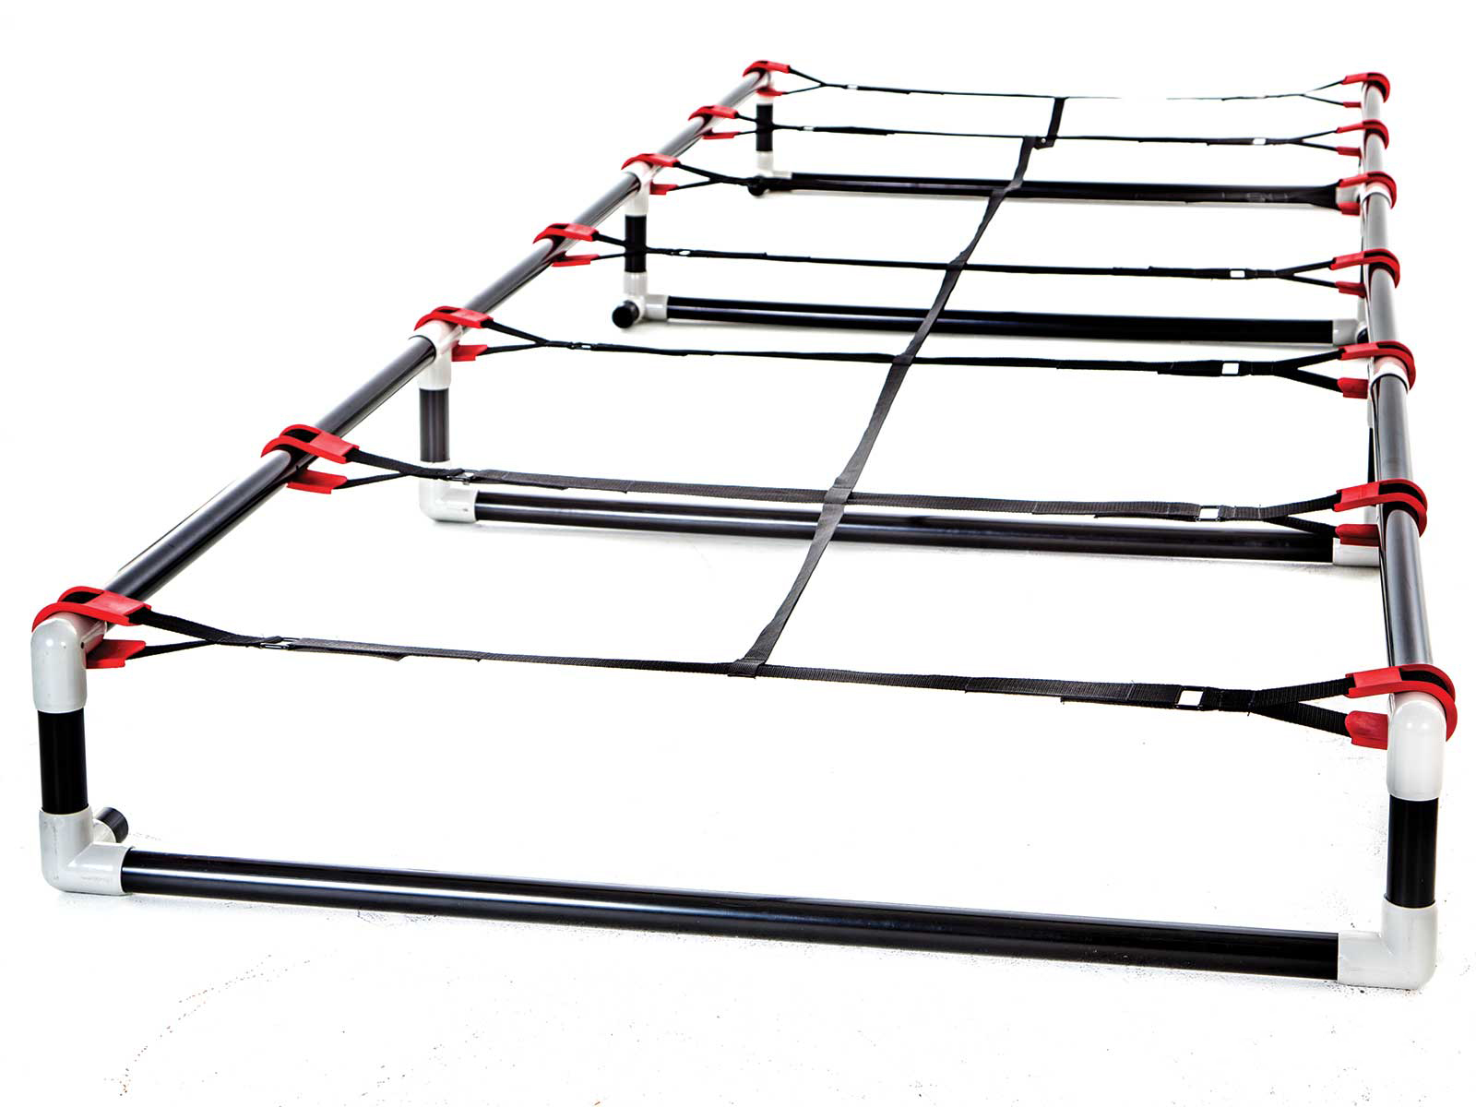
Ladders Used 2 (Click on Pics to go to Website)
Ultra Fit Roll Out Ladder
Adheres to floor well
Easy to roll out and store
Sklz Agility Trainer Pro
Easily create different ladder patterns
Can also add a hurdle in the middle of the ladder
High Rise Agility Ladder
More challenging with 6`` or 9`` rise
Very durable

Slide 4
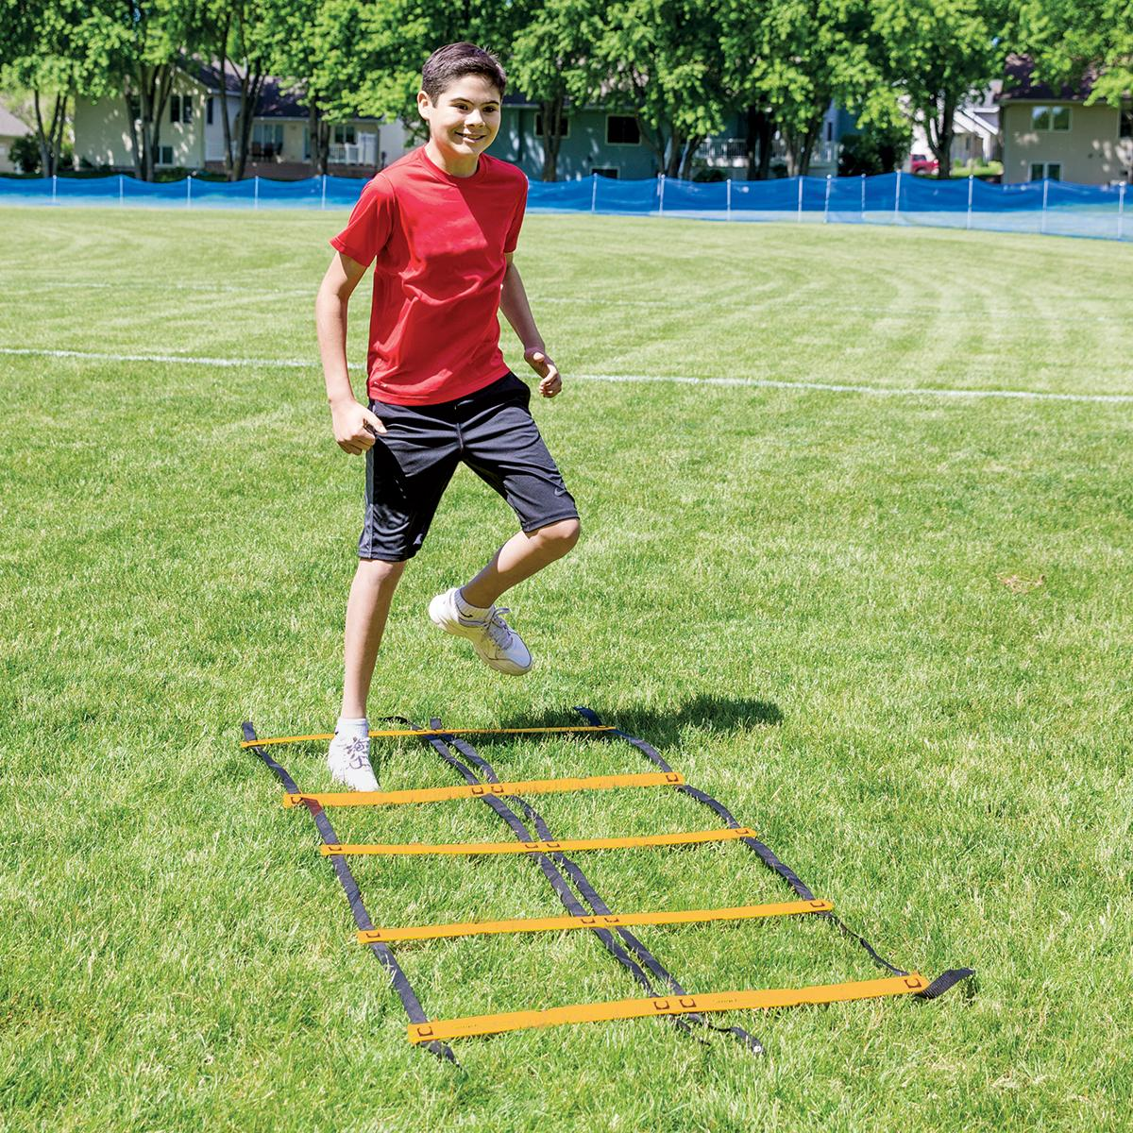
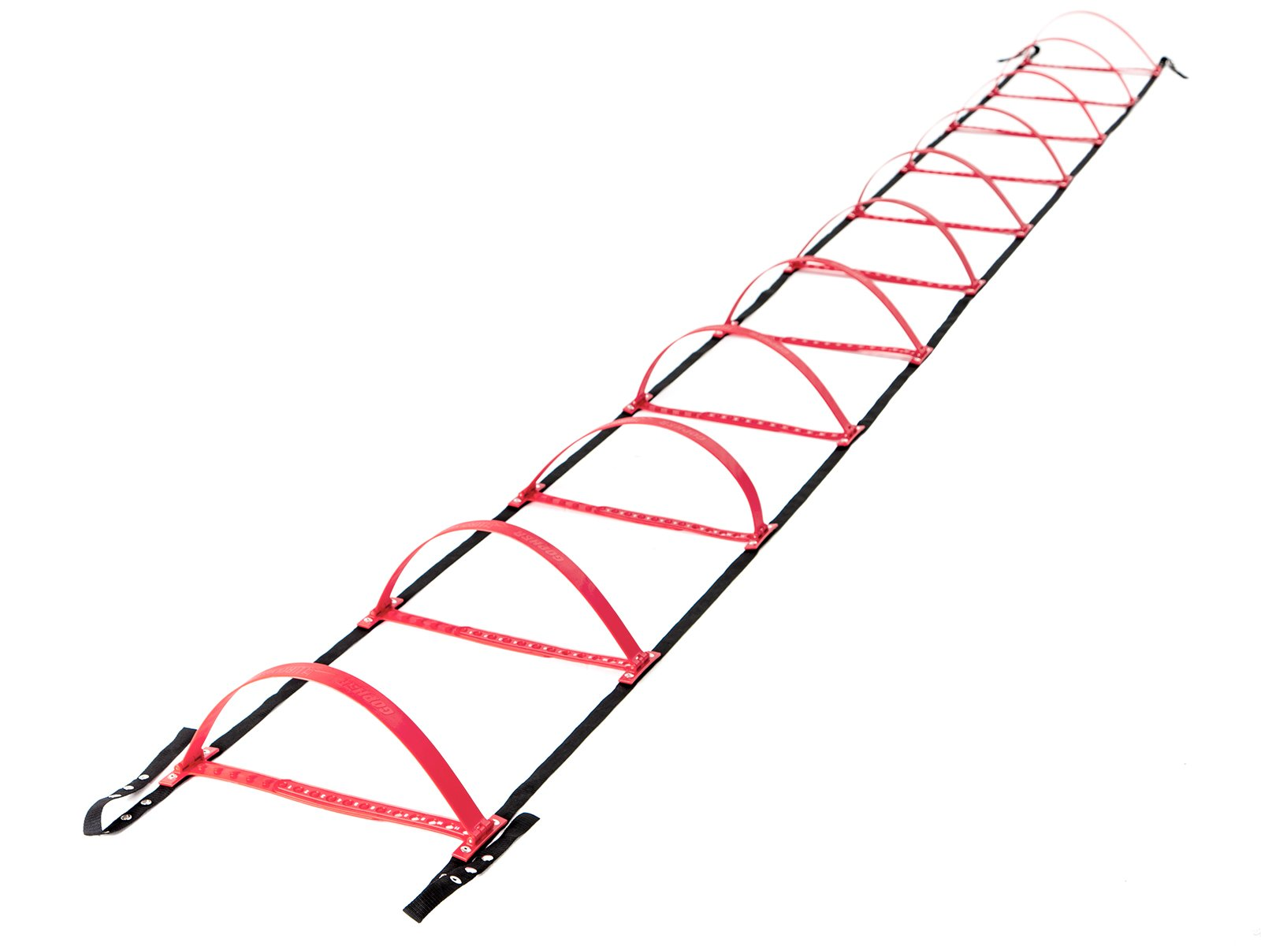
Ladders Used 3 (Click on Pics to go to Website)
Smart Modular Agility Ladder
Easily create side-by-side ladders
Gopher HurdLadder Agility Ladder
Easily adjusts to various heights

Slide 5
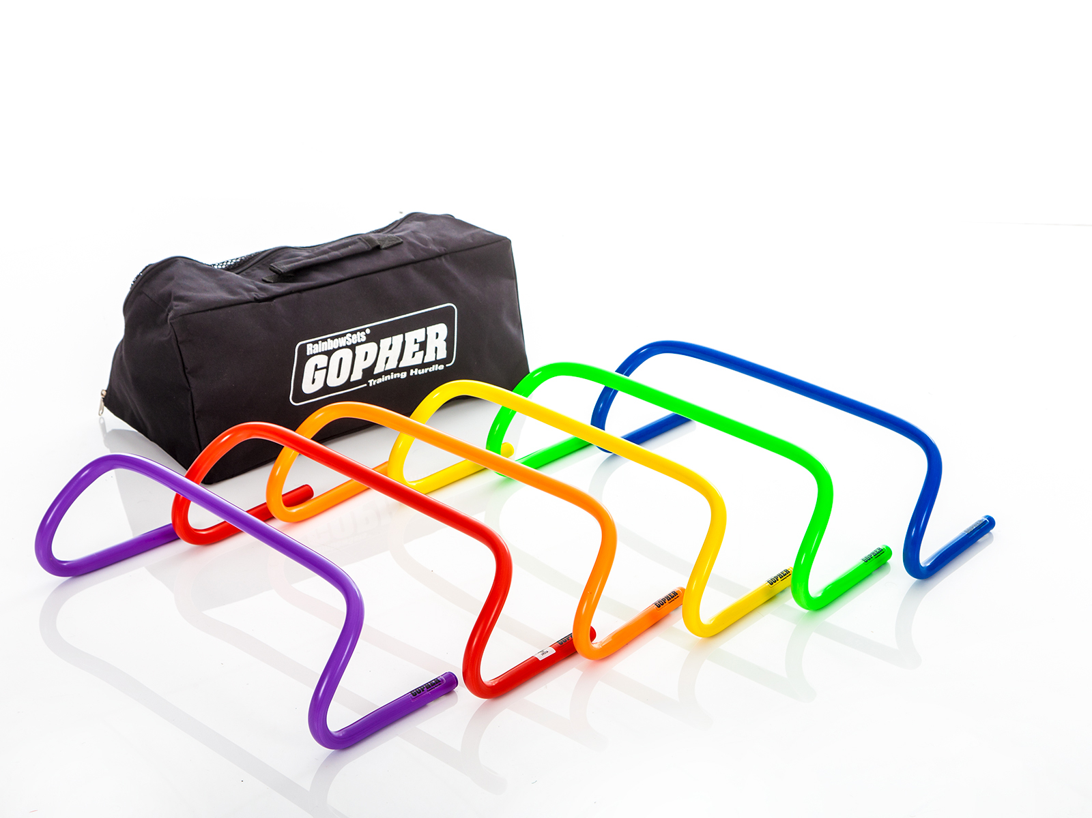
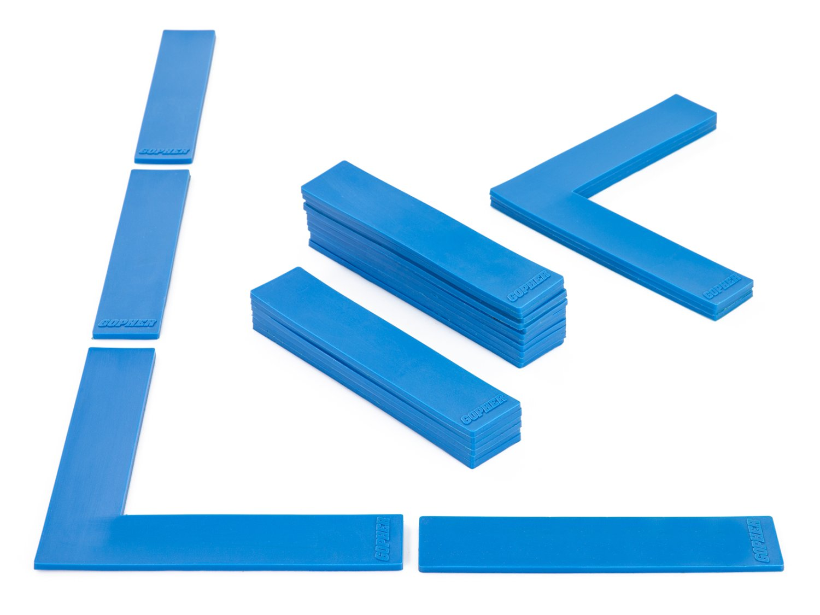
Ladders Used 4 (Click on Pics to go to Website)
Ultrafit Training Hurdles
Come in 4 different heights 6`` to 16``
Boundary Markers
Secure on the floor
Moving one tread will not impact other treads

Slide 6
Definitions
Running
Quicker than a walk so that both feet are not on the ground at the same time.
Jumping
Pushing oneself off a surface with both feet.
Hoping
Pushing oneself off a surface balanced from one foot.

Slide 7
Hands and Feet Ladder Activities
Though ladders are traditionally used to fun, jump, and hop through, getting on hands and feet offers additional upper-body and core strength building options.

Slide 8
In In Out Out In In with Hands and Feet https://www.canadago4sport.com/Ladders/Ladder-In-In-Out-Out-With-Hands-and-Feet

Slide 9
In In Out Out With Hands https://www.canadago4sport.com/Ladders/Ladder-In-In-Out-Out-With-Hands

Slide 10
Every Rung Sideways With High Fives https://www.canadago4sport.com/Ladders/Ladder-Every-Rung-Sideways-With-Hands-and-High-Fives

Slide 11
Sideways Up Up Back Up Up With Feet https://www.canadago4sport.com/Ladders/Ladder-Sideways-Fwd-Fwd-Back-Fwd-Fwd-Back-With-Feet

Slide 12
Every Rung Sideways With Hands https://www.canadago4sport.com/Ladders/Ladder-Sideways-Each-Rung-With-Hands

Slide 13
Mountain Climb Push Ups https://www.canadago4sport.com/Ladders/Ladder-Mountain-Climb-Push-Ups

Slide 14
Ladder Push Ups https://www.canadago4sport.com/Ladders/Push-Ups

Slide 15
Sideways with Explosive 3-Point Pushups https://www.canadago4sport.com/Ladders/Ladder-Sideways-Each-Rung-With-Explosive-Three-point-Pushups

Slide 16
Web Resources
Canadago4sport:
600+ game docs and 250+ game videos
www.canadago4sport.com
Nearly 50 different ladder activities
https://www.canadago4sport.com/agility-ladders
Gopher Sport:
Order from over 12 different ladders
https://www.gophersport.com/fitness/saq?tag=agility
Order from hundreds of equipment ideas.
https://www.gophersport.com/
Unconditional 100% satisfaction guarantee
Your satisfaction is our #1 concern! If you are not satisfied with any product you buy from us, we'll simply replace it or refund your money. No questions. No hassles. No exclusions. No kidding!

Slide 17
Pinterest and YouTube
Pinterest:
23 boards, and 600+ pins
Follow at https://www.pinterest.ca/canadago4sport/
YouTube:
330+ videos
Subscribe at https://www.youtube.com/c/canadago4sport/

Slide 18
Social Media and Further Questions
Twitter & Instagram:
Tuesday (sometimes other days) posts
Follow at @canadago4sport
Love to hear from you:
JOHNBYL50@gmail.com

Slide 19
With thanks
To all of the wonderful people
who inspire each other
at conferences and other places!
To Gopher Sport
for their innovative products
and high quality equipment!

Slide 20
Download slides at:
https://www.canadago4sport.com/conferences-and-workshops

