Slide 1
Innovative Agility Ladder Fitness Challenges With Feet Only
Dr. John Byl
JOHNBYL50@gmail.com
While we wait, sign up for Tuesday & Thursday activity postings on:
Twitter or Instagram
@canadago4sport

Slide 2
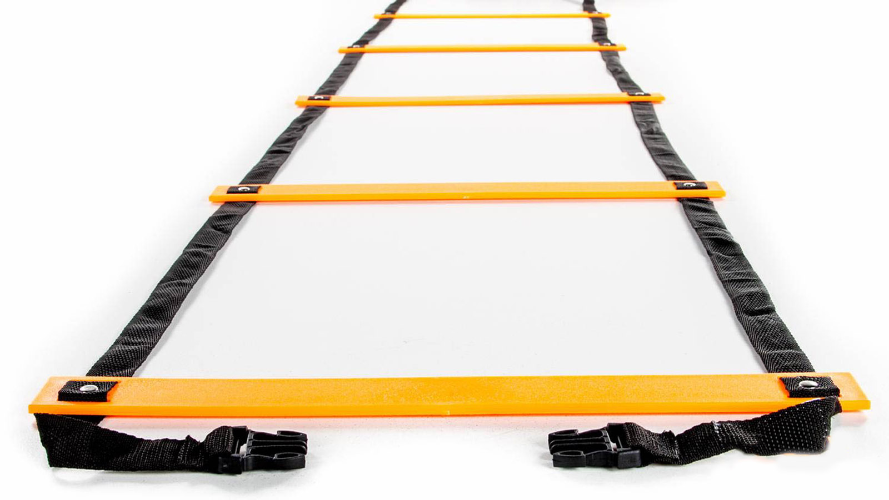
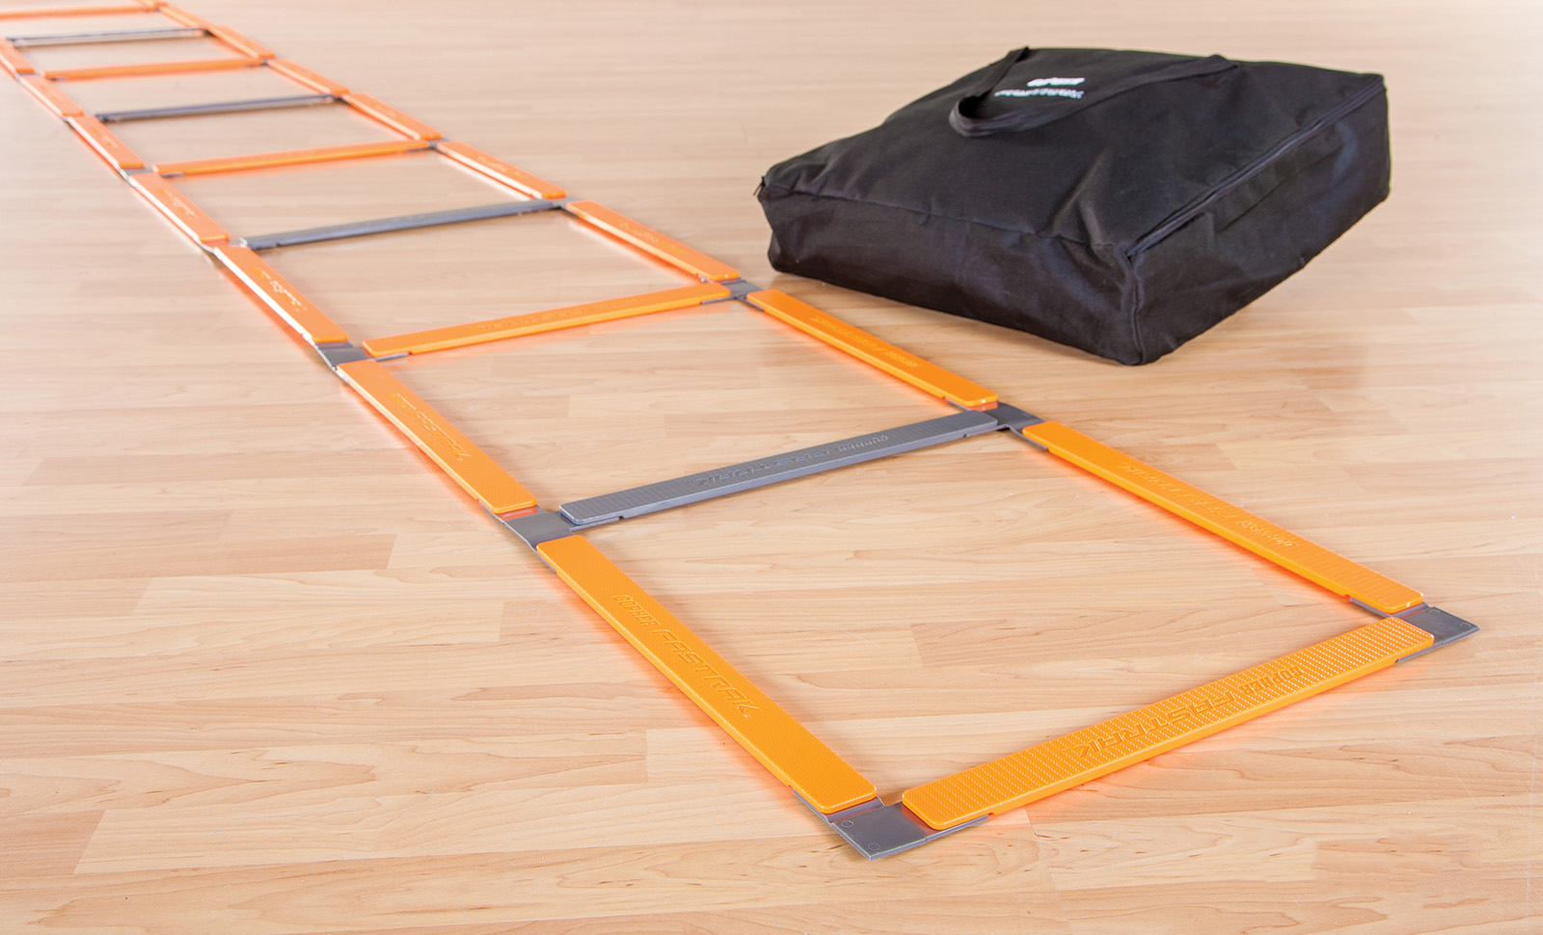
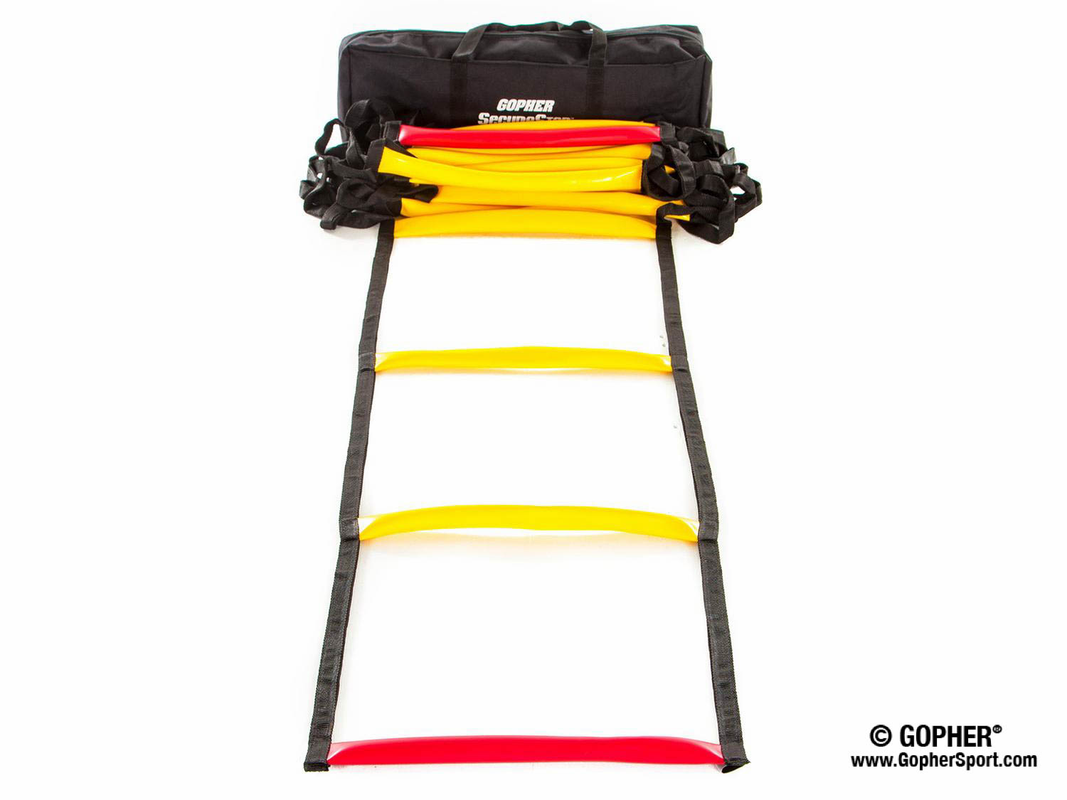
Ladders Used 1 (Click on Pics to go to Website)
Screamin Orange Agility Ladder
Inexpensive
Great for beginners
Fast Trak Agility Ladder
Safe flat design
Never gets tangled
SecureStep Agility Ladder
Ruberized treads will not slip on floor
Extremely durable

Slide 3
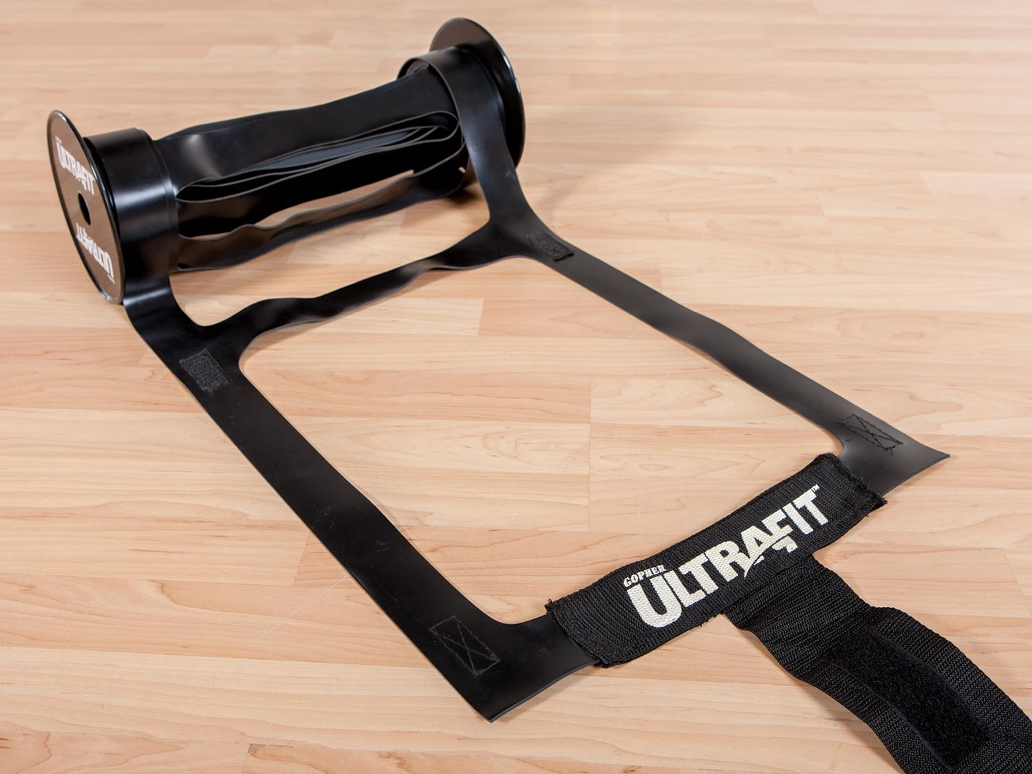
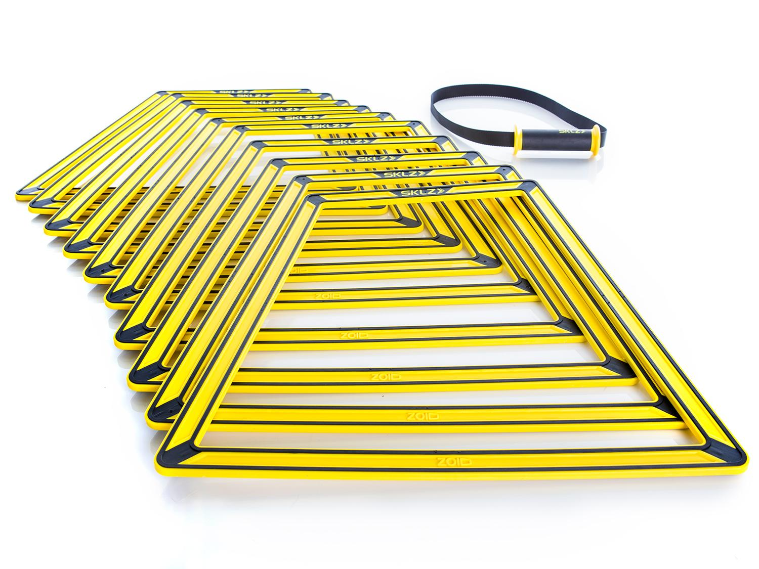
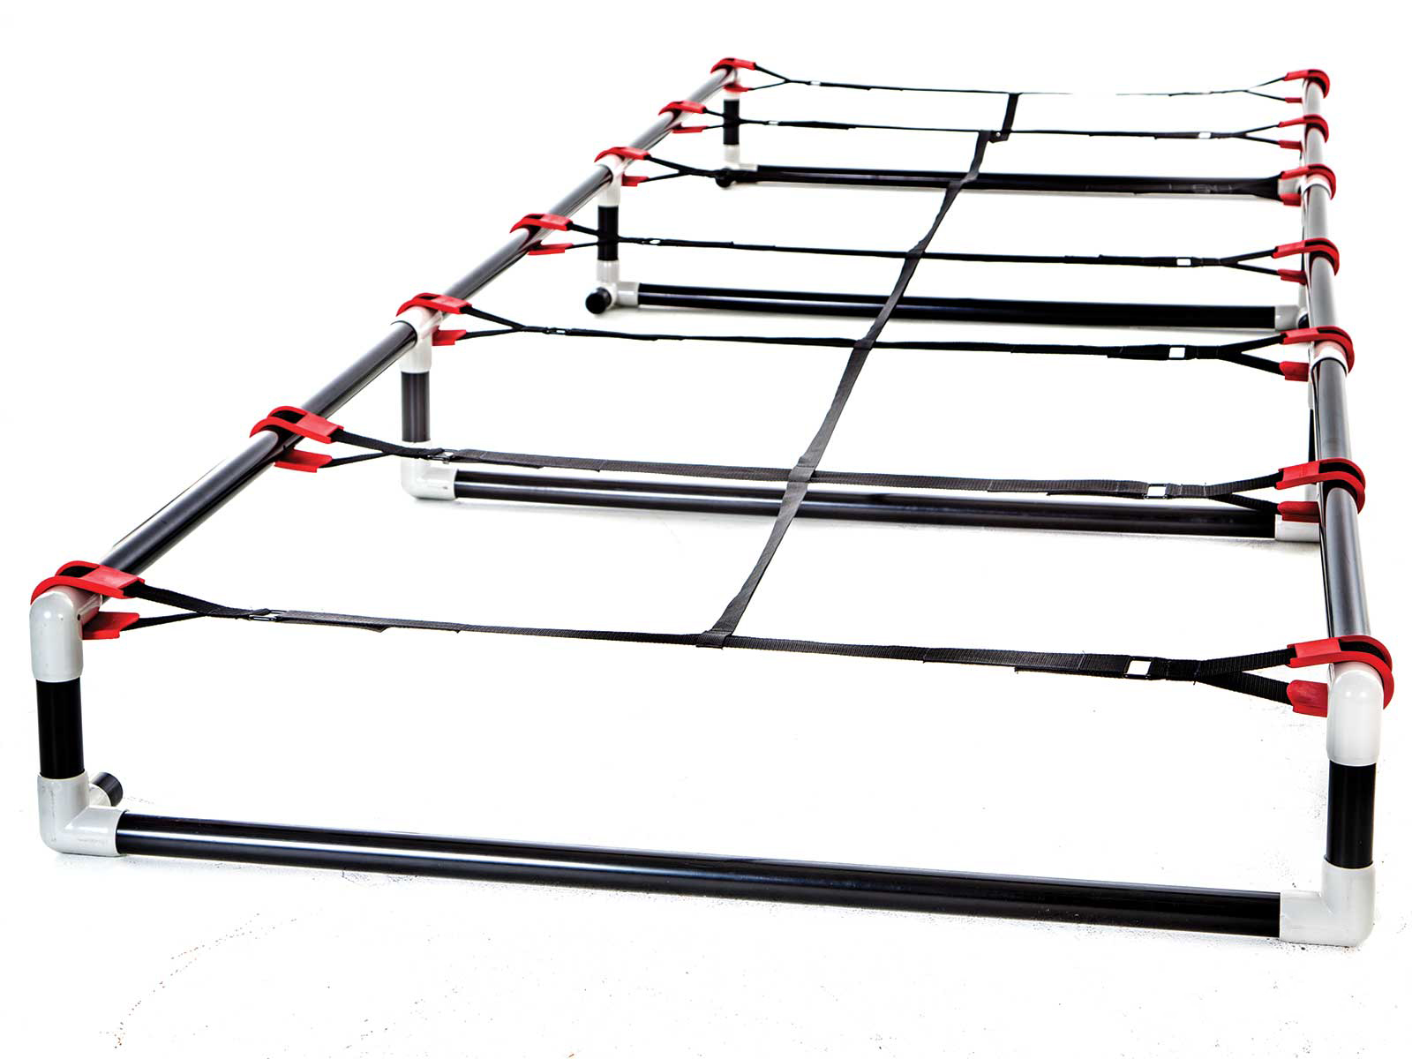
Ladders Used 2 (Click on Pics to go to Website)
Ultra Fit Roll Out Ladder
Adheres to floor well
Easy to roll out and store
Sklz Agility Trainer Pro
Easily create different ladder patterns
Can also add a hurdle in the middle of the ladder
High Rise Agility Ladder
More challenging with 6`` or 9`` rise
Very durable

Slide 4
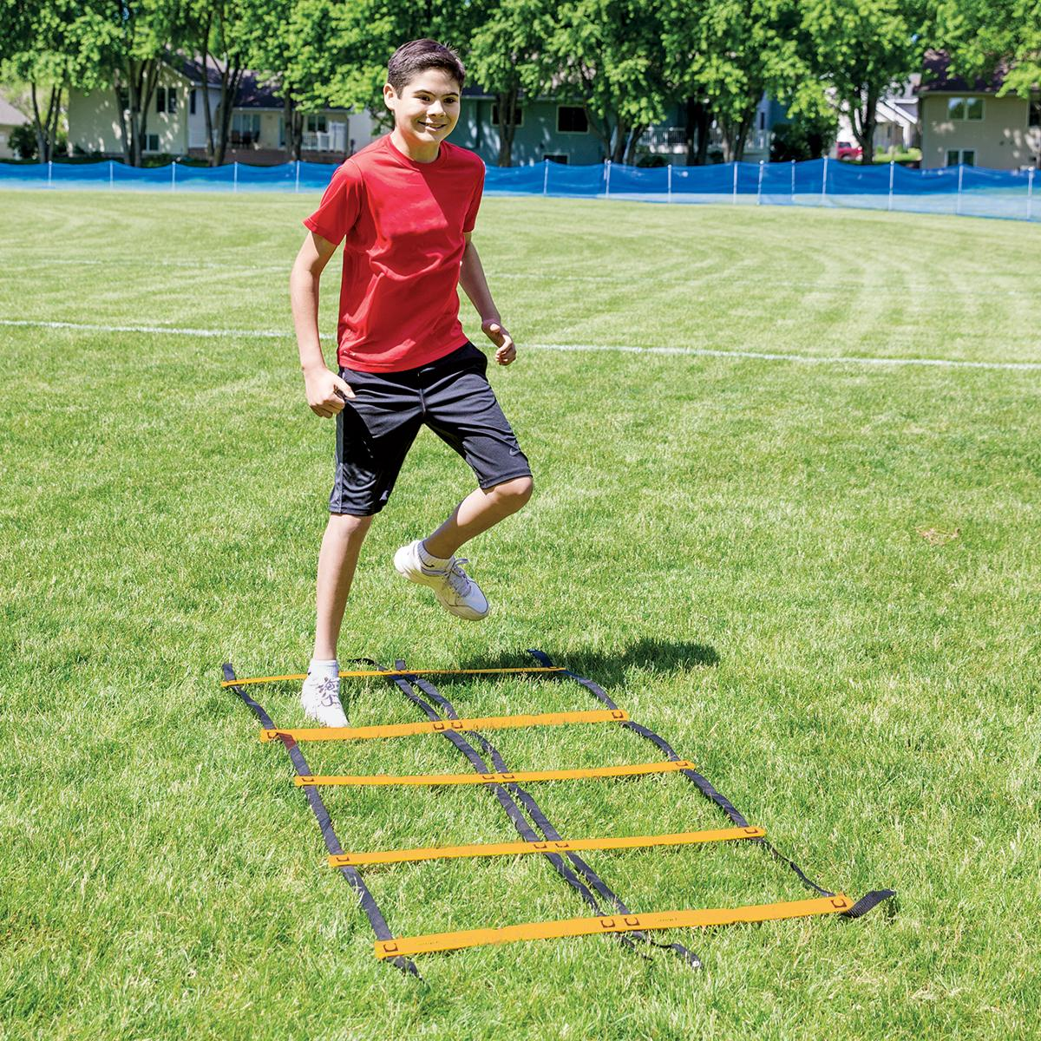
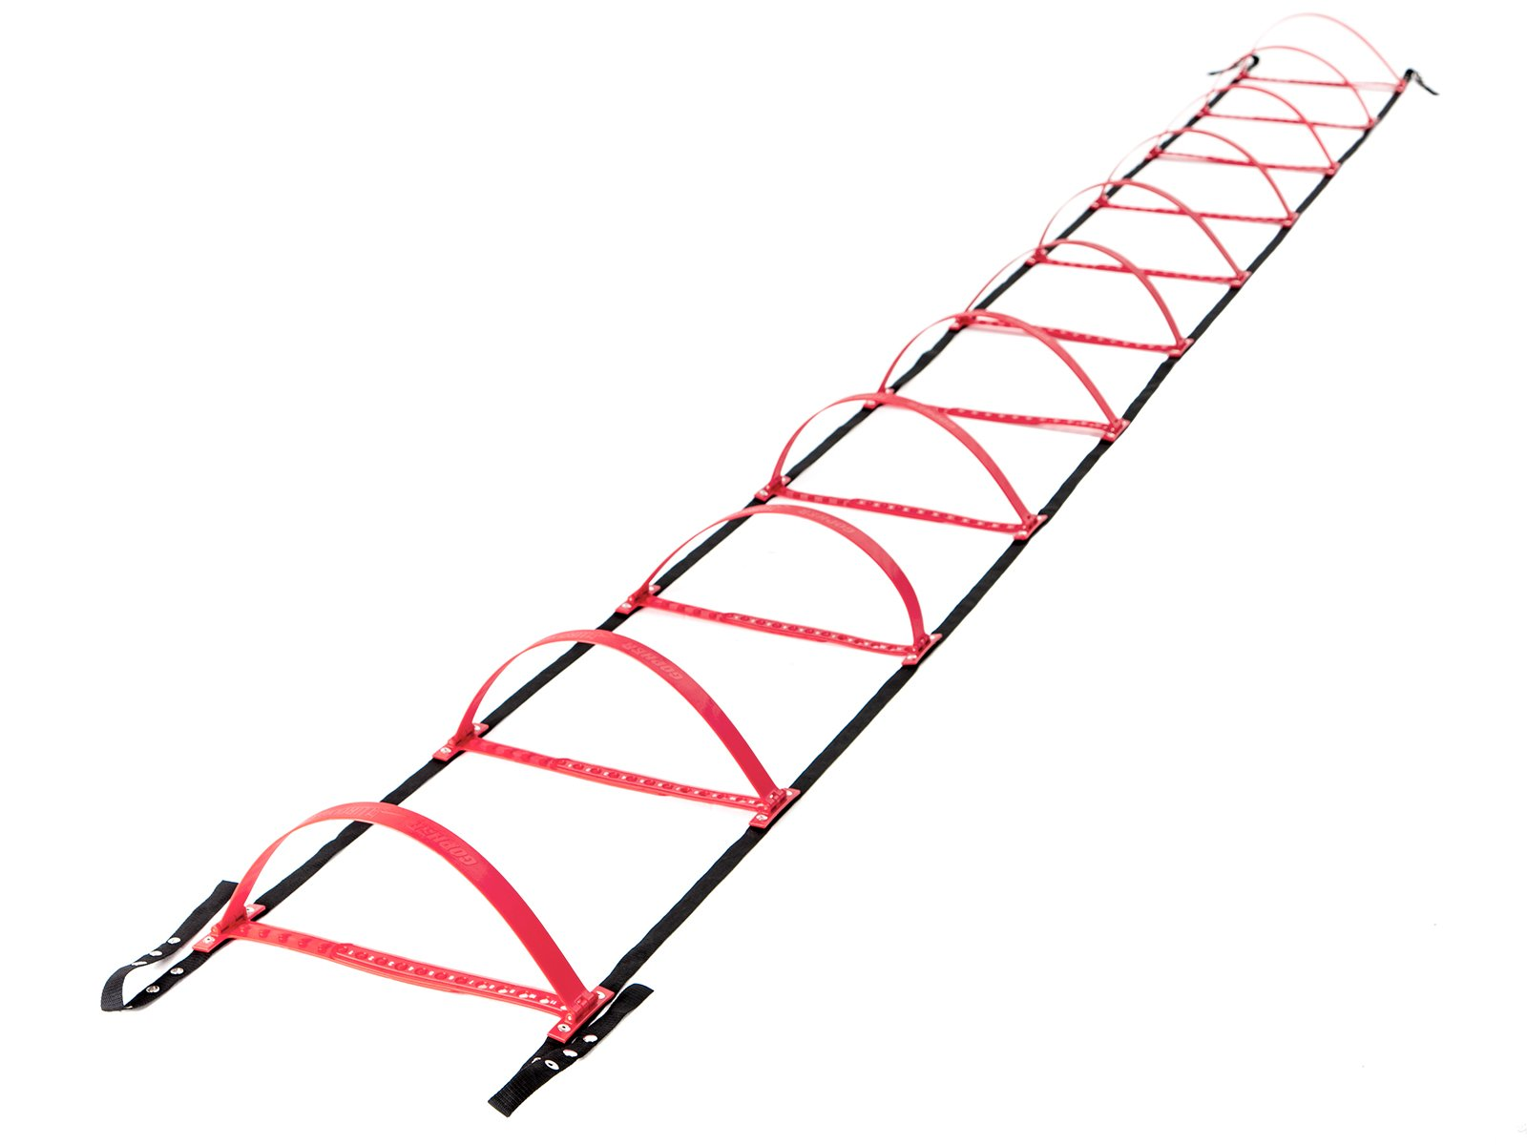
Ladders Used 3 (Click on Pics to go to Website)
Smart Modular Agility Ladder
Easily create side-by-side ladders
Gopher HurdLadder Agility Ladder
Easily adjusts to various heights

Slide 5
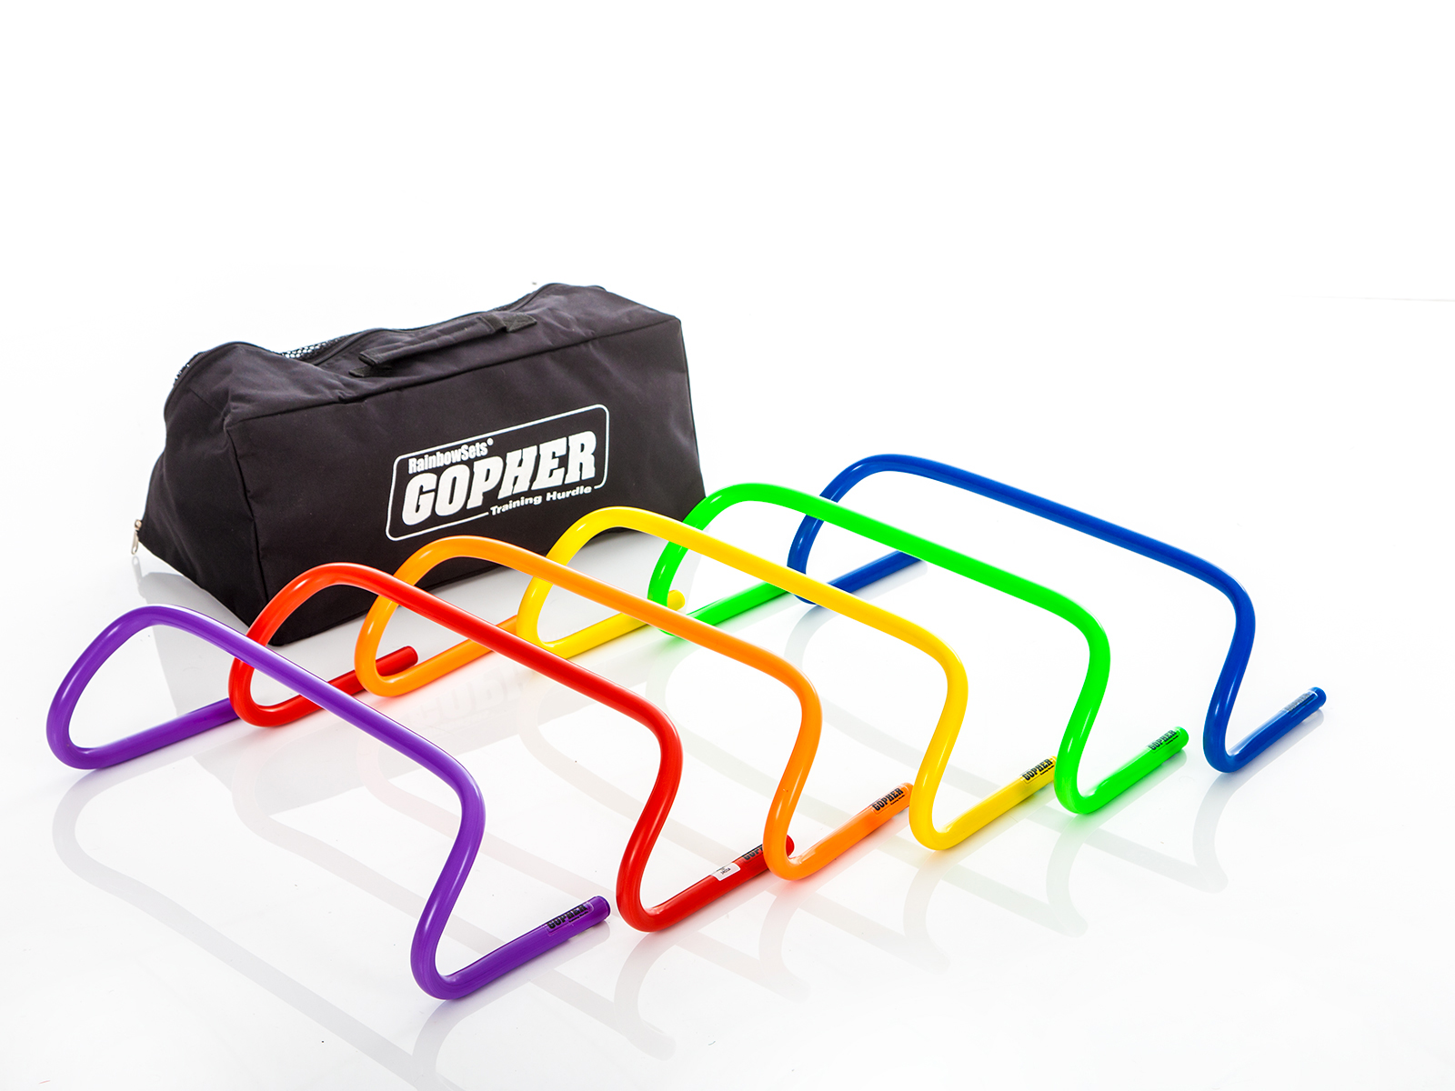
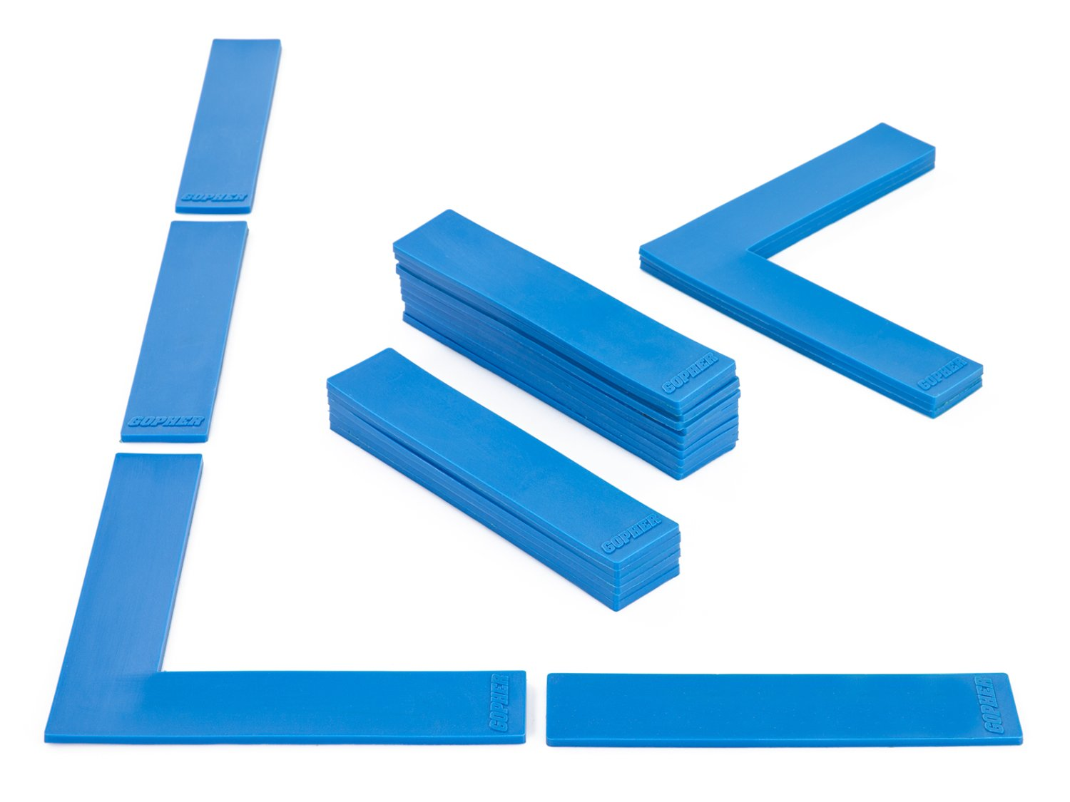
Ladders Used 4 (Click on Pics to go to Website)
Ultrafit Training Hurdles
Come in 4 different heights 6`` to 16``
Boundary Markers
Secure on the floor
Moving one tread will not impact other treads

Slide 6
Definitions
Running
Quicker than a walk so that both feet are not on the ground at the same time.
Jumping
Pushing oneself off a surface with both feet.
Hoping
Pushing oneself off a surface balanced from one foot.

Slide 7
On Your Feet Ladder Activities
Each of these activities has participants running, jumping, and hoping through the various ladders.
For almost all ladder activities in this slideshow leaders and participants can also use chalk to outline the ladders.

Slide 8
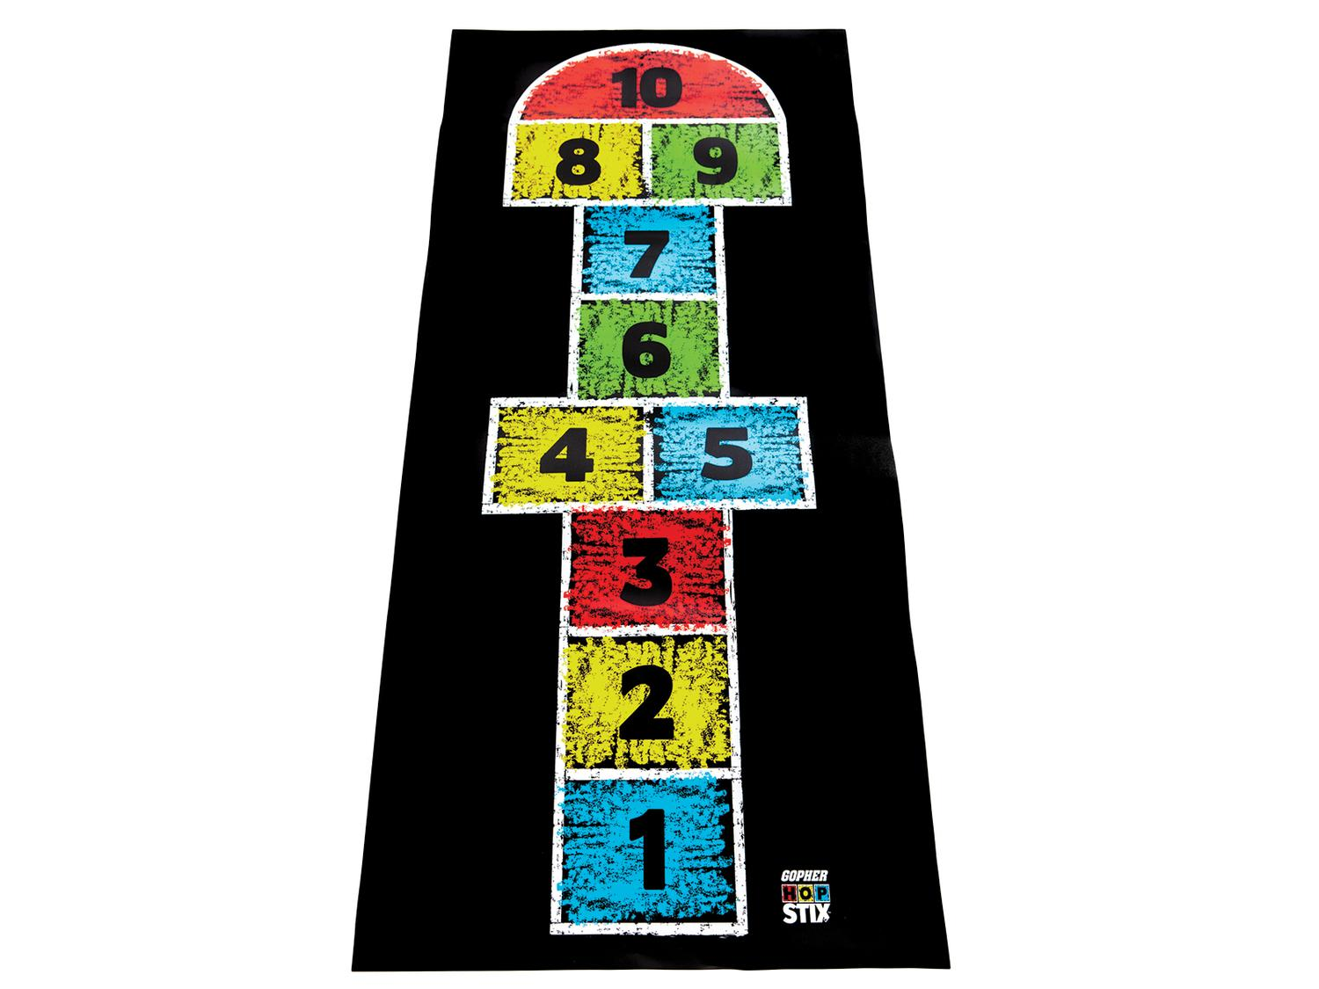
Hop Scotch Need to add still
Need video still

Slide 9
Every Other Rung Run https://www.canadago4sport.com/Ladders/Every-Other-Rung-Run

Slide 10
Every Rung Run https://www.canadago4sport.com/Ladders/Every-Rung-Run

Slide 11
High Knee Every Other Rung (Go Left/Right or Left/Right days) https://www.canadago4sport.com/Ladders/High-knee%E2%80%94Every-Other-Rung

Slide 12
Tap In https://www.canadago4sport.com/Ladders/Tap-In

Slide 13
Three Jumps and Three Runs… https://www.canadago4sport.com/Ladders/Three-Jumps-and-Three-Runs

Slide 14
Jump Every Rung https://www.canadago4sport.com/Ladders/Two-Foot-Jump%E2%80%94Every-Rung

Slide 15
High Vertical Jumps https://www.canadago4sport.com/Ladders/High-Vertical-Jumps

Slide 16
Jump Forward In and Hop Out https://www.canadago4sport.com/Ladders/Jump-Forward-and-In%2C-Hop-Out

Slide 17
Jump In In Straddle Out https://www.canadago4sport.com/Ladders/Ladder-Jump-In-In-Out-In-In

Slide 18
In and Out Jumps https://www.canadago4sport.com/Ladders/In-Then-Out-Jumps

Slide 19
180s https://www.canadago4sport.com/Ladders/180s

Slide 20
Hops https://www.canadago4sport.com/Ladders/Hops-

Slide 21
Hop In and Out https://www.canadago4sport.com/Ladders/Hop-In-Out

Slide 22
Every Rung Sideways Run https://www.canadago4sport.com/Ladders/Every-Rung-Sideways-Run

Slide 23
Sideways Crossover Run https://www.canadago4sport.com/Ladders/Every-Rung-Sideways-Crossover-Run

Slide 24
In and Out Sideways Run https://www.canadago4sport.com/Ladders/Alternate-In-and-Out-Sideways-Run

Slide 25
In In Out Out Each Rung https://www.canadago4sport.com/Ladders/In-and-Out-Every-Rung

Slide 26
In In Out Out Through Each Rung https://www.canadago4sport.com/Ladders/In-and-Out-Run

Slide 27
Jump In In Out https://www.canadago4sport.com/Ladders/In-In-Out

Slide 28
In In Out Jumps

Slide 29
In with High Ten and Out https://www.canadago4sport.com/Ladders/In-Outs

Slide 30
Downhill Skiing https://www.canadago4sport.com/Ladders/Downhill-Skiing

Slide 31
Slalom Skiing https://www.canadago4sport.com/Ladders/Slalom-Skiing

Slide 32
Boxing Shuffle https://www.canadago4sport.com/Ladders/Boxing-Shuffle

Slide 33
Hands and Feet Ladder Activities
Though ladders are traditionally used to fun, jump, and hop through, getting on hands and feet offers additional upper-body and core strength building options.

Slide 34
In In Out Out In In with Hands and Feet https://www.canadago4sport.com/Ladders/Ladder-In-In-Out-Out-With-Hands-and-Feet

Slide 35
In In Out Out With Hands https://www.canadago4sport.com/Ladders/Ladder-In-In-Out-Out-With-Hands

Slide 36
Every Rung Sideways With High Fives https://www.canadago4sport.com/Ladders/Ladder-Every-Rung-Sideways-With-Hands-and-High-Fives

Slide 37
Sideways Up Up Back Up Up With Feet https://www.canadago4sport.com/Ladders/Ladder-Sideways-Fwd-Fwd-Back-Fwd-Fwd-Back-With-Feet

Slide 38
Every Rung Sideways With Hands https://www.canadago4sport.com/Ladders/Ladder-Sideways-Each-Rung-With-Hands

Slide 39
Mountain Climb Push Ups https://www.canadago4sport.com/Ladders/Ladder-Mountain-Climb-Push-Ups

Slide 40
Ladder Push Ups https://www.canadago4sport.com/Ladders/Push-Ups

Slide 41
Sideways with Explosive 3-Point Pushups https://www.canadago4sport.com/Ladders/Ladder-Sideways-Each-Rung-With-Explosive-Three-point-Pushups

Slide 42
Ladders With Additional Equipment

Slide 43
Squat 180 Squat 180 https://www.canadago4sport.com/Ladders/Squat-180

Slide 44
High Knee Carrying Weighted Ball https://www.canadago4sport.com/Ladders/High-Knee%3A-Every-Rung

Slide 45
Jump Every Other Rung with Weighted Ball https://www.canadago4sport.com/Ladders/Two-Foot-Jump%E2%80%94Every-Other-Rung

Slide 46
Explosive Jumps with Weighted Ball https://www.canadago4sport.com/Ladders/Explosive-jumps

Slide 47
In Slam Ball Out https://www.canadago4sport.com/Ladders/Ladder-In-Slamball-Out

Slide 48
Ladder Ball Bounce Each Rung https://www.canadago4sport.com/Ladders/Ladder-Ball-Bounce-Each-Rung

Slide 49
Crossover Sideways Run With Ball https://www.canadago4sport.com/Ladders/Every-Other-Rung-Sideways-Run

Slide 50
In In Out Out With Ball Toss https://www.canadago4sport.com/Ladders/Ladder-In-and-Out-Run-While-Throwing-a-Ball

Slide 51
Jump Every Rung While Bouncing a Ball https://www.canadago4sport.com/Ladders/Jump-Every-Rung-While-Bouncing-Ball

Slide 52
Human Ladder Jump with Push Ups https://www.canadago4sport.com/Ladders/Human-Ladder-Jump-With-Push-Ups

Slide 53
In In Out Out While Dribbling Ball with Racquet https://www.canadago4sport.com/Ladders/Ladder-In-In-Out-Out-While-Dribbling-Ball-With-Racquet

Slide 54
In Out Racquet Rally https://www.canadago4sport.com/Ladders/Ladder-In-In-Out-Out-Racquet-Rally

Slide 55
Lunges with Badminton https://www.canadago4sport.com/Ladders/Lunges-with-badminton-bird

Slide 56
Ladder Games
A pair of games using two different types of ladders.
More ideas

Slide 57
Rock Paper Scissors Ladder Football Need to add to website still

Slide 58
Snowflake https://www.canadago4sport.com/Locomotor/Snowflake

Slide 59
Innovative Bosu Ball Challenges
Dr. John Byl
JOHNBYL50@gmail.com
While we wait, sign up for weekly Tuesday & Thursday+ activity postings on:
Twitter or Instagram
@canadago4sport

Slide 60
Activities Familiarizing with the Bosu Ball

Slide 61
Side Planks https://www.canadago4sport.com/bosu-ball-challenges-1/side-planks

Slide 62
Gluteus Bridge https://www.canadago4sport.com/bosu-ball-challenges-1/gluteus-bridge

Slide 63
Split Squats https://www.canadago4sport.com/bosu-ball-challenges-1/split-squats

Slide 64
Stand and Stork Stand https://www.canadago4sport.com/bosu-ball-challenges-1/stand-and-stork-stand

Slide 65
Step Up With High Knee https://www.canadago4sport.com/bosu-ball-challenges-1/step-up-with-high-knee

Slide 66
Jumps

Slide 67
Jump 180s https://www.canadago4sport.com/bosu-ball-challenges-1/jump-180s

Slide 68
Lateral Jumps https://www.canadago4sport.com/bosu-ball-challenges-1/lateral-jumps

Slide 69
Side Step https://www.canadago4sport.com/bosu-ball-challenges-1/side-step

Slide 70
Straight Up Jumps https://www.canadago4sport.com/bosu-ball-challenges-1/straight-up-jumps

Slide 71
Jumps https://www.canadago4sport.com/bosu-ball-challenges-1/jumps

Slide 72
Jumps 180 https://www.canadago4sport.com/bosu-ball-challenges-1/jump-180s

Slide 73
Push-Ups

Slide 74
Burpee to Balance to 180 https://www.canadago4sport.com/bosu-ball-challenges-1/burpee-to-bosu-ball-balance-and-180-degree-turn

Slide 75
Mountain Climbers https://www.canadago4sport.com/bosu-ball-challenges-1/mountain-climbers

Slide 76
Push Ups https://www.canadago4sport.com/bosu-ball-challenges-1/push-ups

Slide 77
Truck Driver Wheel Push Up https://www.canadago4sport.com/bosu-ball-challenges-1/truck-driver-wheel-push-ups

Slide 78
Squats and Resistance

Slide 79
Squats https://www.canadago4sport.com/bosu-ball-challenges-1/squats

Slide 80
Jump Squats with 90 Degree Turns https://www.canadago4sport.com/bosu-ball-challenges-1/jump-squats-with-90-degree-turns
No video yet

Slide 81
Dumbbell Swing https://www.canadago4sport.com/bosu-ball-challenges-1/dumbbell-swing-

Slide 82
Bench Press https://www.canadago4sport.com/bosu-ball-challenges-1/bench-press

Slide 83
Partner Resistance Band Pull https://www.canadago4sport.com/bosu-ball-challenges-1/partner-resistance-band-pulls

Slide 84
Medicine and Omnikin Balls

Slide 85
High Balls https://www.canadago4sport.com/bosu-ball-challenges-1/high-balls

Slide 86
Partner Back-to-Back Medicine Ball Toss https://www.canadago4sport.com/bosu-ball-challenges-1/partner-back-to-back-medicine-ball-pass-

Slide 87
Partner Medicine Ball Toss https://www.canadago4sport.com/bosu-ball-challenges-1/partner-medicine-ball-pass-

Slide 88
Ball Slam https://www.canadago4sport.com/bosu-ball-challenges-1/ball-slam-

Slide 89
V-Sit Omnikin Pass https://www.canadago4sport.com/bosu-ball-challenges-1/v-sit-pass

Slide 90
Partner Omnikin Two-Ball Pass https://www.canadago4sport.com/bosu-ball-challenges-1/partner-omnikin-two-ball-pass-

Slide 91
Omnikin Two-Ball Bounce https://www.canadago4sport.com/bosu-ball-challenges-1/omnikin-two-ball-bounce-

Slide 92
Rebounding Burpees https://www.canadago4sport.com/bosu-ball-challenges-1/rebounding-burbees

Slide 93
Game Oriented

Slide 94
Numbered Snag https://www.canadago4sport.com/bosu-ball-challenges-1/numbered-snag

Slide 95
Planked Hockey https://www.canadago4sport.com/bosu-ball-challenges-1/planked-hockey

Slide 96
Racquet Juggle https://www.canadago4sport.com/bosu-ball-challenges-1/racquet-juggle

Slide 97
Racquet Rally https://www.canadago4sport.com/bosu-ball-challenges-1/racquet-rally

Slide 98
Volleyball Setting https://www.canadago4sport.com/bosu-ball-challenges-1/volleyball-setting

Slide 99
Gopher Equipment
VINTAGE ANTIMICROBIAL MEDICINE BALLS - INDIVIDUAL, 4 LB C$32.00
CLASSPLUS BOSU BALANCE TRAINER PACKS - SET OF 10, BOSU NEXGEN C$1,749.00
OMNIKIN SIX BALLS - OMNIKIN SIX BALLS C$399.00
RAINBOW RELIAPADDLE PADDLE - RAINBOW SET C$50.00
GOPHER OVERSIZED FOAM TENNIS BALLS - GOPHER OVERSIZED FOAM TENNIS BALLS C$18.00
STANDARD INFLATOR - STANDARD INFLATORC$125.00

Slide 100
Web Resources
Canadago4sport:
700+ game docs and 300+ game videos
www.canadago4sport.com

Slide 101
Gopher Sport:
Order from hundreds of equipment ideas.
https://www.gophersport.com/
Unconditional 100% satisfaction guarantee
Your satisfaction is our #1 concern! If you are not satisfied with any product you buy from us, we'll simply replace it or refund your money. No questions. No hassles. No exclusions. No kidding!

Slide 102
Pinterest and YouTube
Pinterest:
23 boards, and 800+ pins
Follow at https://www.pinterest.ca/canadago4sport/
YouTube:
500+ videos
Subscribe at https://www.youtube.com/c/canadago4sport/

Slide 103
Social Media and Further Questions
Twitter & Instagram:
Tuesday and Thursdays (sometimes other days) posts
Follow at @canadago4sport
Love to hear from you:
JOHNBYL50@gmail.com

Slide 104
With thanks
To all of the wonderful people
who inspire each other
at conferences and other places!
To Gopher Sport
for their innovative products
and high quality equipment!

Slide 105
Download slides at:
https://www.canadago4sport.com/conferences-and-workshops

