Slide 1
What do you Expect: Physical Education & Cross Curricular Ideas?
Dr. John Byl
JOHNBYL50@gmail.com
While we wait, sign up for Tuesday & Thursday activity postings on:
Twitter or Instagram
@canadago4sport

Slide 2
What are we Doing Anyways?

Slide 3
Health Pandemic

Slide 4
Borg Exertion Scale

Slide 5
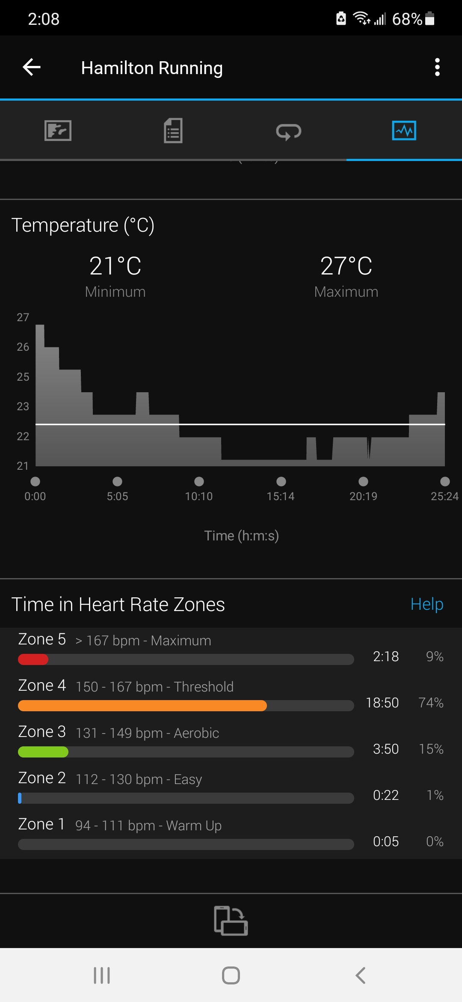
Went for a run two days ago

Slide 7
Suggestions
Develop around current curriculum
Cheer leaders and encouragers (video?)
Odd days emphasize one side of body; Even days emphasize other side of body for total body/skill development.

Slide 8
Dance—Everyone is a Dancer
Resources https://www.gophersport.com/pe/dance?tg=1
Everybody Move https://www.gophersport.com/pe/movement/everybody-move?item=6202
Samples https://www.pinterest.ca/canadago4sport/dance/
Don`t Sit Still Swimming Groove

Slide 9
Secret Dancers
Secret dancers (2) with detective (1) in the middle—switch moves at least every 15 seconds.
From: Fair & Square, CIRA Ontario

Slide 10
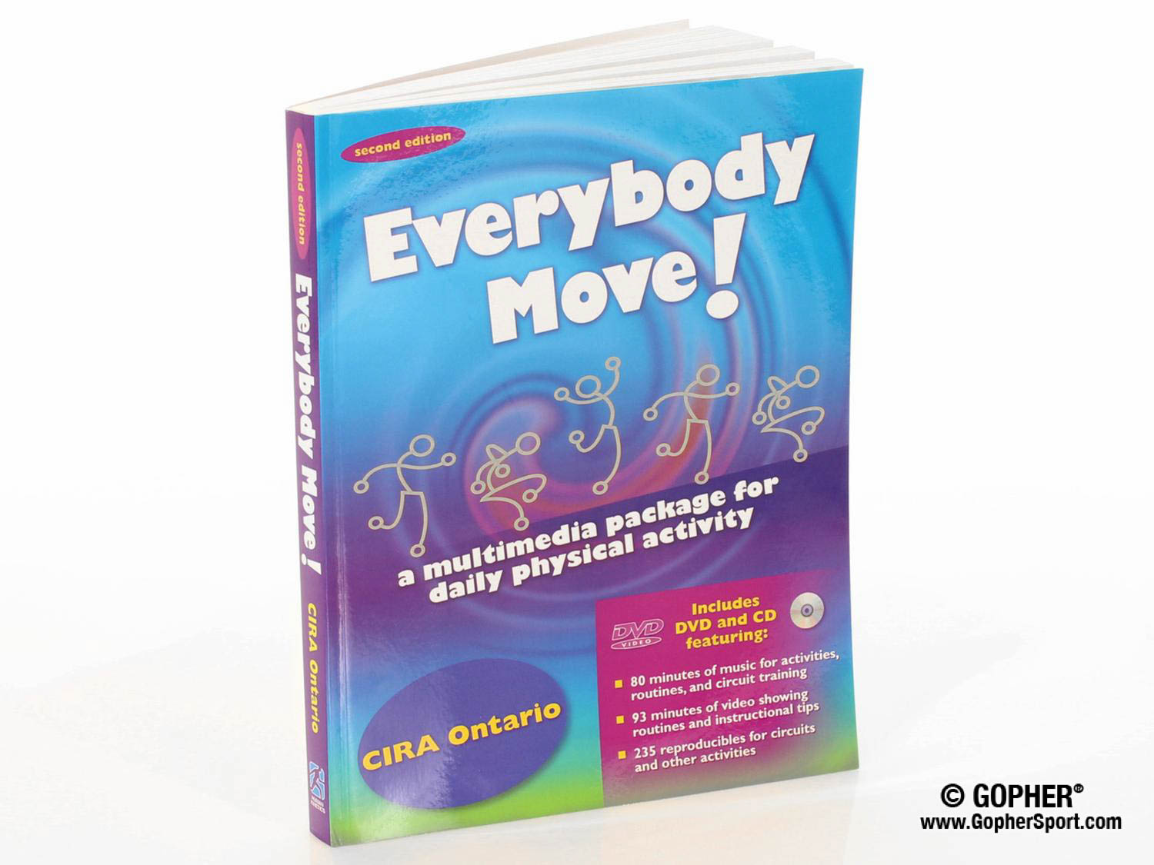
Daily Physical Activity (DPA)
Everybody Move https://www.gophersport.com/pe/movement/everybody-move?item=6202
Sample of 8 beat dance, then build with two people, then four people….

Slide 11
Dance Pl3y https://www.dancepl3y.com/

Slide 13
National Ballet School Megan Ferris OPLS 2021 Let’s do it ☺
Four Body Parts
Pick Order and Movement
Do 8x; do with 8x then 4x
Patterning with feet (add a pose at beginning & end: Curriculum connect)—Normal, small, big.
Open
Closed
Crossed
O O C C X X O C

Slide 14
Wake up:
Turn off alarm
Stretch
Tooth brushing
Run to school…
Same with different music

Slide 17
True/False Tag https://www.canadago4sport.com/Numeracy/True-and-False

Slide 18
Numeracy
Higher or lower guess by leader
One player stands behind leader with a page with a number from 1-100
Leader jogs on the spot
Leader takes a guess at the number
If the guess is too high the group does jumping jacks (or other pre-determined activity)
If the number is too low the group does squats (or other pre-determined activity)
From: Fair & Square, CIRA Ontario

Slide 19
Even and Odd With Wall Sit and Run https://www.canadago4sport.com/Numeracy/Even-and-Odd-With-Wall-Sit-and-Run

Slide 20
Quick Count Relay https://www.canadago4sport.com/Numeracy/Quick-Count-Relay

Slide 21
Odd Even Tag https://www.canadago4sport.com/Numeracy/Odd-Even-Tag

Slide 22
Ding Dong 7 https://www.canadago4sport.com/Numeracy/Ding-Dong-7

Slide 23
21 Pilots Sorry no video yet
One player picks a number between 2-9, and an exercise
Group stands in a circle and walks on the spot (or other activity)
Players begin to count with first player 1, second player 2…
When a player needs to say the picked number or a multiple of that number they do the prescribed exercise without saying the number…
If a player says a number they should not then that player runs around the circle and the next player begins with number 1…
If the group is successful add a second number and exercise…

Slide 24
Paint Palette Relay https://www.canadago4sport.com/Numeracy/Paint-Pallette-Relay

Slide 25
Tag and Add (also multiply, divide, subtract +/-) https://www.canadago4sport.com/Numeracy/Tag-and-Add

Slide 26
Squared Off https://www.canadago4sport.com/Numeracy/Squared-Out

Slide 27
Squared Off Bean Bag Toss https://www.canadago4sport.com/Target1/Squared-Out-Toss-Instructions

Slide 28
Connecting Four

Slide 29
Connect Four Up https://www.canadago4sport.com/Numeracy/Connect-Four-Up

Slide 30
Connecting Five in a Row (Could use large checker board…)

Slide 31
Active Checkers https://www.canadago4sport.com/Numeracy/Active-Checkers

Slide 32
Number Sequence (use playing cards instead of spots) https://www.canadago4sport.com/Numeracy/Number-Sequence-Relay

Slide 33
Human Tic Tac Toe
Create a large square with nine internal squares—or nine spots.
Three players per team line up (physically distanced from each other) behind a starting line.
Determine which teams are Xs (arms spread to the side), and which are Os (arms held together pointing up).
On the signal to begin the first player runs to a square and shows a line or a dot, then the second player goes, and then the third.
If no team has three in a row, the first player changes squares…
Variations:
Teams can decide who moves to a new square.
For more players have one player return to start line while next player moves onto one of the nine squares.

Slide 34
Human Tic Tac Toe https://www.canadago4sport.com/Numeracy/Human-Tic-Tac-Toe-in-Order Also Choose

Slide 35
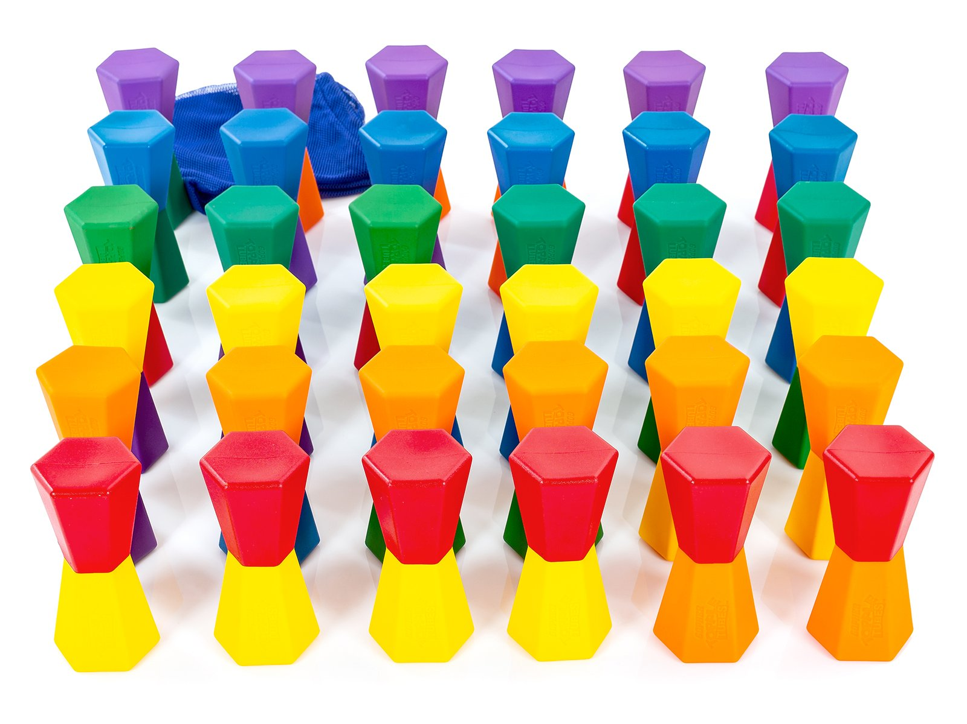
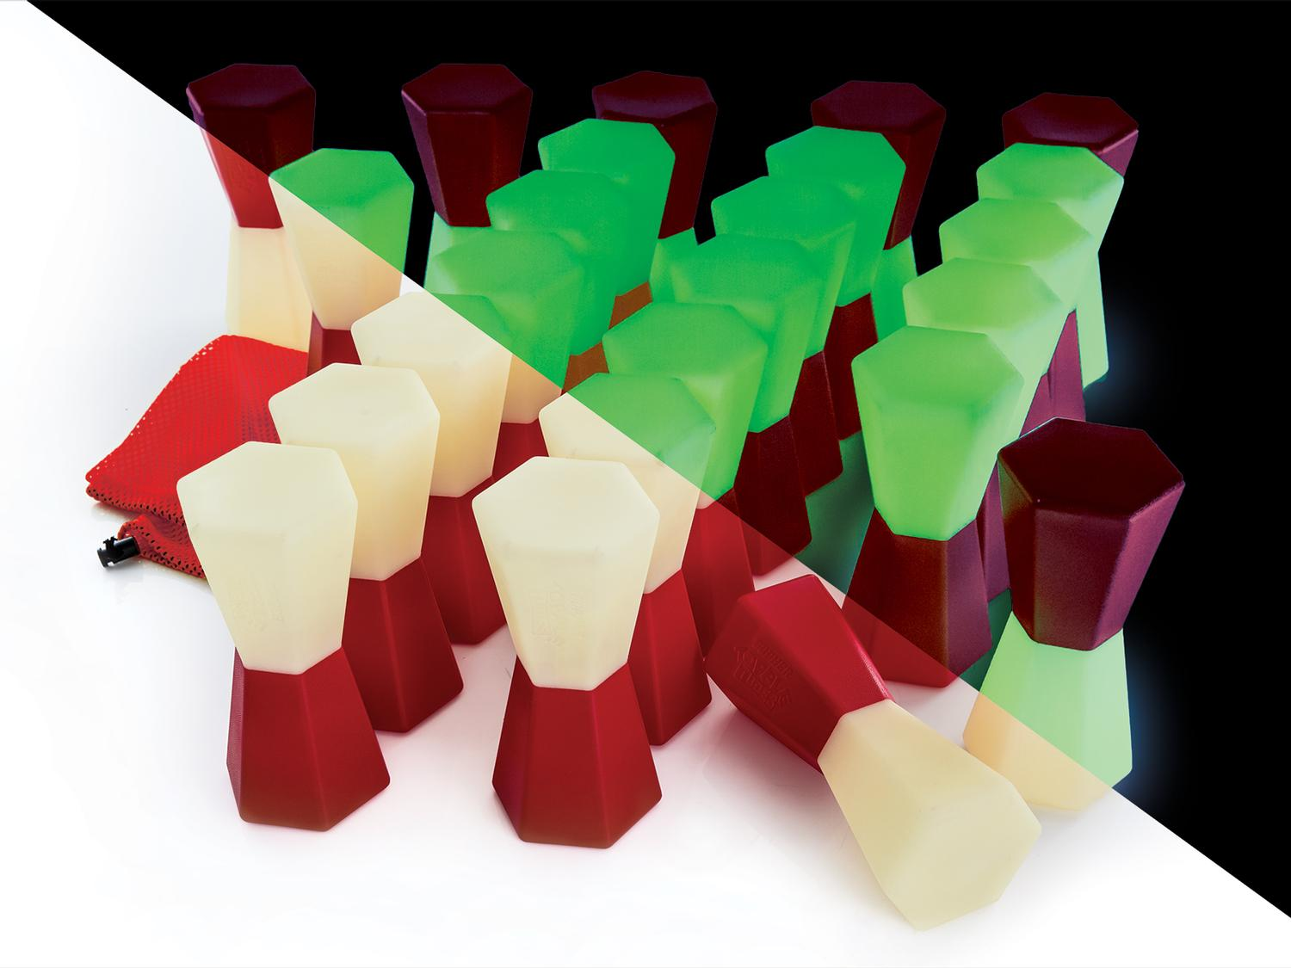
Toppletubes https://www.gophersport.com/search-unbxd?q=toppletubes

Slide 36
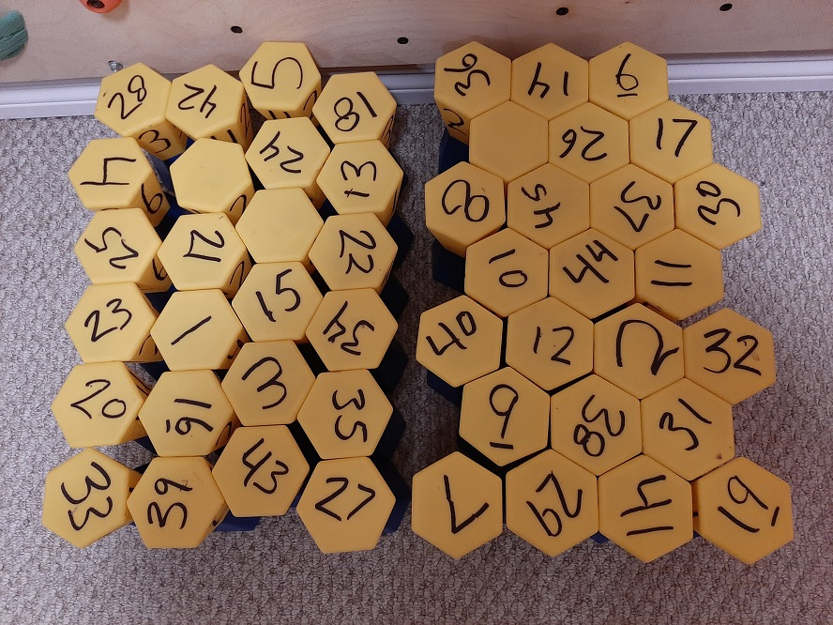
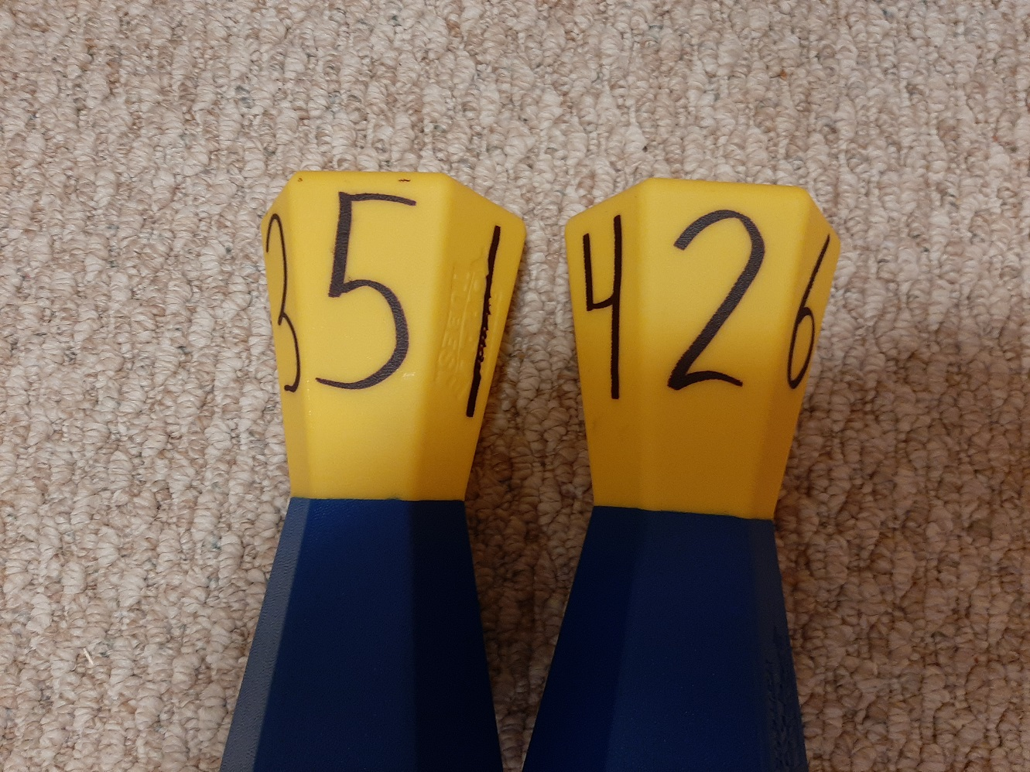
Numbering
Number all 48 on the yellow side with a black marker, with numbers 1-48
I mark about 10 of them with the numbers 1-6 around the edges
I put the number 1 on the side with the Gopher imprint (because any other number does not work well over that imprint), then a 6 on the opposite side
Then a 4 beside the 1 and a 3 on the opposite side of 4
Then a 5 on the other side of 1 with a 2 on the opposite side of 5

Slide 37
StrykN the Pins: Inhibitory Control https://www.canadago4sport.com/Numeracy/StrykeN-the-Pins

Slide 38
StrykN the Pins Over 50: Working Memory https://www.canadago4sport.com/Numeracy/StrykeN-the-Pins-to-Over-50

Slide 39
StrykN the Pins to Exactly 40: Cognitive Flexibility https://www.canadago4sport.com/Numeracy/StrykeN-the-Pins-to-Exactly-40

Slide 40
Topple a Specific Number (Could use playing cards—add suit or colour) https://www.canadago4sport.com/Numeracy/Topple-Specific-Number

Slide 41
Topple Numbers in Sequence (Could use playing cards—add suit/colour) https://www.canadago4sport.com/Numeracy/Topple-Tube-Number-Sequence

Slide 42
Tic Tac Toe No Grid Instructions (Use ToppleTubes instead of Rubber Bars) https://www.canadago4sport.com/Numeracy/Tic-Tac-Toe--No-Grid-Instructions

Slide 43
Pushup Tic Tac Toe (Use ToppleTubes instead of Bean Bags…) https://www.canadago4sport.com/Numeracy/Tic-Tac-Toe%E2%80%94No-Grid-With-Push-Up

Slide 44
Tic Tac Toe No Grid Relay https://www.canadago4sport.com/Numeracy/Tic-Tac-Toe%E2%80%94No-Grid-Relay

Slide 45
Literacy

Slide 46
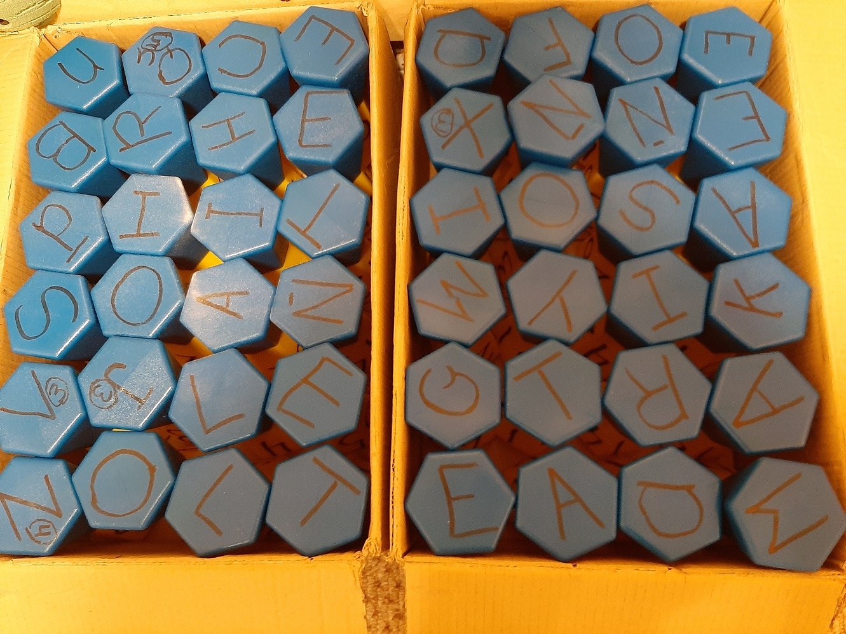
Lettering Two sets of ToppleTubes (48) lettered as following on the blue end of the ToppleTubes--number before the letter indicates how many ToppleTubes should have that number, and all letters are worth one (1) point unless otherwise noted:
4 x A 1 X B 1 C 2 D 6 E 1 F 1 G 1 H 4 I 1 J 3 points 1 K 2 L
1 M 3 N 4 O 1 P 1 Qu 5 points 2 R 2 S 3 T 1 U 1 V 3 points 1 W 1 X 3 points 1 Y 2 Z 4 points

Slide 47
Word Relay https://www.canadago4sport.com/Leadership/Word-Relay

Slide 48
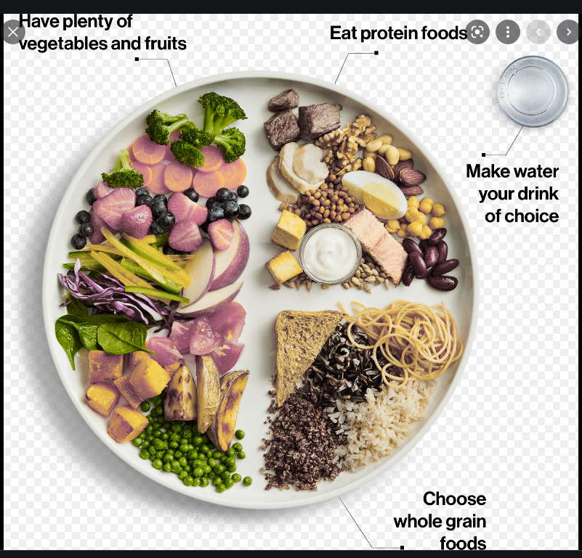
Nutrition--Canada’s Food Guide

Slide 49
Balanced Plate https://www.canadago4sport.com/Nutrition/Balanced-Plates
Objective:
In this invasion game, teams of 3-4 players, try to be the first to get a balanced plate (hula hoop) within the predetermined amount of time (based on Canada's 2019 Food Guide of 2 Fruits and Vegetables, 1 grain, and one protein)
Instuctions:
Place 1 hula hoop in the center of the playing area and then place the other hula hoops equal distance apart.
Place the 1.5 sets of 4 different HealthySpots (Use 1 vegetable, 1 fruit, 1 protein, and 1 grain) in the centre hula hoop.
3-4 players stand behind their assigned hula hoop.

Slide 51
Gather Balanced Meals from the Farm https://www.canadago4sport.com/Nutrition/Gather-Balanced-Meals-from-the-Farm
Objective (RPS in corners):
Be the first team to get a balanced meal—1 balanced meal = (based on Canada's 2019 Food Guide of 2 Fruits and Vegetables, 1 grain, and one protein).
Instructions:
Place 4 PolySpots in four corners (like a baseball diamond—increasing the distance between these PolySpots increases the activity level and time it takes to complete the game, decreasing the distance decreases the activity level and time it takes to complete the game).
Assign one PolySpot as the Barn.
All players begin at the barn in teams of 3-6 players (the more players per team the quicker the game goes, the fewer players per team the longer the game goes).

Slide 53
Food Run https://www.canadago4sport.com/Nutrition/Food-Run
Objective:
To be the first team to get 3 balanced meals—(based on Canada's 2019 Food Guide of 2 Fruits and Vegetables, 1 grain, and one protein).
Instructions:
Place 3 sets of FoodGroup Flags at the end of each playing area.
Designate a “Serving Area” space where teams can place their food (FoodGroup Flags).
Players stand in a scattered pattern in their assigned safe zone.
One-three players from each team is given a pool noodle.

Slide 55
RPS for a Balanced Meal or two… https://www.canadago4sport.com/Nutrition/RPS-for-a-Balanced-Meal
On the leader’s signal to begin, players pair up with players and play a game of Rock, Paper, Scissors (Rock (fist) smashes Scissors (two fingers in scissors shape), Scissors cuts Paper (flat hand), and Paper covers Rock).
The player that wins then runs to the middle of the playing area and retrieves one HealthyFood Spot.

Slide 56
Gathering a Healthy Meal https://www.canadago4sport.com/Nutrition/Gathering-A-Healthy-Meal
On the leader’s signal to begin, players pair up with players and play a game of Rock, Paper, Scissors (Rock (fist) smashes Scissors (two fingers in scissors shape), Scissors cuts Paper (flat hand), and Paper covers Rock).
The player that wins advances clockwise to the next Marker where the winner picks up a FoodGroup Flag if there is one.

Slide 57
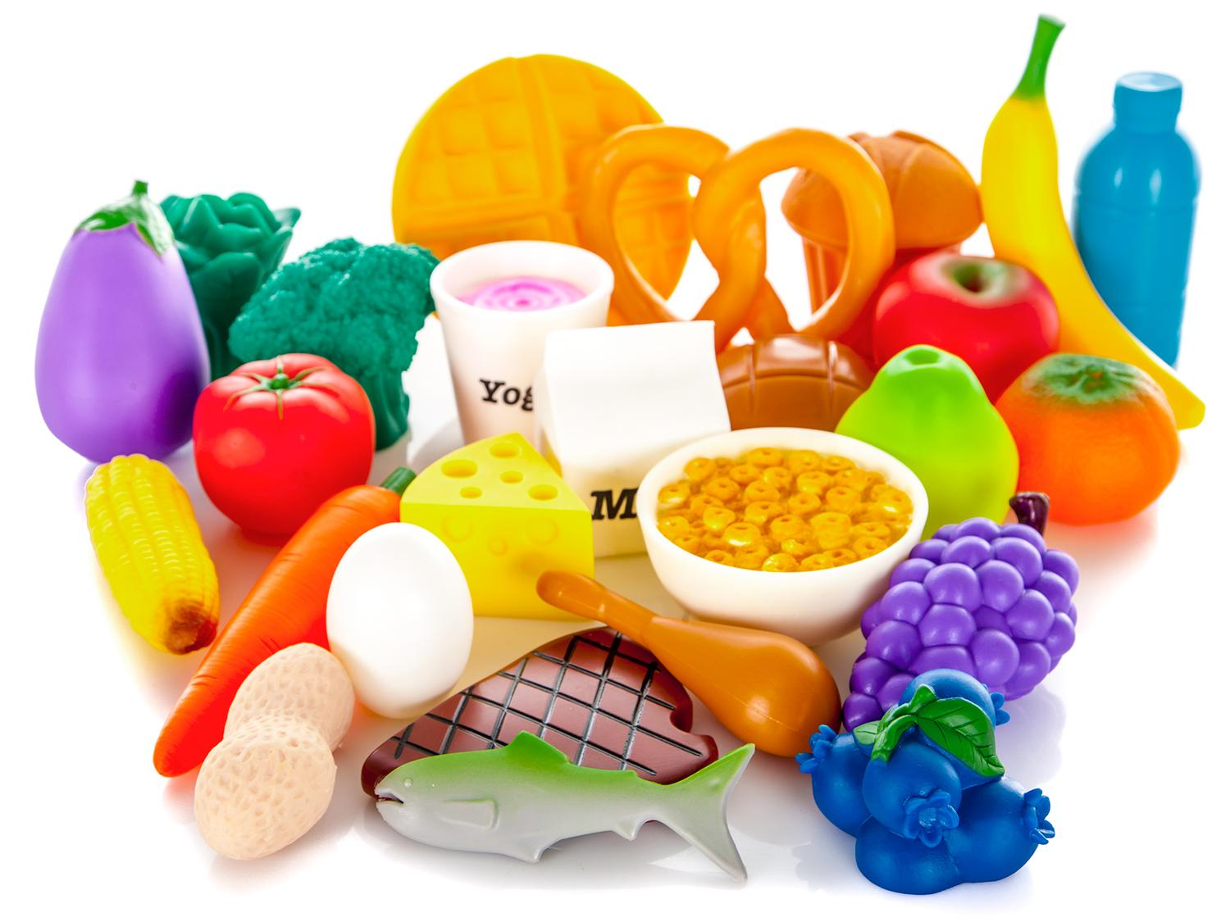
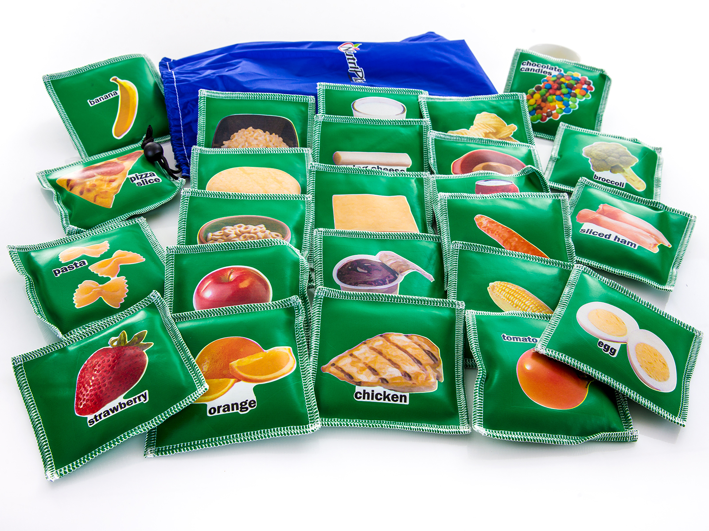
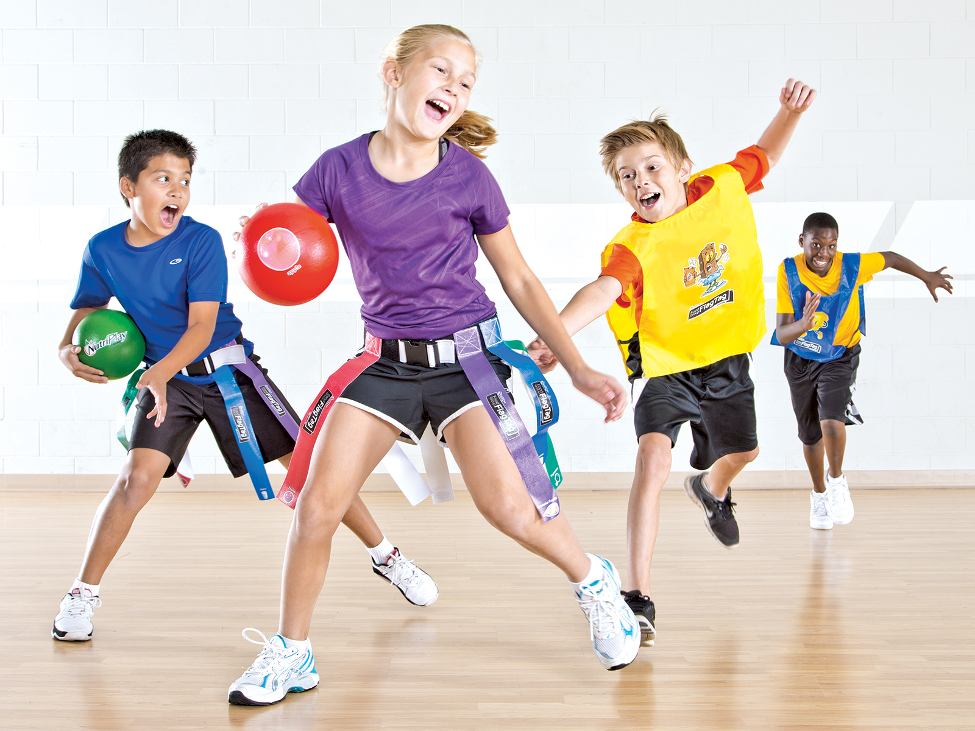
Gopher Equipment
https://www.gophersport.com/pe/nutrition/molded-vinyl-foods?item=13057
https://www.gophersport.com/pe/beanbags/nutriplay-food-beanbags?item=8004
https://www.gophersport.com/pe/nutrition/nutriplay-foodgroup-flagtag?item=8527

Slide 58
Scavenger Hunt https://drive.google.com/file/d/1fcXBksG5a_3Bnb-13LwpxVTDz3d3csz1/view

Slide 59
Leadership Games

Slide 60
Tip the Bucket https://www.canadago4sport.com/Leadership/Tip-the-Bucket

Slide 61
Carry and Drop the Bean Bag https://www.canadago4sport.com/Leadership/Carry-and-Drop-the-Bean-Bags

Slide 62
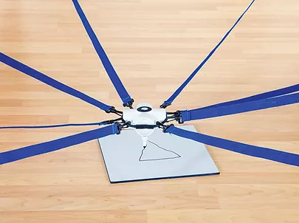
Cooperative Writing https://www.canadago4sport.com/Leadership/Cooperative-Writing
No video yet:

Slide 63
Cooperative Maze https://www.canadago4sport.com/Leadership/Cooperative-Maze

Slide 64
Architect https://www.canadago4sport.com/Leadership/Architect

Slide 65
Simon Says https://www.canadago4sport.com/Leadership/Simon-Says

Slide 66
Simon Says do Previous https://www.canadago4sport.com/Leadership/Simon-Says-Do-Previous

Slide 67
Simon Says do Opposite https://www.canadago4sport.com/Leadership/Simon-Says-Do-Opposite

Slide 68
Ying Yang You Instructions https://www.canadago4sport.com/Leadership/Ying-Yang-You-Instructions

Slide 69
Ying Yang You Slow https://www.canadago4sport.com/Leadership/Ying-Yang-You-Slow

Slide 70
Ying Yang You Faster https://www.canadago4sport.com/Leadership/Ying-Yang-You-Faster

Slide 71
Ying Yang You Back https://www.canadago4sport.com/Leadership/Ying-Yang-You-Back

Slide 72
Head and Shoulders Slow https://www.canadago4sport.com/Leadership/Head-and-Shoulders-Slow

Slide 73
Head and Shoulders Fast https://www.canadago4sport.com/Leadership/Head-and-Shoulders-Fast

Slide 74
Head and Shoulders Reverse Order https://www.canadago4sport.com/Leadership/Head-and-Shoulders-Reverse
S H T K T K T K S H T N NOSE MOUTH EAR & EYE (I had trouble ☺)

Slide 75
Active Furniture https://www.gophersport.com/pe/active-classroom?tag=seating

Slide 76
Swidget https://www.gophersport.com/pe/active-classroom/swidget-duo?item=13085

Slide 77
EmojED Pillows https://www.moving-minds.com/classroom/seating/emojied-seat-cushion

Slide 78
Kore Wobble Chair https://www.gophersport.com/pe/active-classroom/kore-wobble-chairs?item=138964

Slide 79
Kore Adjustable Chair https://www.moving-minds.com/classroom/seating/kore-grow-with-me-wobble-chairs

Slide 80
Ergo Ergo https://www.moving-minds.com/classroom/seating/ergoergo

Slide 81
ShiftED Seat https://www.moving-minds.com/classroom/seating/shifted-active-seat

Slide 82
Study Rocker https://www.moving-minds.com/classroom/seating/studyrocker-floor-chair

Slide 83
Saddled Desk https://www.moving-minds.com/classroom/seating/saddled-active-desk-chair

Slide 84
Revolve Active Seat https://www.moving-minds.com/classroom/seating/revolve-active-seat

Slide 85
TiltED https://www.moving-minds.com/classroom/seating/tilted-seat

Slide 86
Tim Scott
Numbers
Rough/Smooth
Material—plastic…

Slide 87
Tim Scott Continued

Slide 88
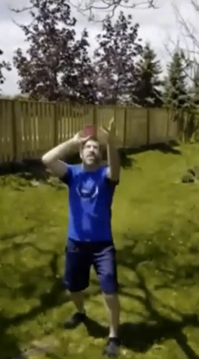
Tim Scott Continued

Slide 89
Other Suggestions?
Tim Scott
https://drive.google.com/drive/folders/13-oJcbZvJUk4Ft1eeLvgMtgxZVeOHU04
Cardio Desk Drumming
Heads or Tails
RPS vrs the teacher (or show with odds and evens)
Who is moving (frozen internet)
Pick a favourite and describe
Exercise gif—be respectful
Be respectful of your time, sleep, health…
Share (use students)
Ontario Physical Literacy Summit (OPLS)—Fall 2022
https://www.ontariophysicalliteracysummit.org/

Slide 90
Web Resources
Canadago4sport:
800+ game docs and 350+ game videos
www.canadago4sport.com
Gopher Sport:
Order from hundreds of equipment ideas.
https://www.gophersport.com/
Unconditional 100% satisfaction guarantee
Your satisfaction is our #1 concern! If you are not satisfied with any product you buy from us, we'll simply replace it or refund your money. No questions. No hassles. No exclusions. No kidding!

Slide 91
Pinterest and YouTube
Pinterest:
24 boards, and 800+ pins
Follow at https://www.pinterest.ca/canadago4sport/
YouTube:
500+ videos
Subscribe at https://www.youtube.com/c/canadago4sport/

Slide 92
Social Media and Further Questions
Twitter & Instagram:
Tuesdays & Thursdays (sometimes other days) posts
Follow at @canadago4sport
Love to hear from you:
JOHNBYL50@gmail.com

Slide 93
With thanks
To all of the wonderful people
who inspire each other
at conferences and other places!
To Gopher Sport
for their innovative products
and high quality equipment!

Slide 94
Download slides at:
https://www.canadago4sport.com/conferences-and-workshops

