Slide 1
Physical Literacy
Dr. John Byl
JOHNBYL50@gmail.com
While we wait, sign up for Tuesday & Thursday activity postings on:
Twitter or Instagram
@canadago4sport

Slide 2
Choosing Abundant Life

Slide 3
My Year Long Cancer Journey: Choosing Life
Summary
https://www.caringbridge.org/visit/drjohnbyl

Slide 4
Physical Literacy Skills
"Physical literacy is the motivation, confidence, physical competence, knowledge, and understanding to value and take responsibility for engagement in physical activities for life." - The International Physical Literacy Association, May 2014

Slide 5
https://sportforlife.ca/physical-literacy/

Slide 6
Movement Skills https://schoolpapl.ca/wp-content/uploads/2021/04/Getting-Started-with-Physical-Literacy-Webinar-Handouts.pdf

Slide 7
Key Cues for Sending Kicking
Kicking – players propel an object by striking it with a foot
What to Look For
Preparation Stage
Does the player start by standing behind the ball?
Is there a quick movement towards the ball that includes planting the non-kicking foot beside the ball?
Are the eyes on the object to be kicked?
Is there a step towards the object with the kicking foot?

Slide 8
Key Cues for Sending Kicking Continued
Kicking Stage
Does the kicking leg swing freely from the hip?
Is the whole movement balanced?
Does the player lean into the kick?
Is contact made with the instep or shoelaces?
Is contact made just below the center of the object being kicked?
Follow-Through Stage
Does the kicking leg continue towards the target and across the body?
Are the arms used to maintain balance?

Slide 9
Physical Literacy Assessment for Youth PLAY
https://physicallit.wpengine.com/wp-content/uploads/2017/01/PLAYbasic-workbook.pdf

Slide 10
Four sub-skills

Slide 11
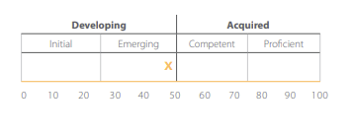
Hopping

Slide 12
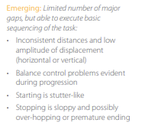
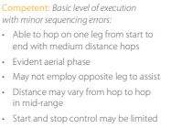
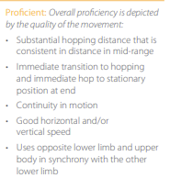
Levels of Competence

Slide 13
Manipulative Retain Balance a Ball https://www.canadago4sport.com/Manipulative-Retain/Balance-Two-Ball

Slide 14
Double Dribble https://www.canadago4sport.com/Manipulative-Retain/Double-Dribble

Slide 15
Soccer Juggle with 360 https://www.canadago4sport.com/Manipulative-Retain/Soccer-Juggle-with-360

Slide 16
Balloon Dribble Relay (groups of 2) https://www.canadago4sport.com/Manipulative-Send/Balloon-Dribble-with-Feet

Slide 17
Topple Four Up Dribble https://www.canadago4sport.com/Numeracy/Topple-Four-Up

Slide 18
Throw to a Wall Timed Race https://www.canadago4sport.com/Manipulative-Send/Throw-to-a-Wall-Relay https://www.canadago4sport.com/Manipulative-Send/Toss-and-Catch-to-Wall
But make an individual or team (2-3 players) race of it.

Slide 19
Bird/Ball Juggle https://www.canadago4sport.com/Manipulative-Send/-Bird%2FBall-Juggle

Slide 20
Side-by-Side Juggle https://www.canadago4sport.com/Manipulative-Retain/Side-by-Side-Juggle

Slide 21
Omnikin Series (can use other balls as well) https://www.gophersport.com/omnikin

Slide 22
Back-of-Hand Bounce https://www.canadago4sport.com/Manipulative-Retain/Omnikin-Back-of-Hand-Bounce

Slide 23
Two-Ball Bounce https://www.canadago4sport.com/Manipulative-Retain/Omnikin-Two-Ball-Bounce

Slide 24
Two Ball Balance https://www.canadago4sport.com/Manipulative-Retain/Omnikin-Two-Ball-Balance

Slide 25
Two-Ball Balance with Kick https://www.canadago4sport.com/Manipulative-Retain/Omnikin-Two-Ball-Balance-With-Kick

Slide 26
Two-Ball Hand Switch https://www.canadago4sport.com/Manipulative-Retain/Omnikin-Two-Ball-Hand-Switch

Slide 27
One-Foot Balance https://www.canadago4sport.com/Manipulative-Retain/Omnikin-One-Foot-Balance

Slide 28
Two-Ball Pass https://www.canadago4sport.com/Manipulative-Retain/Omnikin-Two-Ball-Pass

Slide 29
Headers https://www.canadago4sport.com/Manipulative-Retain/Omnikin-Headers

Slide 30
Knee Balance with Hand Clap https://www.canadago4sport.com/Manipulative-Retain/Omnikin-Two-Knee-Balance-With-Hand-Clap

Slide 31
Manipulative-Receive

Slide 32
Qwick Catch https://www.canadago4sport.com/Manipulative-Receive/Qwick-Catch

Slide 33
Manipulative Receive Circus Catches [with partner or tossed to self] https://www.canadago4sport.com/Stability-Ball1/Circus-Catches

Slide 34
Long Throw Count https://www.canadago4sport.com/Manipulative-Receive/Long-Throw-Count

Slide 35
Kaboom: use a larger ball (basketball or soccer ball) and a smaller ball (tennis) or bean bag [do solo or with safe partner] https://www.canadago4sport.com/Manipulative-Receive/Kaboom

Slide 36
Wobbly Balloon [at home] https://www.canadago4sport.com/Manipulative-Receive/Woobly-Balloon

Slide 37
Reaction Ball Catch https://www.canadago4sport.com/Manipulative-Receive/Reaction-Ball

Slide 38
Back-to-Back Catches https://www.canadago4sport.com/Manipulative-Receive/Back-to-Back-Catch

Slide 39
Manipulative-Send

Slide 40
Dene Snake Slide https://www.canadago4sport.com/Manipulative-Send/Dene-Snake-Slide

Slide 41
Kick Pylon (groups of 4—3 vrs 1) https://www.canadago4sport.com/invasion1-1/Kick-Pylon
No video yet

Slide 42
Kick Beach Ball In Basket (groups of 4) https://www.canadago4sport.com/Manipulative-Retain/Kick-Beachball-Into-Basket

Slide 43
Kick Soccer Ball In Basket (groups of 4) https://www.canadago4sport.com/Manipulative-Retain/Kick-Soccer-Ball-Into-Basket

Slide 44
Two Players Sharing Equipment?
The PHE Canada document does not encourage the sharing of any equipment. For those teachers in other countries, you may wish to consider the following thoughts.
On May 19, 2020 the United States’ Centers for Disease Control and Prevention (CDC) changed its guidelines to state https://www.cdc.gov/coronavirus/2019-ncov/prevent-getting-sick/how-covid-spreads.html:
The virus that causes COVID-19 is spreading very easily and sustainably between people. Information from the ongoing COVID-19 pandemic suggest that this virus is spreading more efficiently than influenza, but not as efficiently as measles, which is highly contagious.
The virus does not spread easily in other ways

Slide 45
Two Players Sharing Equipment? Con’t
COVID-19 is a new disease and we are still learning about how it spreads. It may be possible for COVID-19 to spread in other ways, but these are not thought to be the main ways the virus spreads.
From touching surfaces or objects. It may be possible that a person can get COVID-19 by touching a surface or object that has the virus on it and then touching their own mouth, nose, or possibly their eyes. This is not thought to be the main way the virus spreads, but we are still learning more about this virus.
Based on the CDC guidelines, a school and instructor’s wisdom, you may decide to engage students where there is limited sharing of equipment. How might we do that? Permit a couple of examples if you can still reduce equipment contact if you decide it is wise to go in this direction.

Slide 46
Two Players Sharing Equipment? Con’t
Net Games
Have players share a bird, table tennis ball, or tennis ball.
Playing other two-player games:
Width and Depth https://www.canadago4sport.com/Net/Width-and-Depth
Two Square https://www.canadago4sport.com/Net/Two-Square-Stability-Ball
Striking
Use a different ball for each baseball/cricket inning and for each new pitcher.
There is no unnecessary passing of the ball (tossing the ball around the bases after a strike out…)—but I would rarely (never?) do a full-sized baseball/softball game in a Physical Education class.

Slide 47
Manipulative Send and Receive Noodle Toss Pairs [at home] (but use Rubber Band Ball instead or scoops) Repeat from Previous Grades https://www.canadago4sport.com/Manipulative-Send/Noodle-Toss-Pairs

Slide 48
Backwards Partner Bowling [at home] https://www.canadago4sport.com/Target1/Backwards-Partner-Bowling

Slide 49
Width and Depth [at home] https://www.canadago4sport.com/Net/Width-and-Depth

Slide 50
Scoops with a partner or solo against a wall https://www.canadago4sport.com/Manipulative-Send/Scoop-to-Wall

Slide 51
Toss in the Towel (use a soccer ball instead of stability ball) https://www.canadago4sport.com/Manipulative-Send/Toss-in-the-Towel

Slide 52
Two Player Juggle [at home] (use any three larger balls—soccer, basketball…) https://www.canadago4sport.com/Manipulative-Send/Two-Player-Juggle

Slide 53
Six Square Bump https://www.canadago4sport.com/Manipulative-Send/Six-Square-Bump

Slide 54
Circle Pass to Same Player and Run https://www.canadago4sport.com/Train-Net-NoRacquet/Circle-Pass-to-Same-Player-and-Run
Toss and catch and no run
Toss and catch and run
Volley and run

Slide 55
Locomotor

Slide 56
Your Colour Up https://www.canadago4sport.com/Leadership/Your-Colour-Up

Slide 57
Your Colour Up with Feet https://www.canadago4sport.com/Leadership/Your-Colour-Up-With-Feet

Slide 58
Topple Tic Tac https://www.canadago4sport.com/Numeracy/Topple-Tic-Tac

Slide 59
Topple Double Tic Tac https://www.canadago4sport.com/Numeracy/Topple-Double-Tic-Tac

Slide 60
Tic Tac Toe No Grid Instructions (Use ToppleTubes instead of Rubber Bars) https://www.canadago4sport.com/Numeracy/Tic-Tac-Toe--No-Grid-Instructions

Slide 61
Tic Tac Four in a Row https://www.canadago4sport.com/Numeracy/Tic-Toc-Four-in-a-Row

Slide 62
Tic Tac Double Four in a Row https://www.canadago4sport.com/Numeracy/Tic-Toc-Double-Four-in-a-Row

Slide 63
Topple Three Up https://www.canadago4sport.com/Locomotor/Topple-Three-Up
1,800,000+ views on Pinterest www.pinterest.ca/pin/283515739029933805/

Slide 64
Rock, Paper, Scissors (RPS)
Football & Baseball
Use pool noodle each
From: Fair & Square, CIRA Ontario

Slide 65
Rock, Paper, Scissors (RPS)
From squares or hoops…
RPS Evolution but from squares
RPS I won you run or other activity
RPS ready set shoot and activity in square
RPS stretch to heel-toe across square
From open space
RPS Push them back
From: Fair & Square, CIRA Ontario

Slide 66
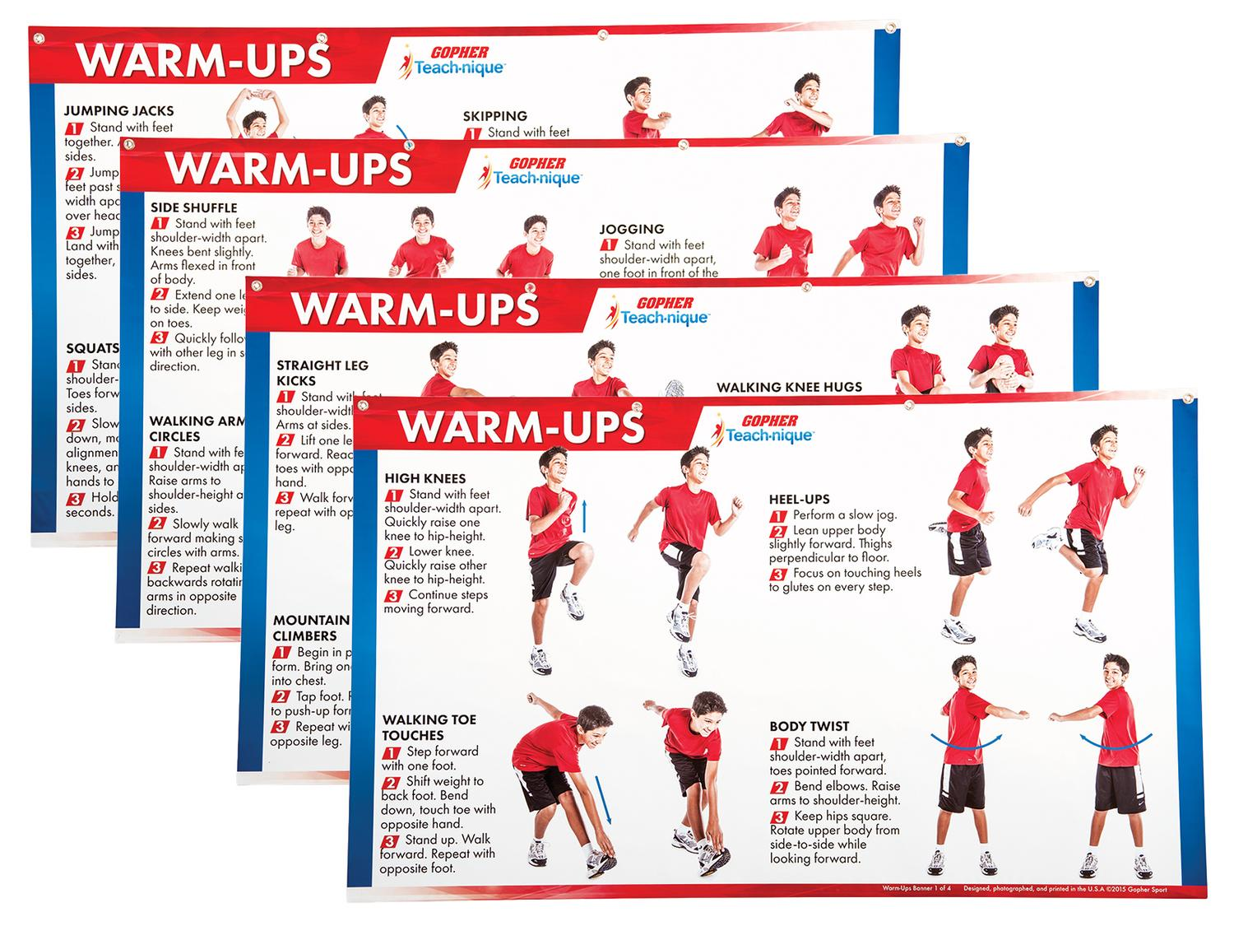
Fitness Activities
Warmup charts without equipment
https://www.gophersport.com/pe/gym-posters/teach-nique-warm-ups-banners?item=9332
F.I.T.T Banners
https://www.gophersport.com/pe/gym-posters/teach-nique-fitt-banners?item=10848

Slide 67
Walking https://sites.google.com/cpfpp.ab.ca/partage-education-physique/%C3%A0-lext%C3%A9rieur
This facility/neighbourhood tour can be relaxing or demanding, the choice is yours:
Do you need an excursion form to get out of the facility?
You can walk inside the facility?
What materials will the participants need?
A clipboard and pencil, colored pencils, a phone to write down their data, etc.
Something to sit on?
What do you want the participants to accomplish, to learn?
A relaxing walk, to chat and discover the facility
A race with fitness breaks
An organized scavenger hunt with a list of things to find
Will it be a repetitive activity with different goals each time or is it a unique experience?

Slide 68
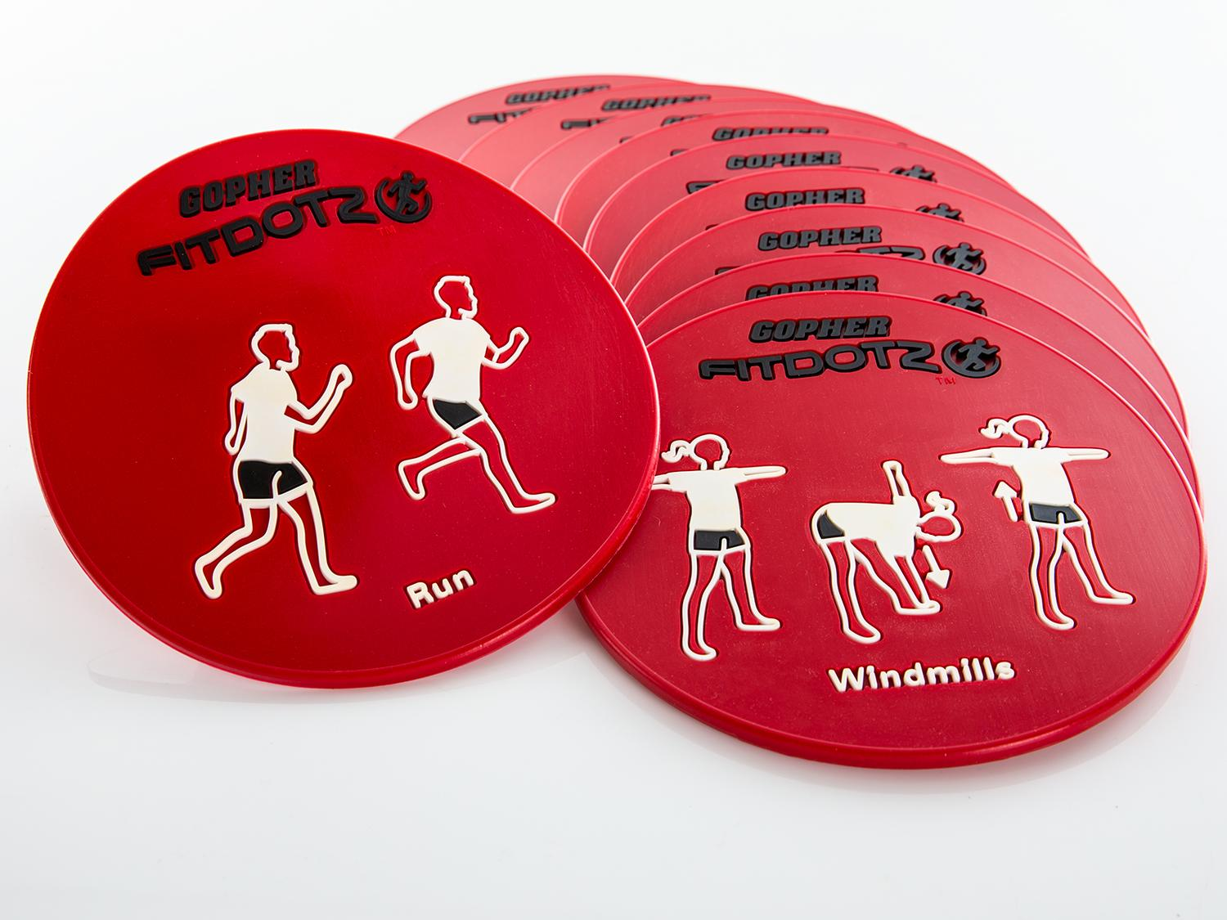
Fitness Activities Con`t Exeropoly https://www.canadago4sport.com/Warmups/Exeropoly

Slide 69
Planks till Odd Use own dice and beanbag https://www.canadago4sport.com/Numeracy/Planks-till-odd

Slide 70
Pushup Tic Tac Toe (Use ToppleTubes… instead of Bean Bags) https://www.canadago4sport.com/Numeracy/Tic-Tac-Toe%E2%80%94No-Grid-With-Push-Up

Slide 71
Push up Hockey in Pairs
https://www.canadago4sport.com/Warmups/Push-Up-Hockey-in-Pairs
https://www.canadago4sport.com/Manipulative-Receive/Feet-to-Feet-Hockey

Slide 72
Four Square Skipping
Skip till those ahead of you mess up or stop.
Also
I spy no add 1 exercise or yes do same number
Huckle buckle body part to specific corner
From: Fair & Square, CIRA Ontario

Slide 73
Ladder Activities
Ladder activities—for about 50 different ways https://www.canadago4sport.com/agility-ladders

Slide 74
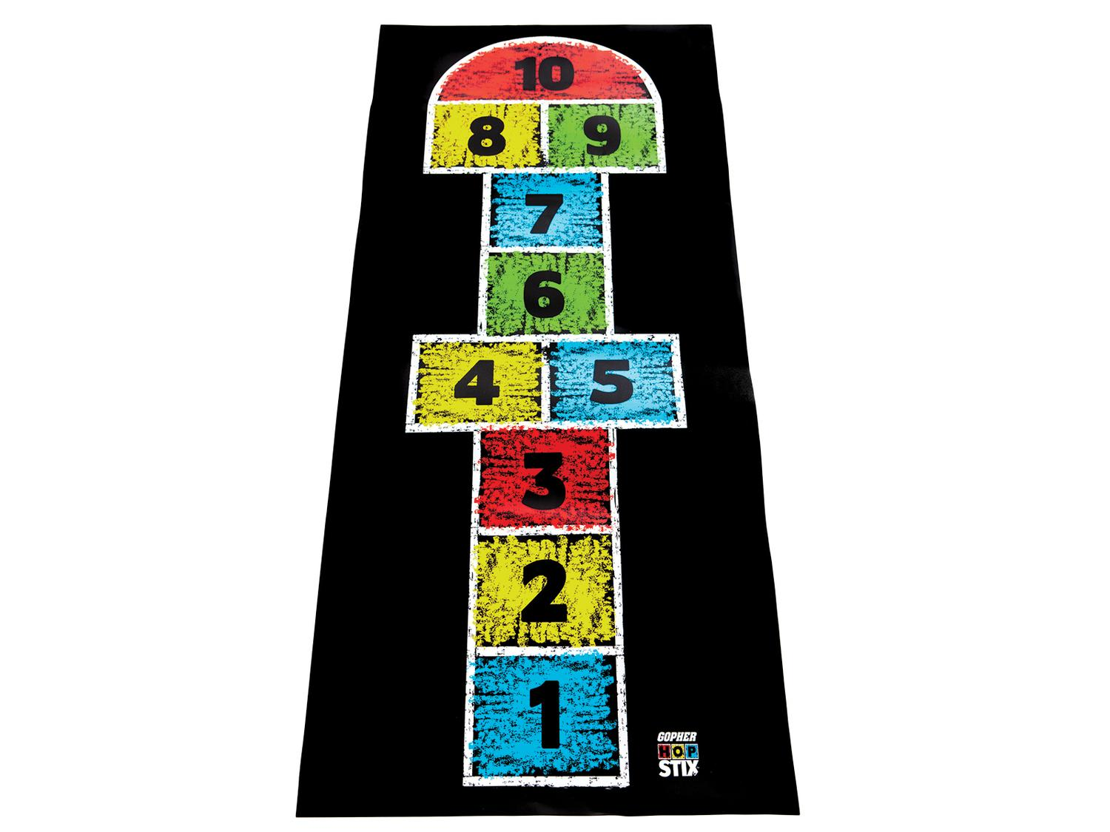
Hop Scotch
Need video still

Slide 75
Ladder Activities Con`t Just with Feet
For example:

Slide 76
Ladder Activities Con`t With Feet and Hands
For example:

Slide 77
Ladder Activities Con`t With Additional Equipment
For example:

Slide 78
Most Tag Games With Cleaned Pool Noodles for Its https://www.gophersport.com/sports/swimming/funoodles-foam-rod-floats?item=-204621
Can add different types of locomotor:
Run
Heel Toe
Skip
Gallop
Hop
Jump…

Slide 79
Sponge Tag https://www.canadago4sport.com/Locomotor/Sponge-Tag

Slide 80
Penguin Lobster Tag https://www.canadago4sport.com/Locomotor/Penguin-Lobster-Tag

Slide 81
Butt Tag https://www.canadago4sport.com/Locomotor/Butt-Tag

Slide 82
Indoor Ice Skating Tag https://www.canadago4sport.com/Locomotor/Ice-Skating-Tag

Slide 83
Safe Under a Halo https://www.canadago4sport.com/Locomotor/Safe-Under-a-Halo

Slide 84
Hot Dog Tag https://www.canadago4sport.com/Locomotor/Hot-Dog-Tag

Slide 85
Cow Tipping Tag https://www.canadago4sport.com/Locomotor/Cow-Tipping-Tag

Slide 86
Bug Tag https://www.canadago4sport.com/Locomotor/Bug-Tag

Slide 87
Races
Can add different types of locomotor:
Run
Heel Toe
Skip
Gallop
Hop
Jump…

Slide 88
Star Race https://www.canadago4sport.com/Locomotor/Star-Race

Slide 89
Anerobic Beanbag Race https://www.canadago4sport.com/Locomotor/Anaerobic-Beanbag-Race

Slide 90
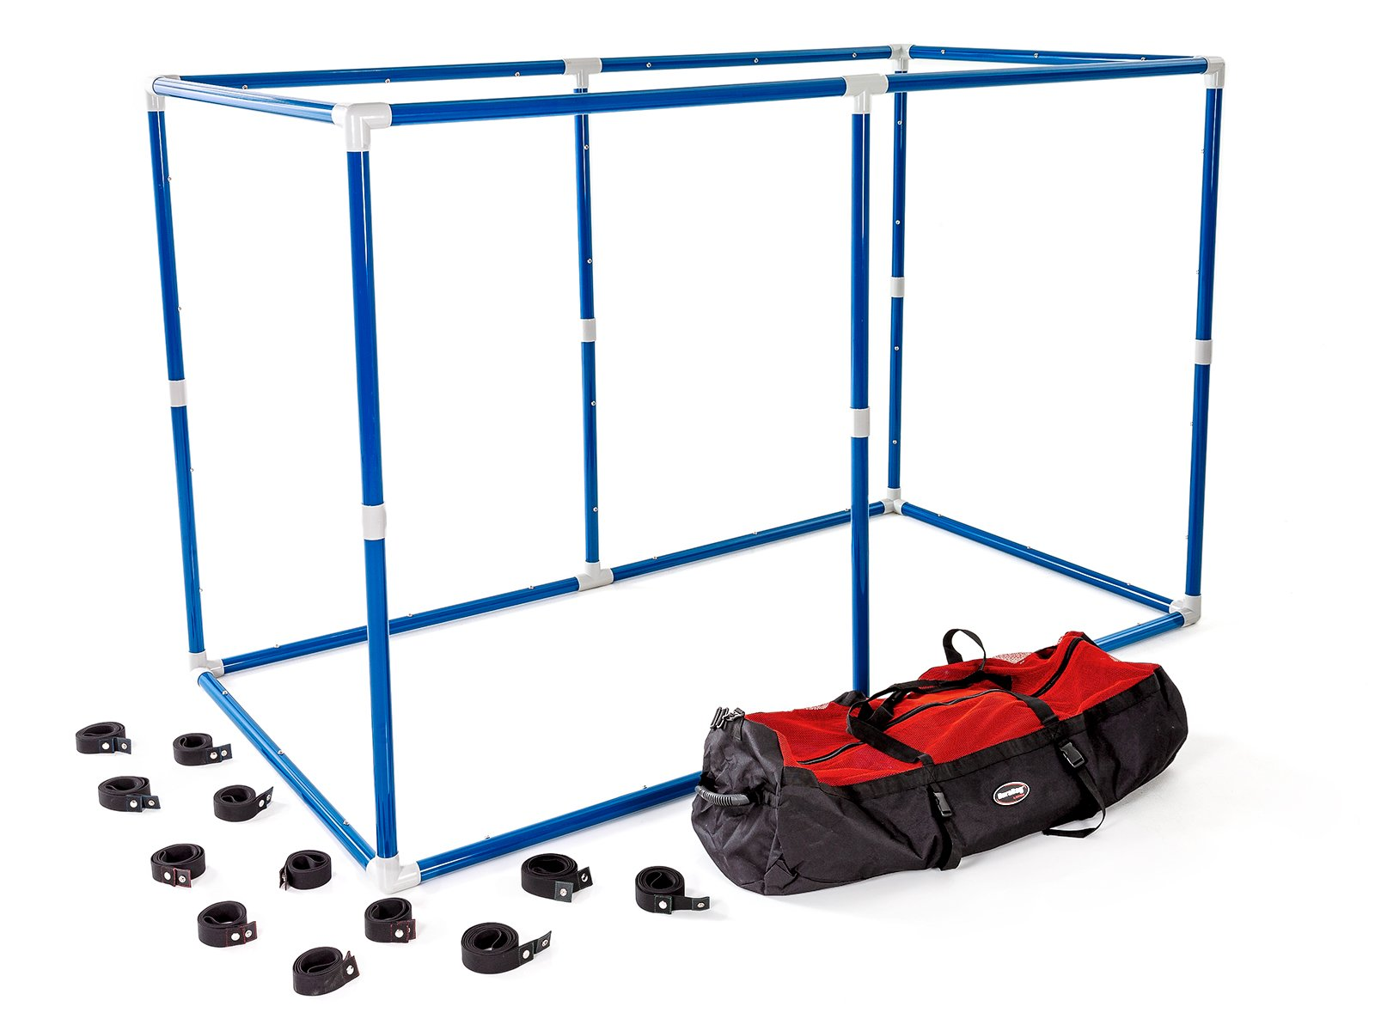
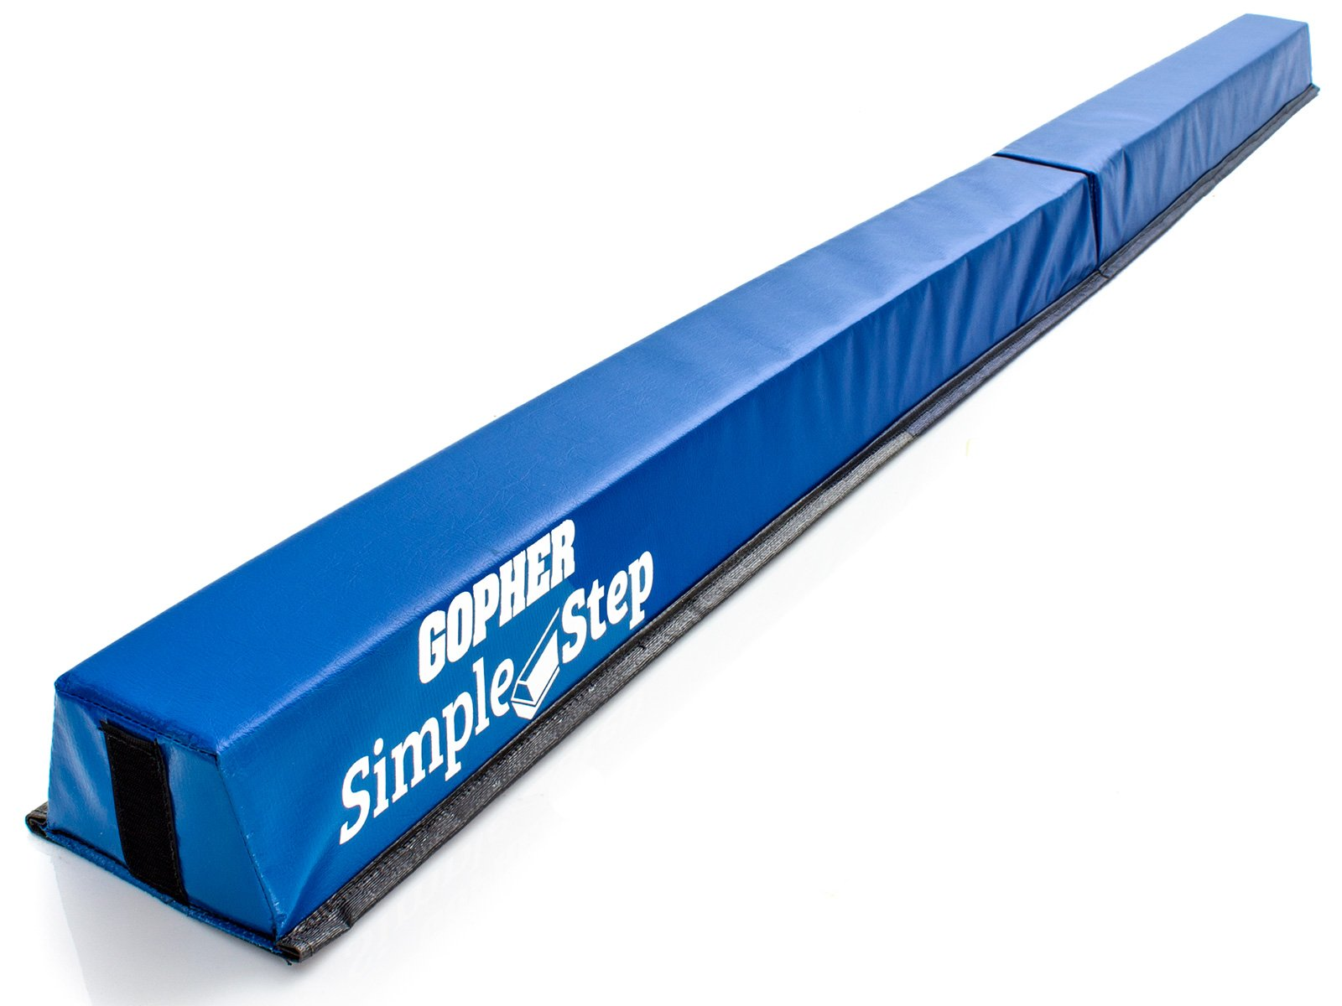
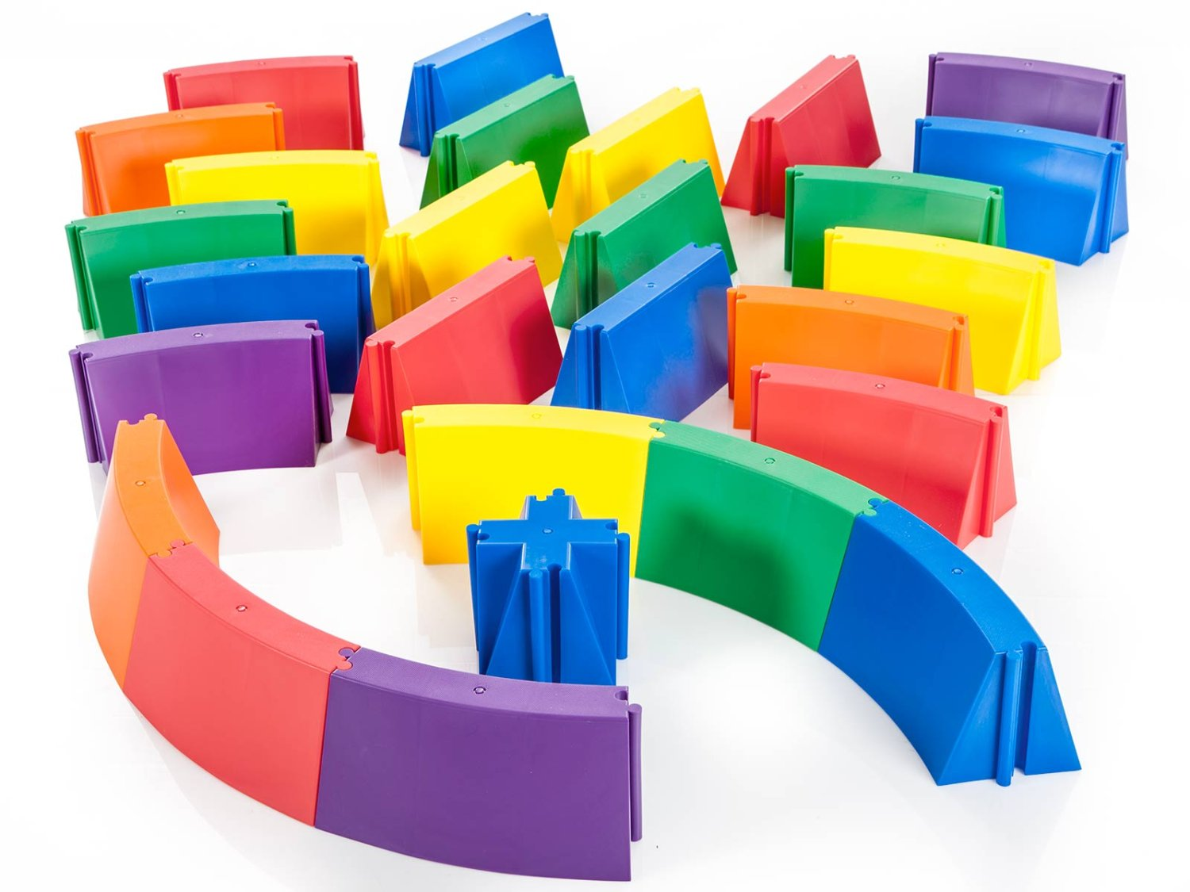
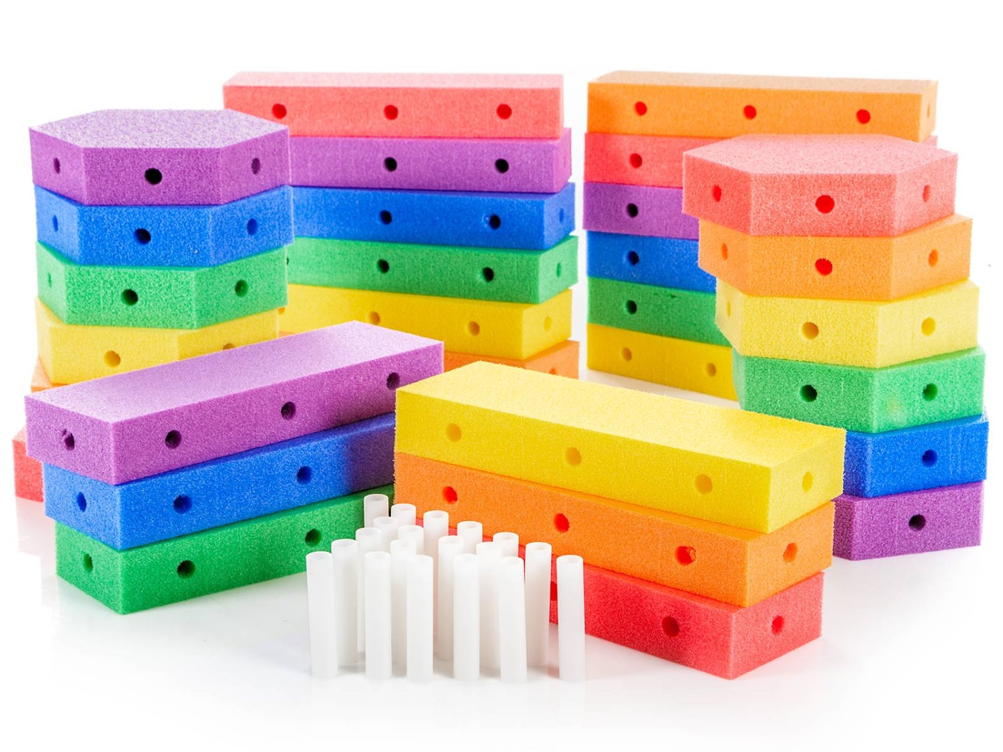
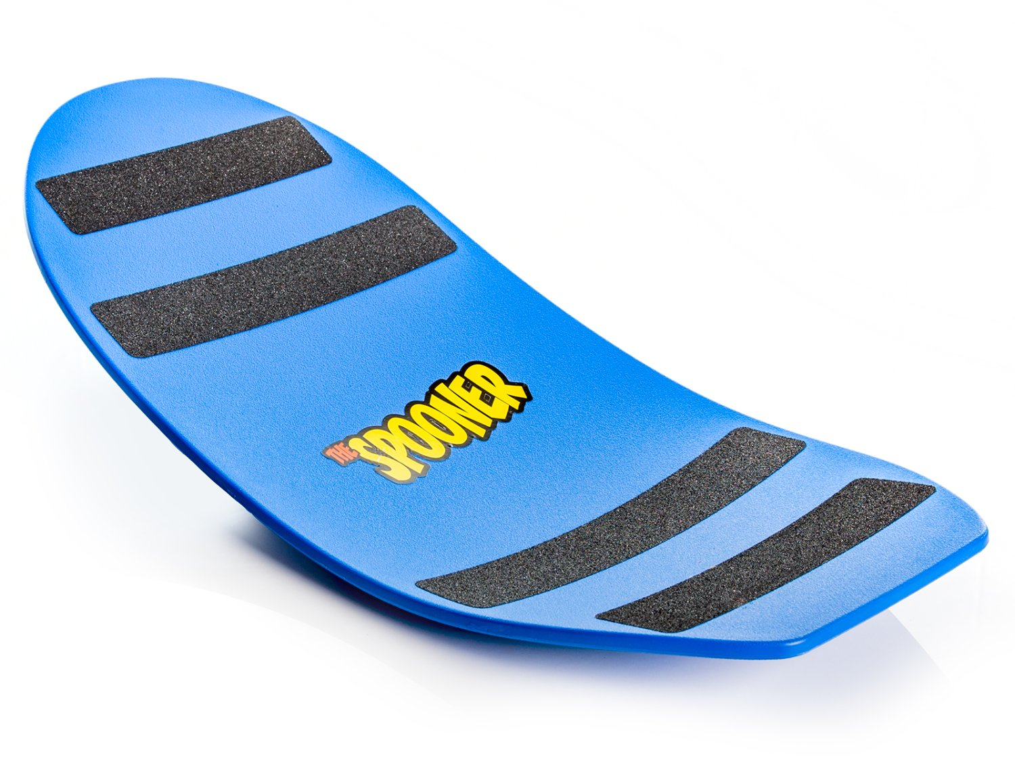
Obstacle Courses
Maneuver Maze https://www.gophersport.com/pe/movement/maneuvermaze-obstacle-course?item=162174
Simple Step https://www.gophersport.com/pe/movement/simplestep-balance-beam?item=154075
Figure 8 https://www.gophersport.com/pe/movement/figure-8-balance-beam?item=5275
Create a Course https://www.gophersport.com/pe/movement/create-a-beam-plus-balance-set?item=9753
Spooner https://www.gophersport.com/pe/movement/the-spooner?item=5584

Slide 91
Sample Obstacle Course https://www.canadago4sport.com/Locomotor/Obstacle-Course

Slide 92
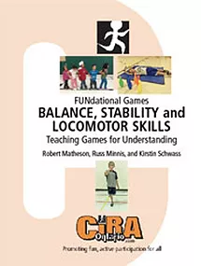
Helpful Resources (K-3)

Slide 93
Web Resources
Canadago4sport:
700+ game docs and 350+ game videos
www.canadago4sport.com
Nearly 50 different ladder activities
https://www.canadago4sport.com/agility-ladders
Gopher Sport:
Order from over 12 different ladders
https://www.gophersport.com/fitness/saq?tag=agility
Order from hundreds of equipment ideas.
https://www.gophersport.com/
Unconditional 100% satisfaction guarantee
Your satisfaction is our #1 concern! If you are not satisfied with any product you buy from us, we'll simply replace it or refund your money. No questions. No hassles. No exclusions. No kidding!

Slide 94
Pinterest and YouTube
Pinterest:
24 boards, and 800+ pins
Follow at https://www.pinterest.ca/canadago4sport/
YouTube:
500+ videos
Subscribe at https://www.youtube.com/c/canadago4sport/

Slide 95
Social Media and Further Questions
Twitter & Instagram:
Tuesday (sometimes other days) posts
Follow at @canadago4sport
Love to hear from you:
JOHNBYL50@gmail.com

Slide 96
With thanks
To all of the wonderful people
who inspire each other
at conferences and other places!
To Gopher Sport
for their innovative products
and high quality equipment!

Slide 97
Download slides at:
https://www.canadago4sport.com/conferences-and-workshops

