Slide 1
Innovative Agility Ladder Fitness Challenges With Equipment
Dr. John Byl
JOHNBYL50@gmail.com
While we wait, sign up for weekly activity postings on:
Twitter or Instagram
@canadago4sport

Slide 2
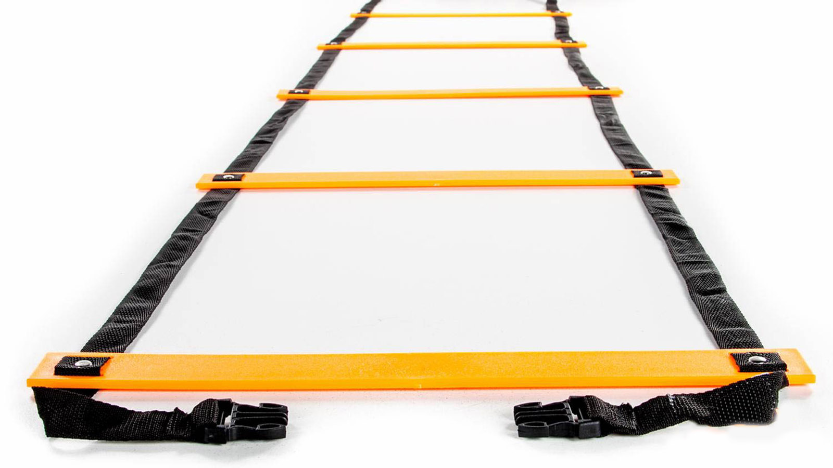
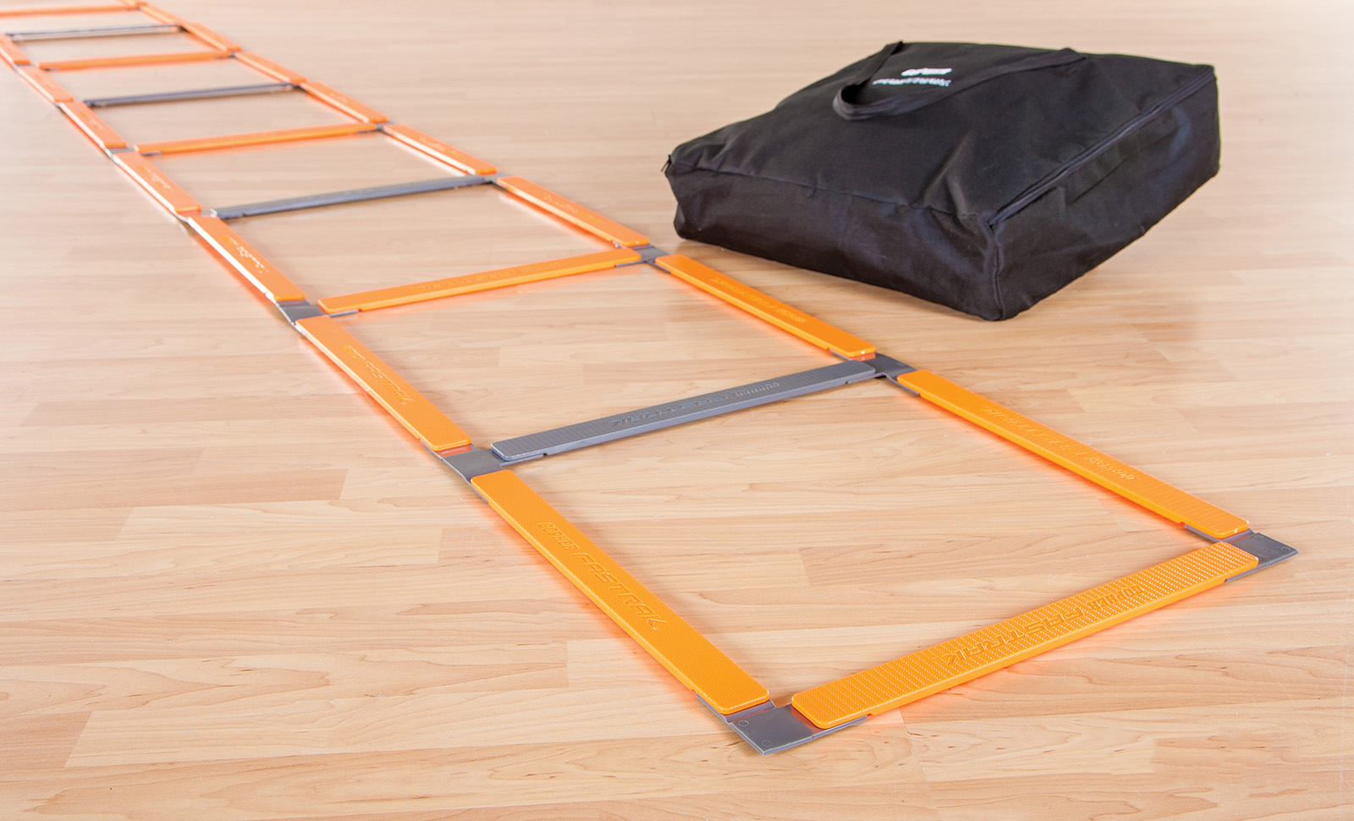
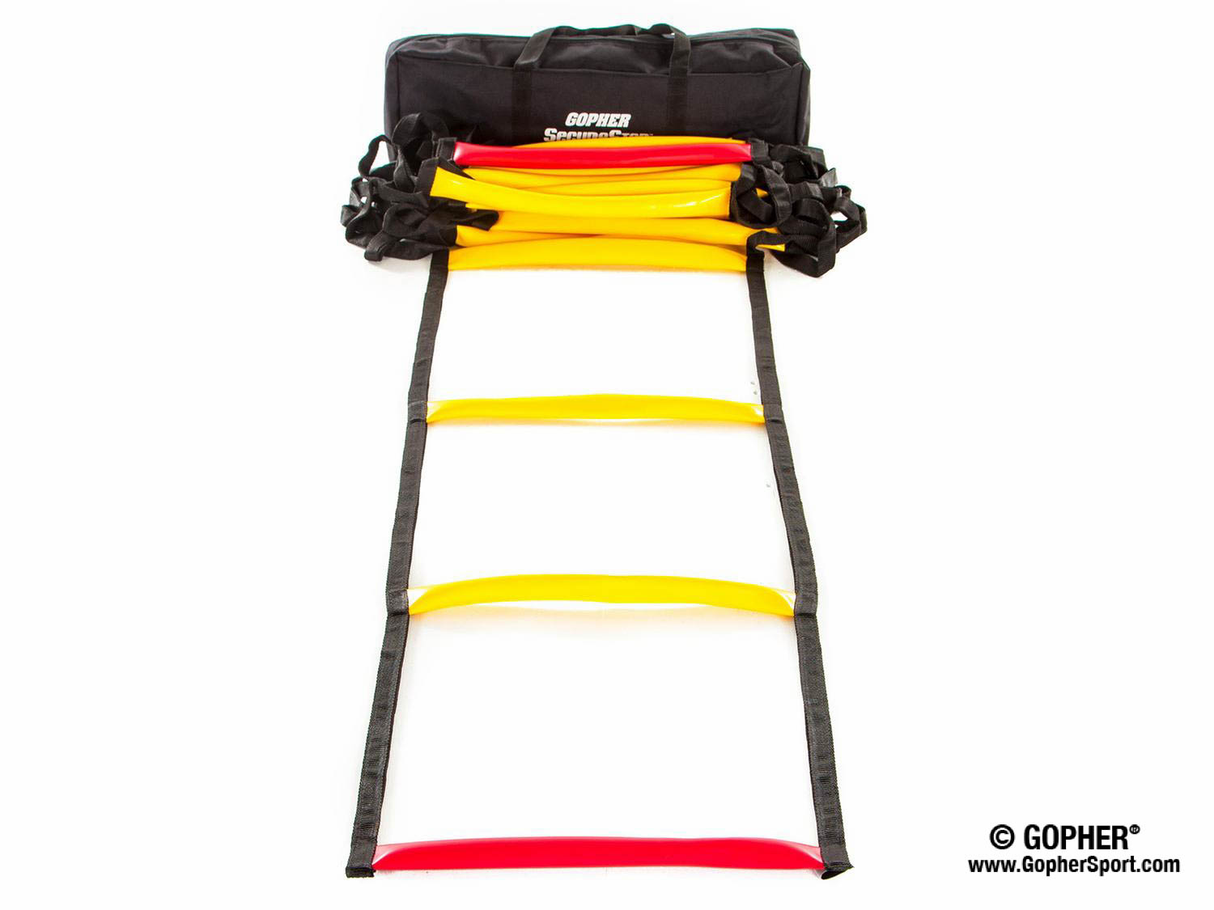
Ladders Used 1 (Click on Pics to go to Website)
Screamin Orange Agility Ladder
Inexpensive
Great for beginners
Fast Trak Agility Ladder
Safe flat design
Never gets tangled
SecureStep Agility Ladder
Ruberized treads will not slip on floor
Extremely durable

Slide 3
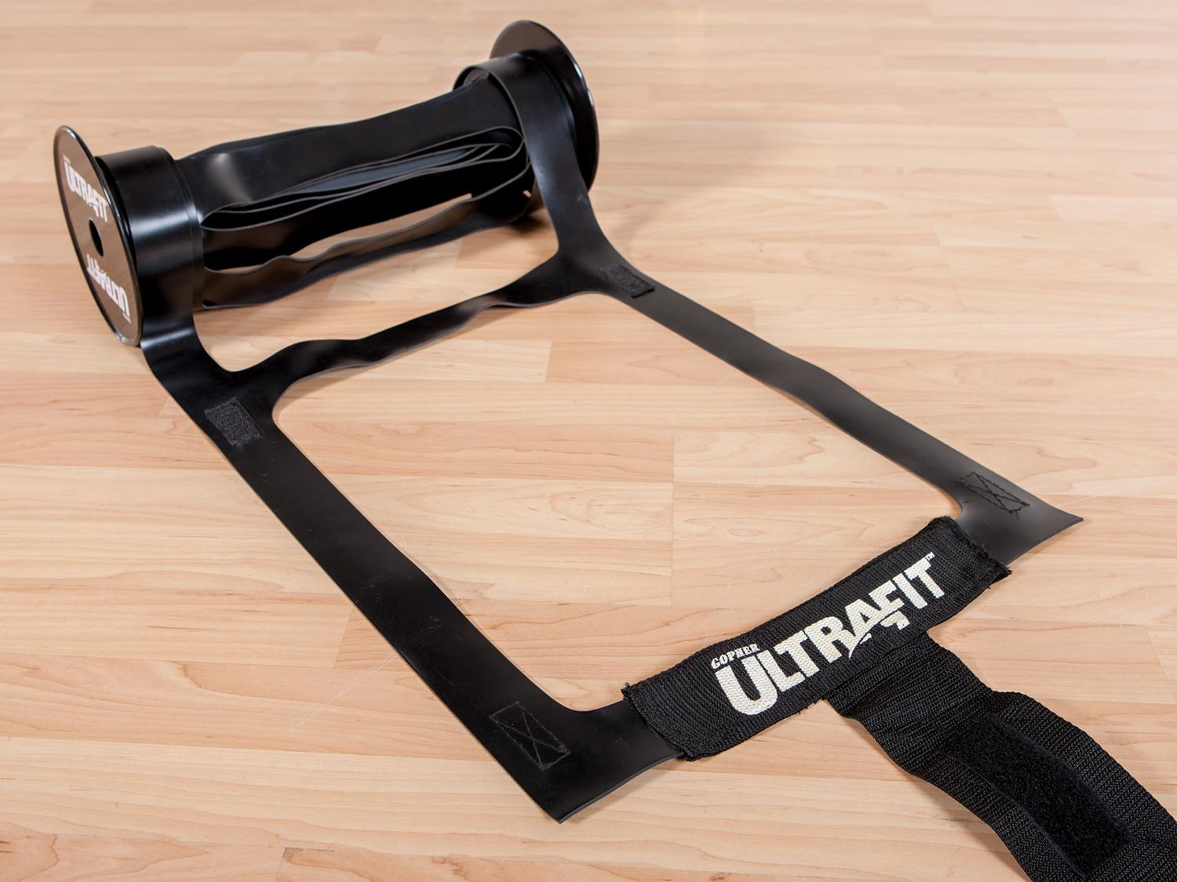
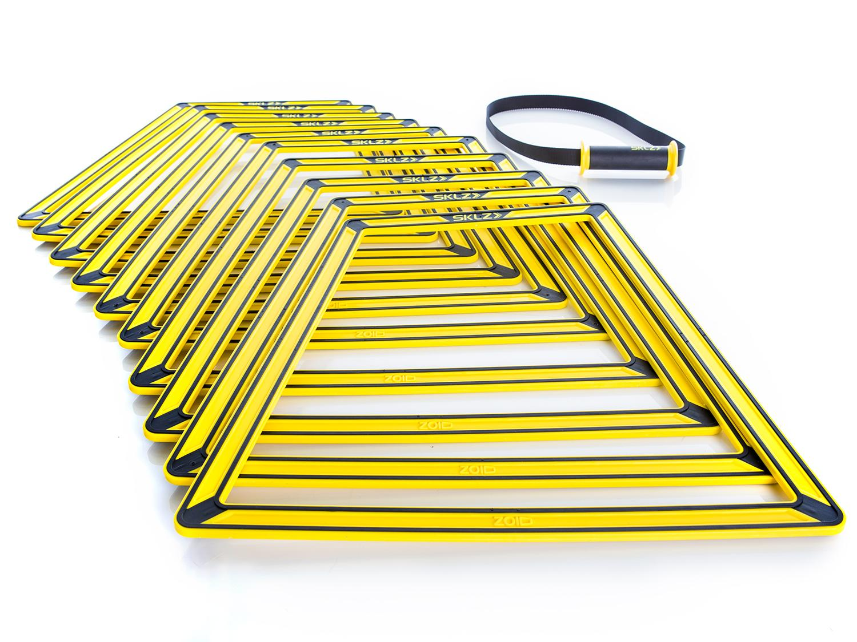
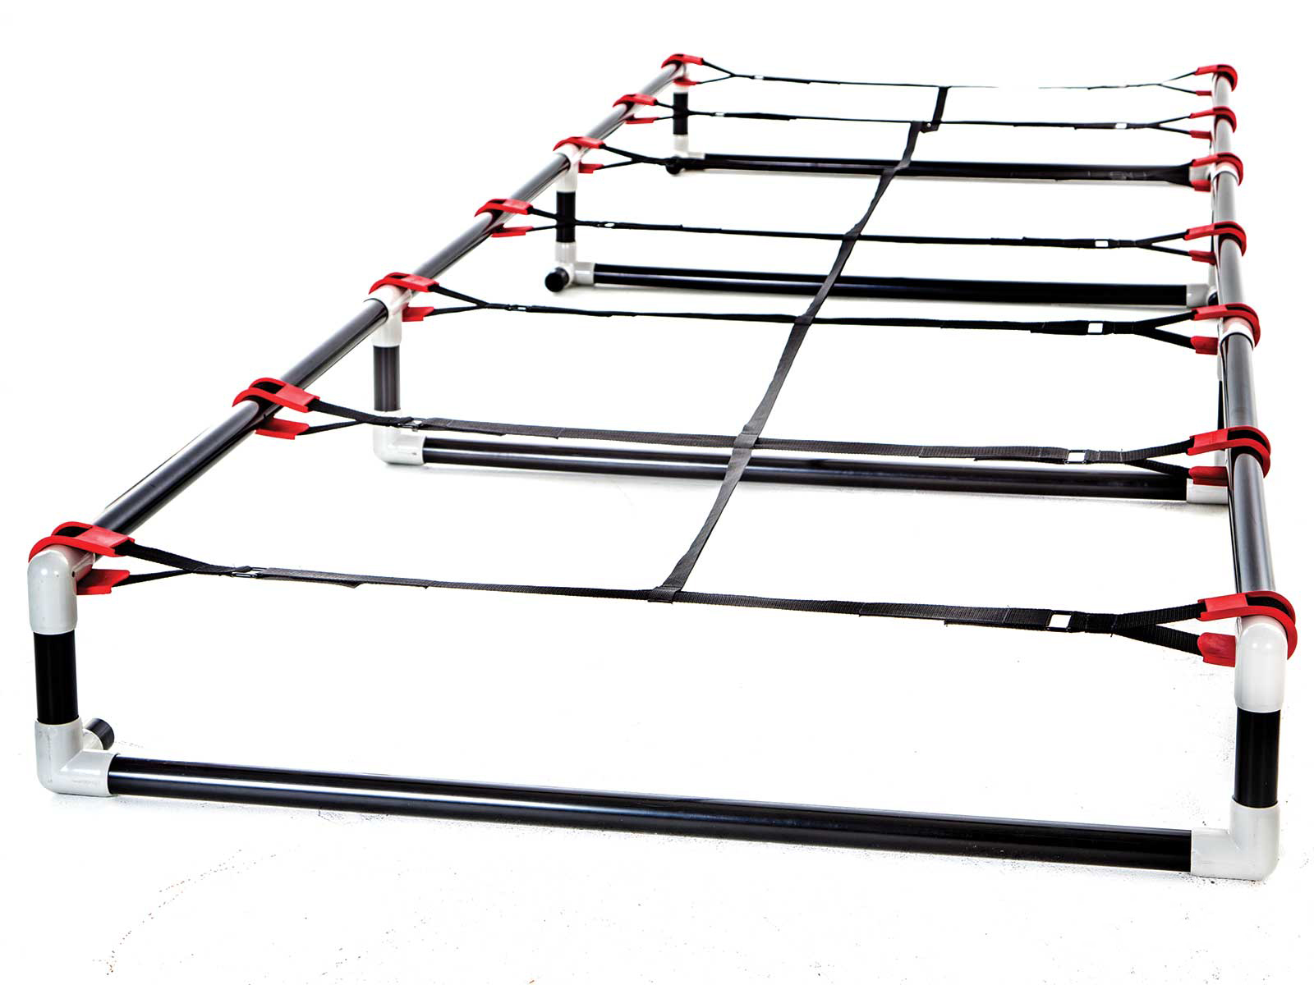
Ladders Used 2 (Click on Pics to go to Website)
Ultra Fit Roll Out Ladder
Adheres to floor well
Easy to roll out and store
Sklz Agility Trainer Pro
Easily create different ladder patterns
Can also add a hurdle in the middle of the ladder
High Rise Agility Ladder
More challenging with 6`` or 9`` rise
Very durable

Slide 4
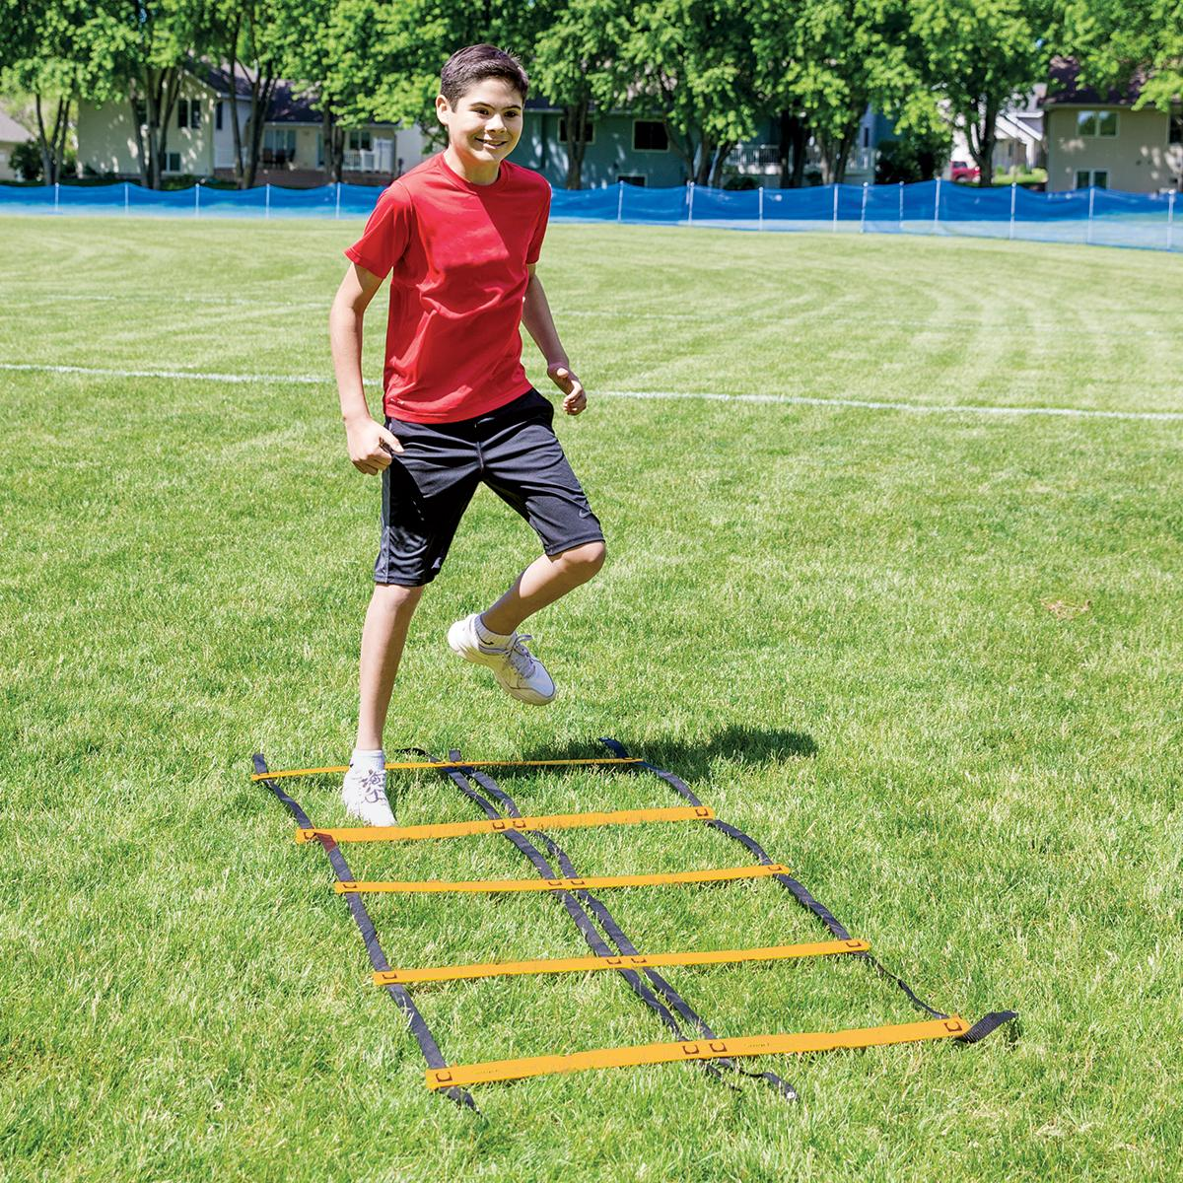
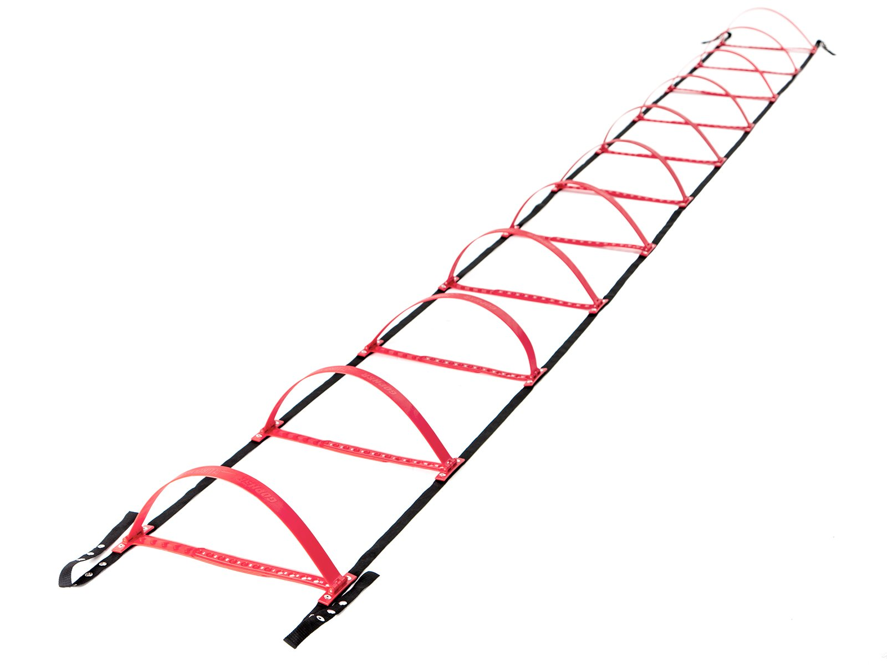
Ladders Used 3 (Click on Pics to go to Website)
Smart Modular Agility Ladder
Easily create side-by-side ladders
Gopher HurdLadder Agility Ladder
Easily adjusts to various heights

Slide 5
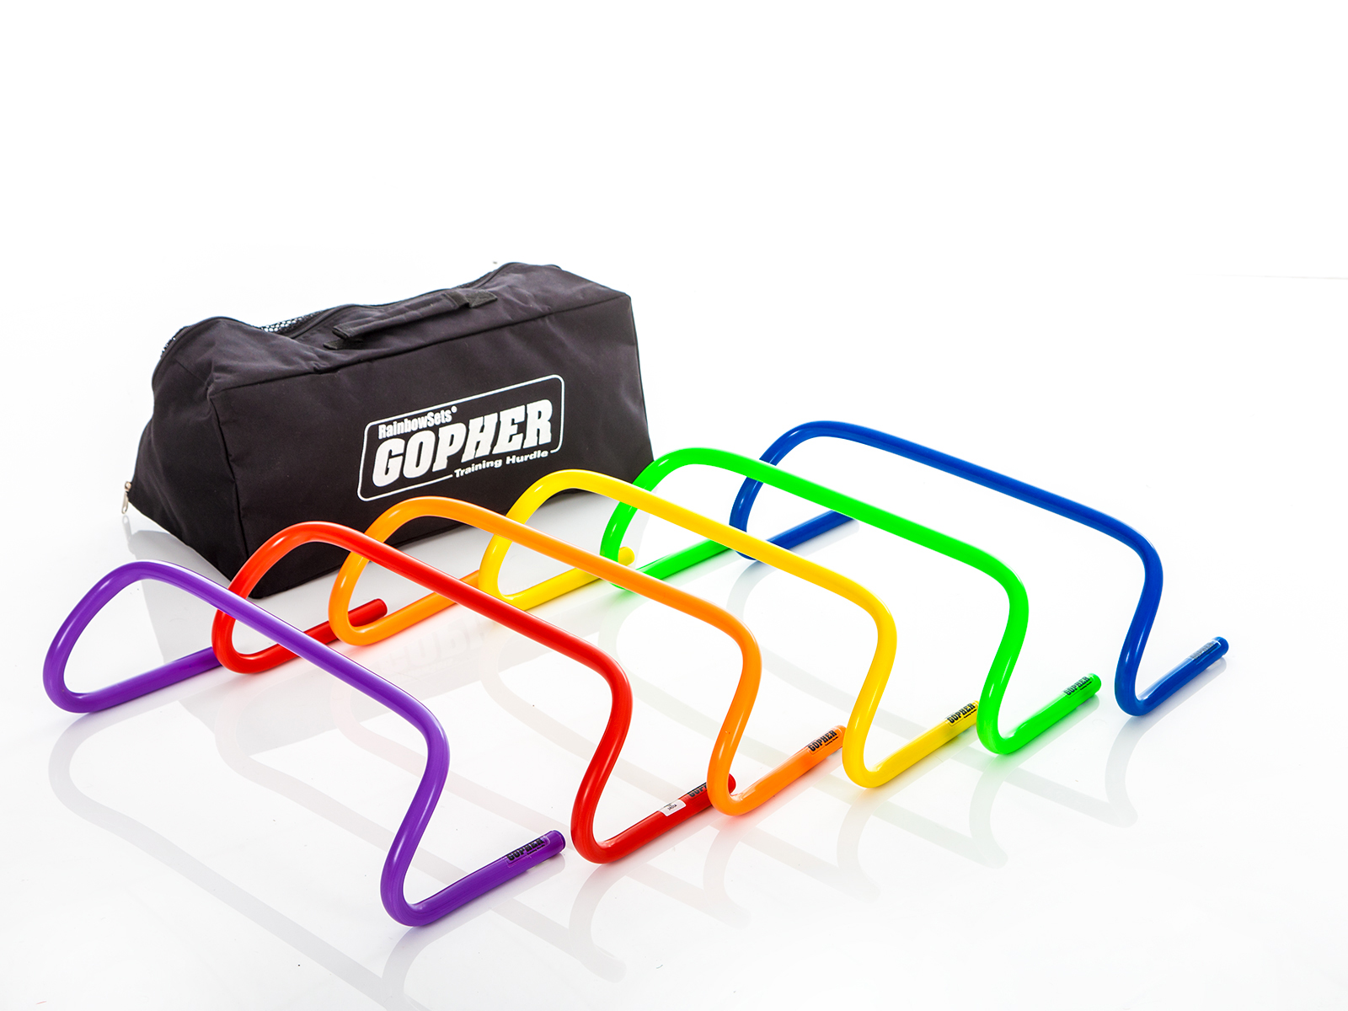
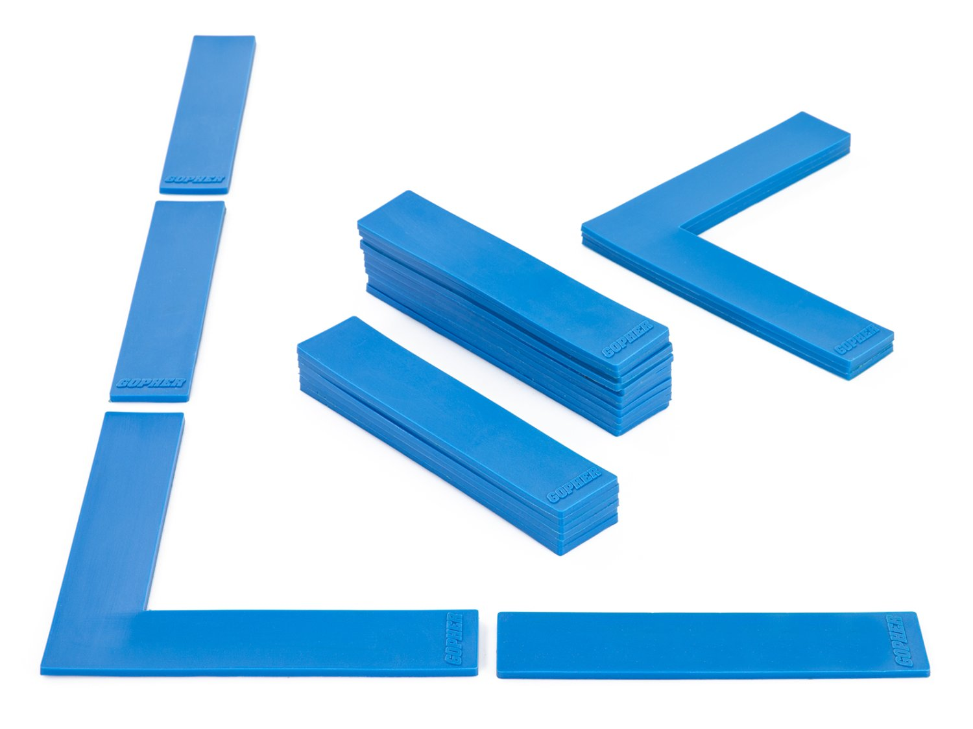
Ladders Used 4 (Click on Pics to go to Website)
Ultrafit Training Hurdles
Come in 4 different heights 6`` to 16``
Boundary Markers
Secure on the floor
Moving one tread will not impact other treads

Slide 6
Other Equipment
Weighted balls
https://www.gophersport.com/search-unbxd?q=weighted%20balls
Slam balls
https://www.gophersport.com/fitness/medicine-balls?tag=slam
Foam balls
https://www.gophersport.com/search-unbxd?q=Foam%20Balls
Basketballs
https://www.gophersport.com/sports/basketball?tag=balls
Beanbags
https://www.gophersport.com/pe/beanbags?tg=1
Paddles
https://www.gophersport.com/search-unbxd?q=Racquets%20%26%20Paddles

Slide 7
Definitions
Running
Quicker than a walk so that both feet are not on the ground at the same time.
Jumping
Pushing oneself off a surface with both feet.
Hoping
Pushing oneself off a surface balanced from one foot.

Slide 8
Ladder Activities With Equipment
Adding any weighted balls to have participants use and develop more strength and power…
Insert balls and racquets and further develop physical literacy skills.

Slide 9
Squat 180 Squat 180 https://www.canadago4sport.com/Ladders/Squat-180

Slide 10
High Knee Carrying Weighted Ball https://www.canadago4sport.com/Ladders/High-Knee%3A-Every-Rung

Slide 11
Jump Every Other Rung with Weighted Ball https://www.canadago4sport.com/Ladders/Two-Foot-Jump%E2%80%94Every-Other-Rung

Slide 12
Explosive Jumps with Weighted Ball https://www.canadago4sport.com/Ladders/Explosive-jumps

Slide 13
In Slam Ball Out https://www.canadago4sport.com/Ladders/Ladder-In-Slamball-Out

Slide 14
Ladder Ball Bounce Each Rung https://www.canadago4sport.com/Ladders/Ladder-Ball-Bounce-Each-Rung

Slide 15
Crossover Sideways Run With Ball https://www.canadago4sport.com/Ladders/Every-Other-Rung-Sideways-Run

Slide 16
In In Out Out With Ball Toss https://www.canadago4sport.com/Ladders/Ladder-In-and-Out-Run-While-Throwing-a-Ball

Slide 17
Jump Every Rung While Bouncing a Ball https://www.canadago4sport.com/Ladders/Jump-Every-Rung-While-Bouncing-Ball

Slide 18
Human Ladder Jump with Push Ups https://www.canadago4sport.com/Ladders/Human-Ladder-Jump-With-Push-Ups

Slide 19
In In Out Out While Dribbling Ball with Racquet https://www.canadago4sport.com/Ladders/Ladder-In-In-Out-Out-While-Dribbling-Ball-With-Racquet

Slide 20
In Out Racquet Rally https://www.canadago4sport.com/Ladders/Ladder-In-In-Out-Out-Racquet-Rally

Slide 21
Lunges with Badminton https://www.canadago4sport.com/Ladders/Lunges-with-badminton-bird

Slide 22
Ladder Games
A pair of games using two different types of ladders.
More ideas

Slide 23
Rock Paper Scissors Ladder Football Need to add to website still

Slide 24
Snowflake https://www.canadago4sport.com/Locomotor/Snowflake

Slide 25
Web Resources
Canadago4sport:
600+ game docs and 250+ game videos
www.canadago4sport.com
Nearly 50 different ladder activities
https://www.canadago4sport.com/agility-ladders
Gopher Sport:
Order from over 12 different ladders
https://www.gophersport.com/fitness/saq?tag=agility
Order from hundreds of equipment ideas.
https://www.gophersport.com/
Unconditional 100% satisfaction guarantee
Your satisfaction is our #1 concern! If you are not satisfied with any product you buy from us, we'll simply replace it or refund your money. No questions. No hassles. No exclusions. No kidding!

Slide 26
Pinterest and YouTube
Pinterest:
23 boards, and 600+ pins
Follow at https://www.pinterest.ca/canadago4sport/
YouTube:
330+ videos
Subscribe at https://www.youtube.com/c/canadago4sport/

Slide 27
Social Media and Further Questions
Twitter & Instagram:
Tuesday (sometimes other days) posts
Follow at @canadago4sport
Love to hear from you:
JOHNBYL50@gmail.com

Slide 28
With thanks
To all of the wonderful people
who inspire each other
at conferences and other places!
To Gopher Sport
for their innovative products
and high quality equipment!

Slide 29
Download slides at:
https://www.canadago4sport.com/conferences-and-workshops

