Slide 1
Innovative Agility Ladder Fitness Challenges With Feet Only
Dr. John Byl
JOHNBYL50@gmail.com
While we wait, sign up for weekly activity postings on:
Twitter or Instagram
@canadago4sport

Slide 2
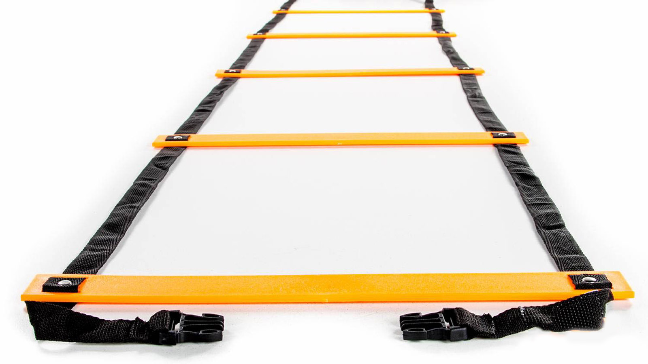
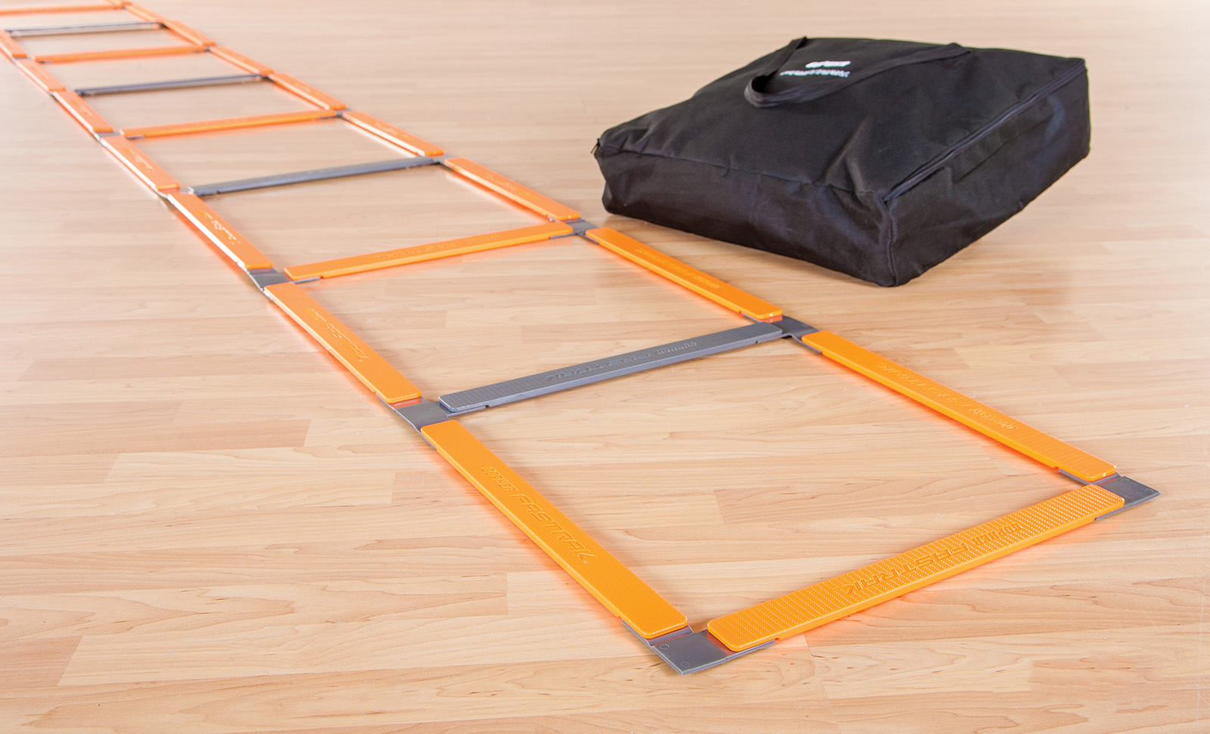
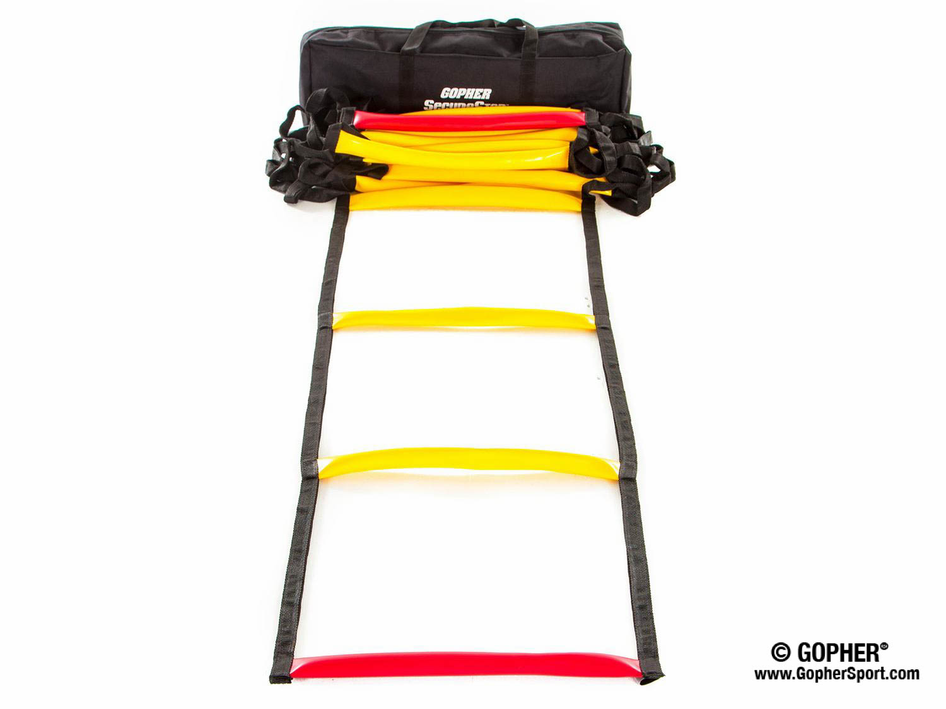
Ladders Used 1 (Click on Pics to go to Website)
Screamin Orange Agility Ladder
Inexpensive
Great for beginners
Fast Trak Agility Ladder
Safe flat design
Never gets tangled
SecureStep Agility Ladder
Ruberized treads will not slip on floor
Extremely durable

Slide 3
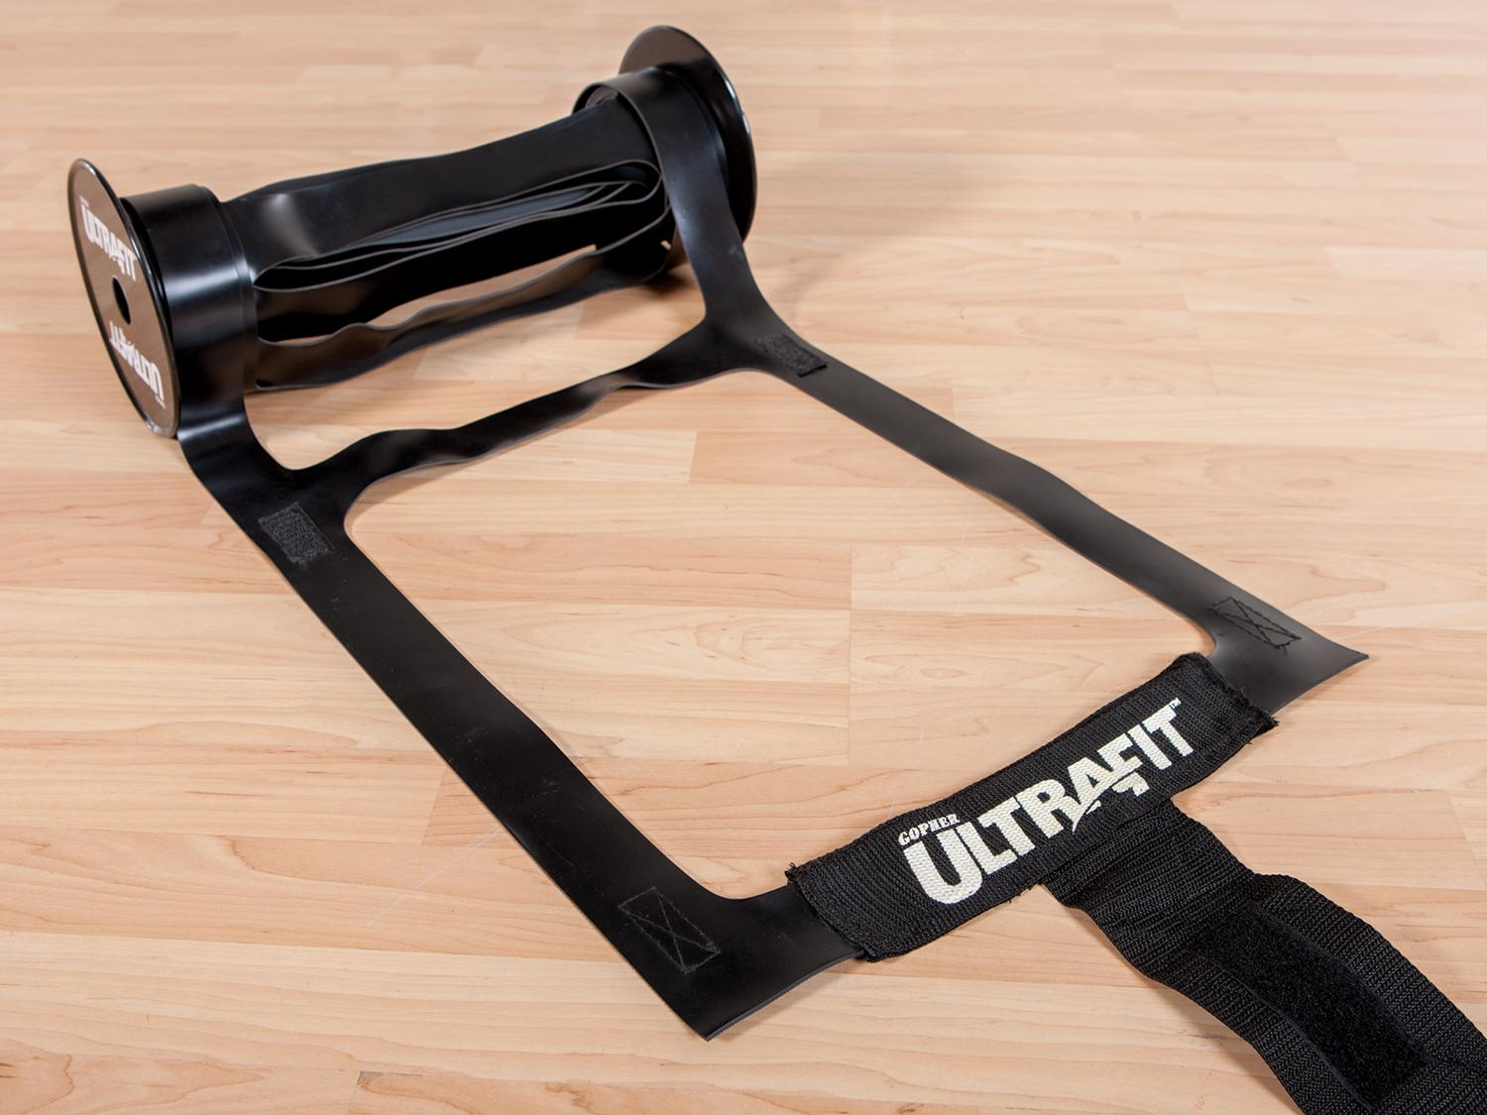
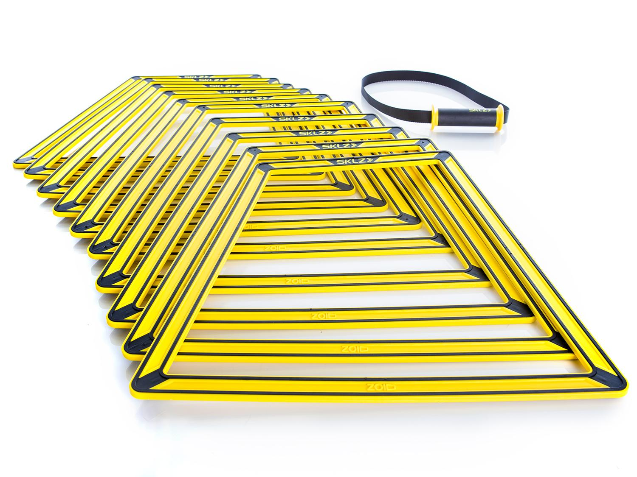
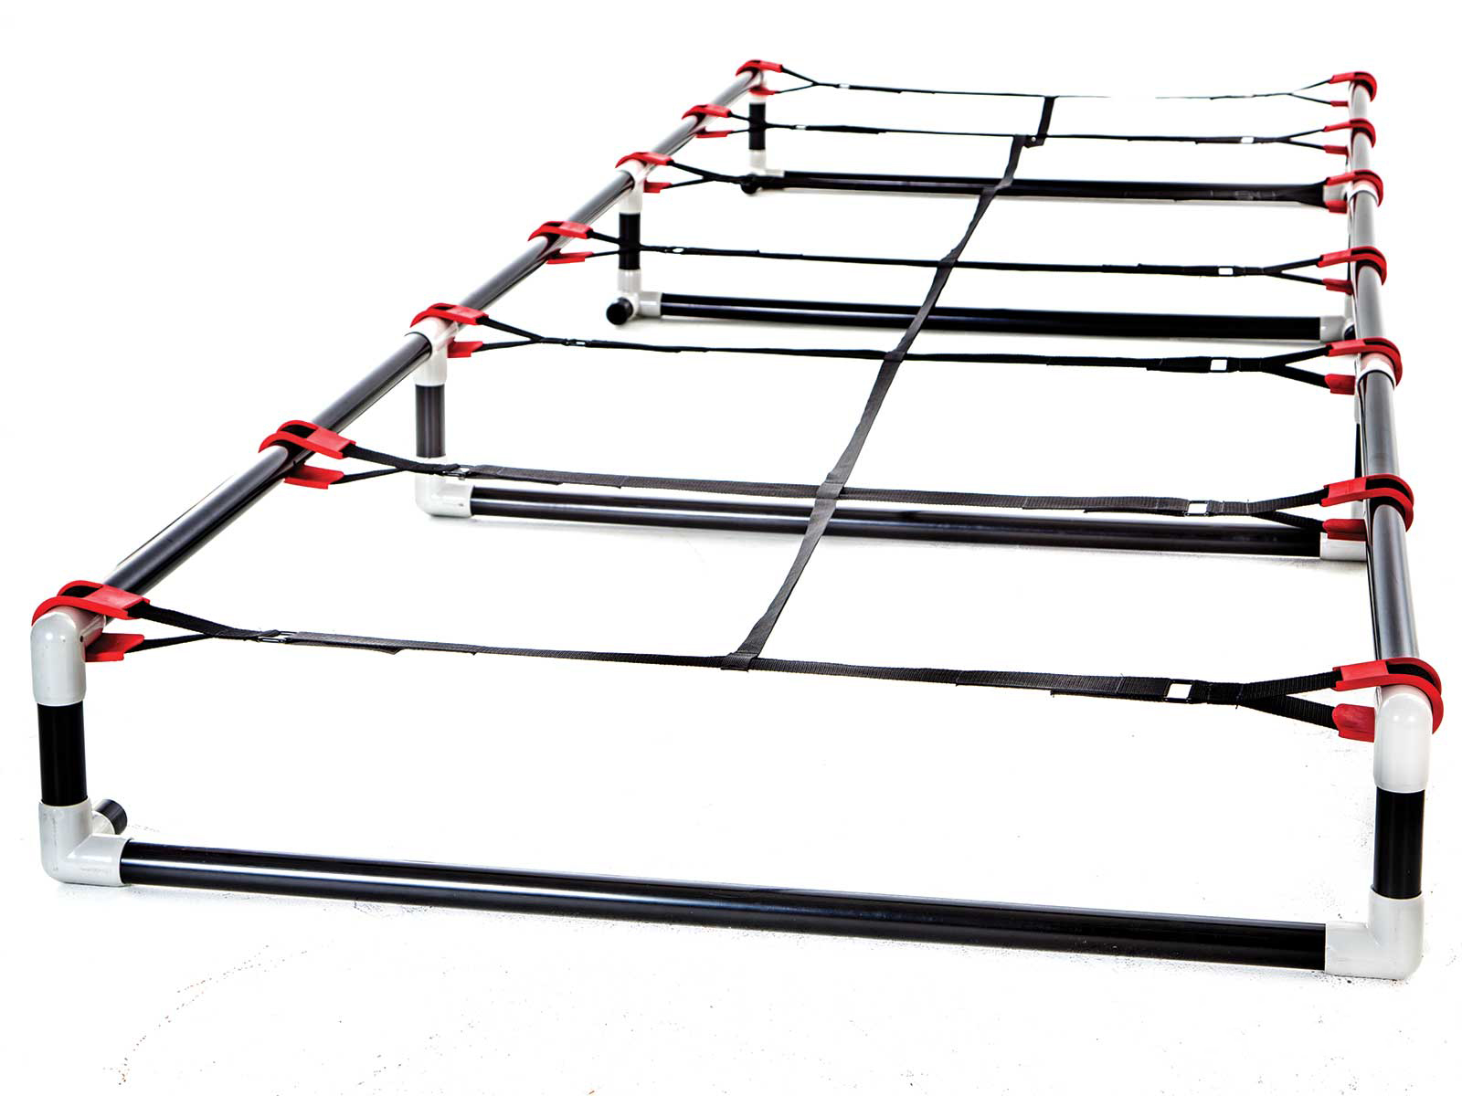
Ladders Used 2 (Click on Pics to go to Website)
Ultra Fit Roll Out Ladder
Adheres to floor well
Easy to roll out and store
Sklz Agility Trainer Pro
Easily create different ladder patterns
Can also add a hurdle in the middle of the ladder
High Rise Agility Ladder
More challenging with 6`` or 9`` rise
Very durable

Slide 4
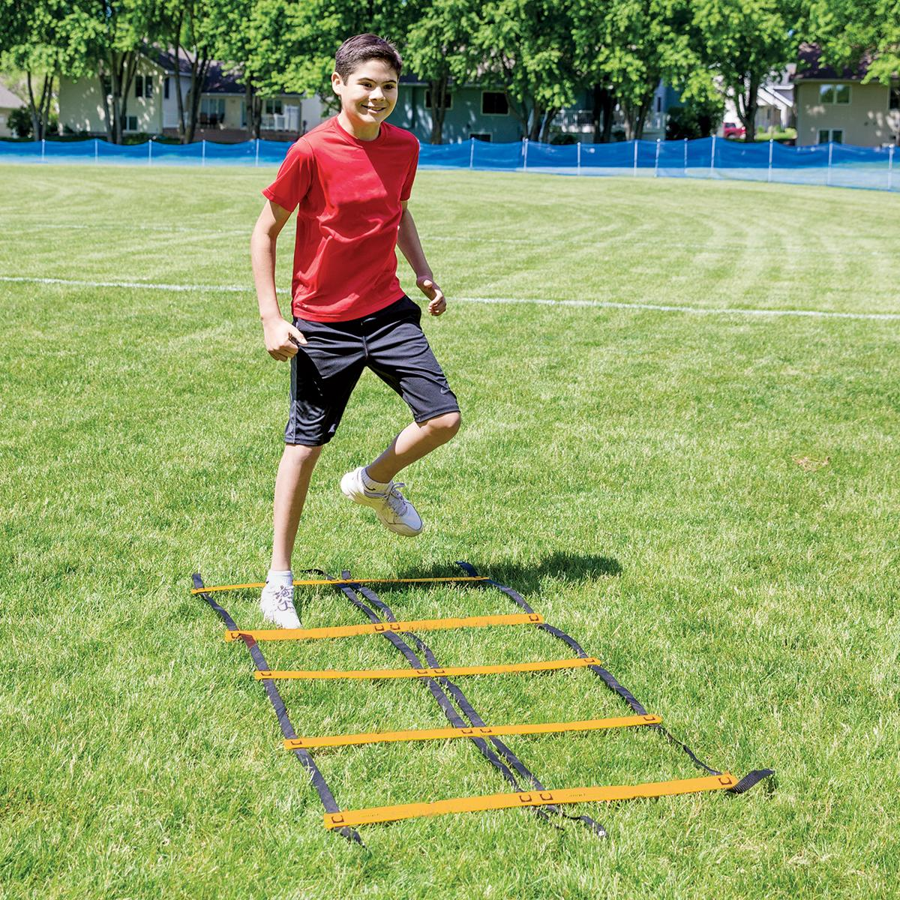
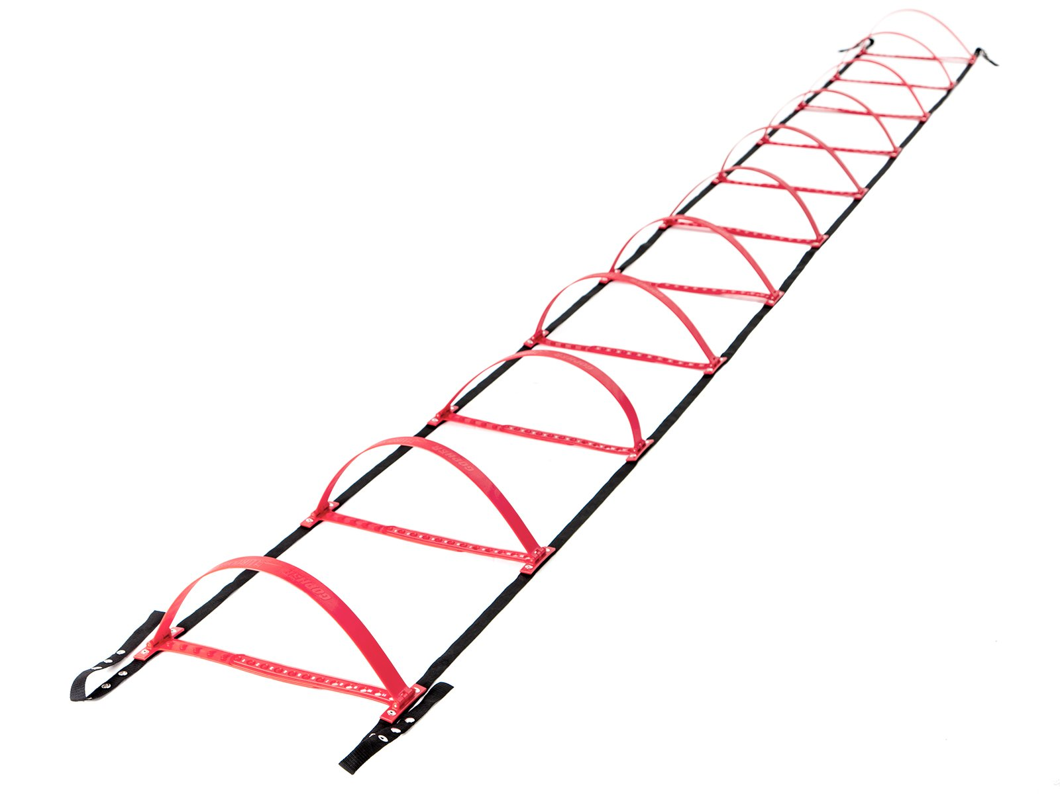
Ladders Used 3 (Click on Pics to go to Website)
Smart Modular Agility Ladder
Easily create side-by-side ladders
Gopher HurdLadder Agility Ladder
Easily adjusts to various heights

Slide 5
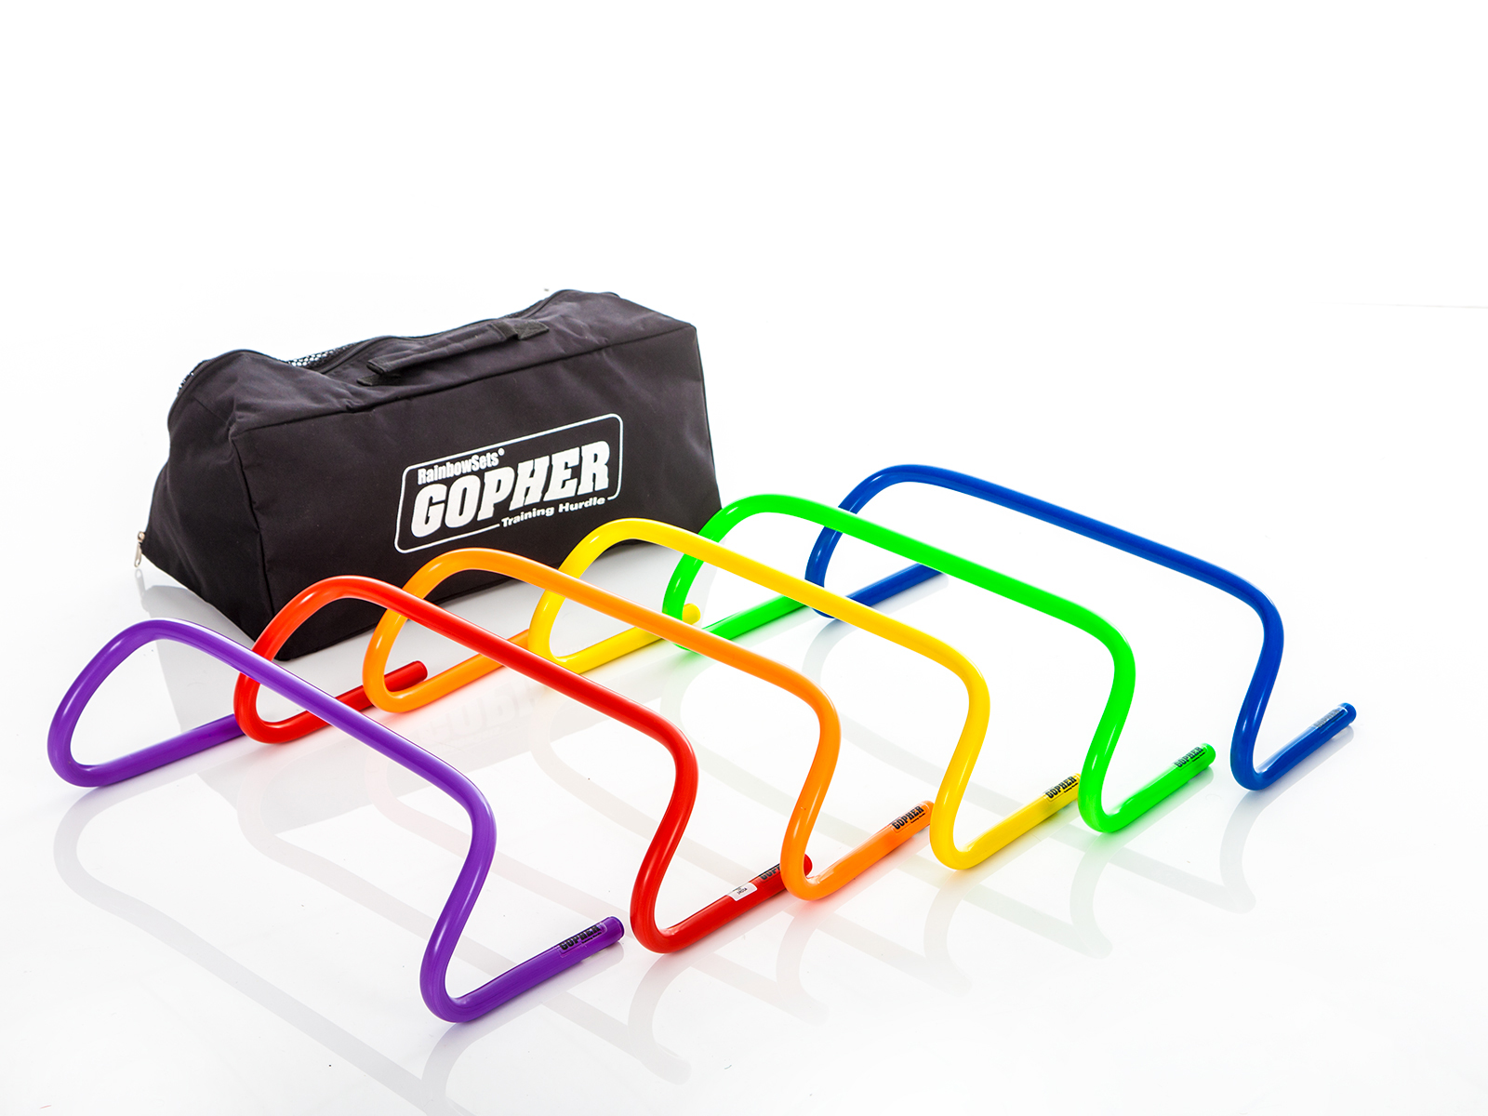
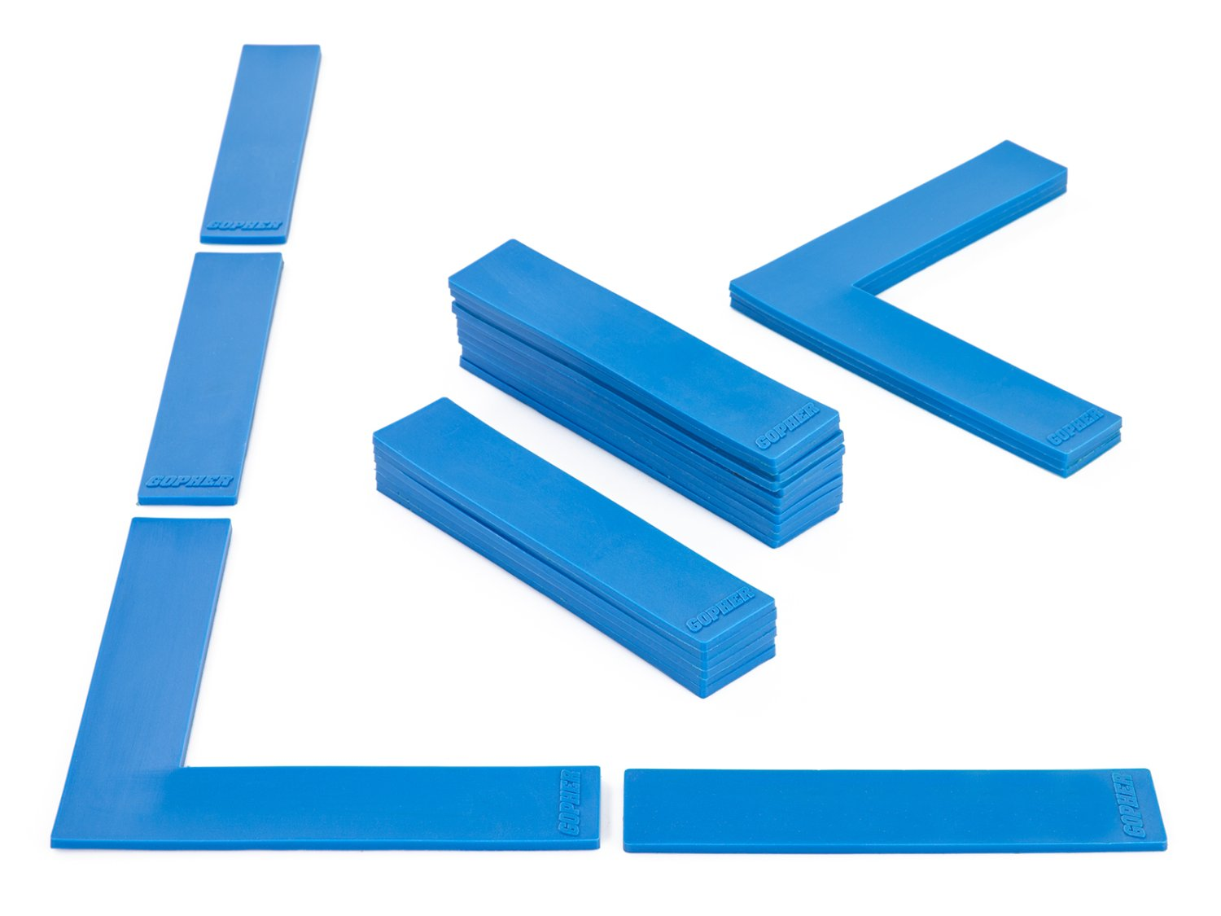
Ladders Used 4 (Click on Pics to go to Website)
Ultrafit Training Hurdles
Come in 4 different heights 6`` to 16``
Boundary Markers
Secure on the floor
Moving one tread will not impact other treads

Slide 6
Definitions
Running
Quicker than a walk so that both feet are not on the ground at the same time.
Jumping
Pushing oneself off a surface with both feet.
Hoping
Pushing oneself off a surface balanced from one foot.

Slide 7
On Your Feet Ladder Activities
Each of these activities has participants running, jumping, and hoping through the various ladders.
For almost all ladder activities in this slideshow leaders and participants can also use chalk to outline the ladders.

Slide 8
Hop Scotch Need to add still
Need video still

Slide 9
Every Other Rung Run https://www.canadago4sport.com/Ladders/Every-Other-Rung-Run

Slide 10
Every Rung Run https://www.canadago4sport.com/Ladders/Every-Rung-Run

Slide 11
High Knee Every Other Rung https://www.canadago4sport.com/Ladders/High-knee%E2%80%94Every-Other-Rung

Slide 12
Tap In https://www.canadago4sport.com/Ladders/Tap-In

Slide 13
Three Jumps and Three Runs… https://www.canadago4sport.com/Ladders/Three-Jumps-and-Three-Runs

Slide 14
Jump Every Rung https://www.canadago4sport.com/Ladders/Two-Foot-Jump%E2%80%94Every-Rung

Slide 15
High Vertical Jumps https://www.canadago4sport.com/Ladders/High-Vertical-Jumps

Slide 16
Jump Forward In and Hop Out https://www.canadago4sport.com/Ladders/Jump-Forward-and-In%2C-Hop-Out

Slide 17
Jump In In Straddle Out https://www.canadago4sport.com/Ladders/Ladder-Jump-In-In-Out-In-In

Slide 18
In and Out Jumps https://www.canadago4sport.com/Ladders/In-Then-Out-Jumps

Slide 19
180s https://www.canadago4sport.com/Ladders/180s

Slide 20
Hops https://www.canadago4sport.com/Ladders/Hops-

Slide 21
Hop In and Out https://www.canadago4sport.com/Ladders/Hop-In-Out

Slide 22
Every Rung Sideways Run https://www.canadago4sport.com/Ladders/Every-Rung-Sideways-Run

Slide 23
Sideways Crossover Run https://www.canadago4sport.com/Ladders/Every-Rung-Sideways-Crossover-Run

Slide 24
In and Out Sideways Run https://www.canadago4sport.com/Ladders/Alternate-In-and-Out-Sideways-Run

Slide 25
In In Out Out Each Rung https://www.canadago4sport.com/Ladders/In-and-Out-Every-Rung

Slide 26
In In Out Out Through Each Rung https://www.canadago4sport.com/Ladders/In-and-Out-Run

Slide 27
Jump In In Out https://www.canadago4sport.com/Ladders/In-In-Out

Slide 28
Jump In In Out Out In In https://www.canadago4sport.com/Ladders/In-In-Out-Out
New video needed

Slide 29
In In Out Jumps

Slide 30
In with High Ten and Out https://www.canadago4sport.com/Ladders/In-Outs

Slide 31
Downhill Skiing https://www.canadago4sport.com/Ladders/Downhill-Skiing

Slide 32
Slalom Skiing https://www.canadago4sport.com/Ladders/Slalom-Skiing

Slide 33
Boxing Shuffle https://www.canadago4sport.com/Ladders/Boxing-Shuffle

Slide 34
Web Resources
Canadago4sport:
600+ game docs and 250+ game videos
www.canadago4sport.com
Nearly 50 different ladder activities
https://www.canadago4sport.com/agility-ladders
Gopher Sport:
Order from over 12 different ladders
https://www.gophersport.com/fitness/saq?tag=agility
Order from hundreds of equipment ideas.
https://www.gophersport.com/
Unconditional 100% satisfaction guarantee
Your satisfaction is our #1 concern! If you are not satisfied with any product you buy from us, we'll simply replace it or refund your money. No questions. No hassles. No exclusions. No kidding!

Slide 35
Pinterest and YouTube
Pinterest:
23 boards, and 600+ pins
Follow at https://www.pinterest.ca/canadago4sport/
YouTube:
330+ videos
Subscribe at https://www.youtube.com/c/canadago4sport/

Slide 36
Social Media and Further Questions
Twitter & Instagram:
Tuesday (sometimes other days) posts
Follow at @canadago4sport
Love to hear from you:
JOHNBYL50@gmail.com

Slide 37
With thanks
To all of the wonderful people
who inspire each other
at conferences and other places!
To Gopher Sport
for their innovative products
and high quality equipment!

Slide 38
Download slides at:
https://www.canadago4sport.com/conferences-and-workshops

