Slide 1
Innovative Toppletubes (Or Plastic Cups): Physical, Numeric, and Language Literacy
Dr. John Byl
JOHNBYL50@gmail.com
While we wait, sign up for weekly activity postings on:
Twitter or Instagram
@canadago4sport

Slide 2
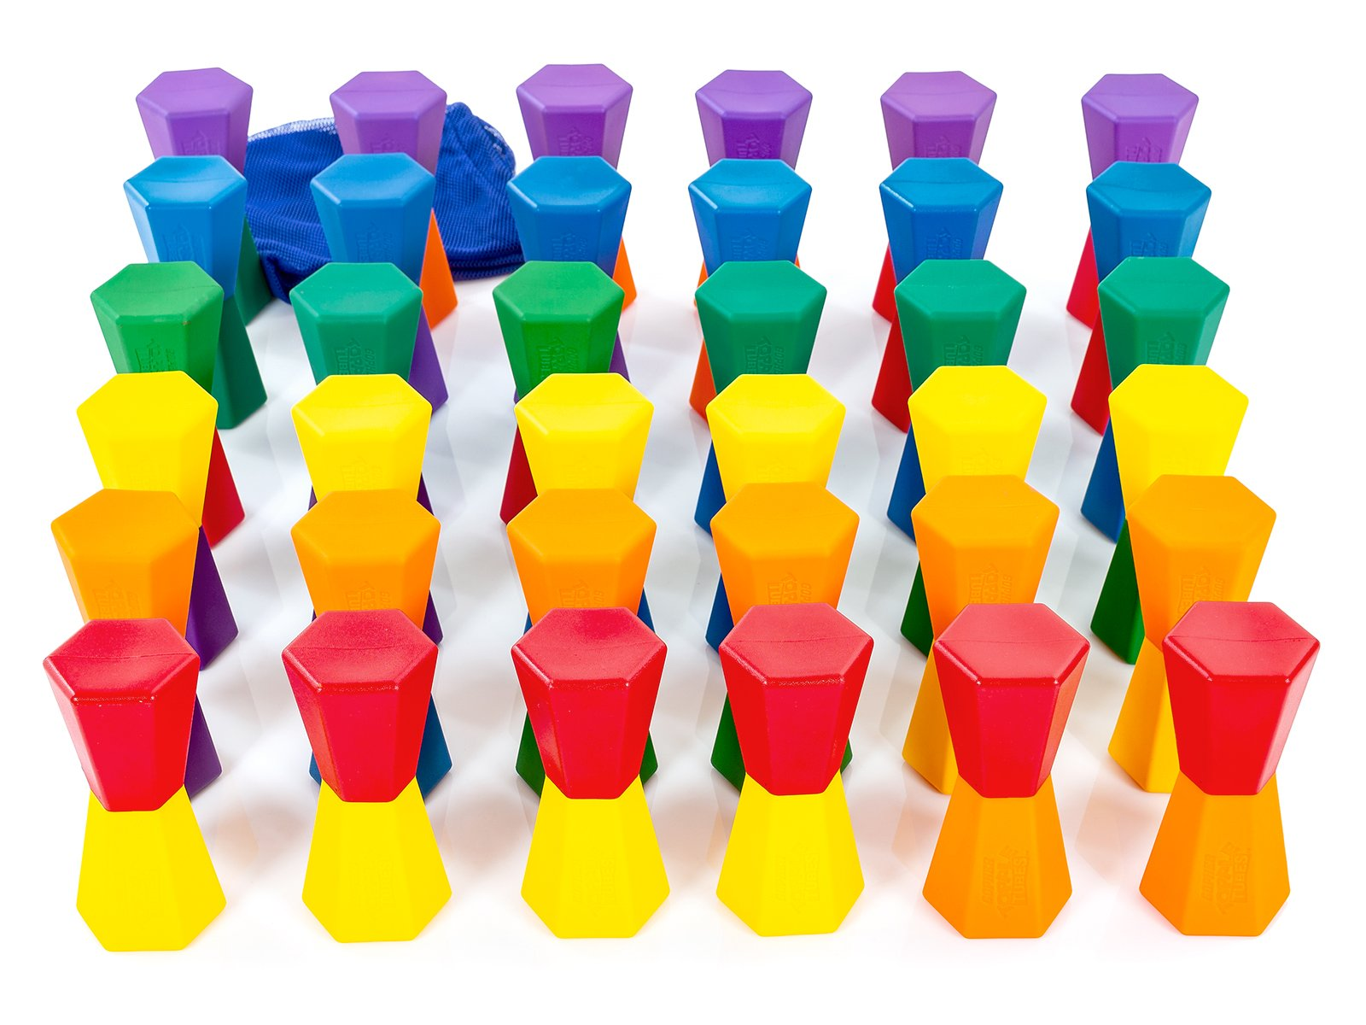
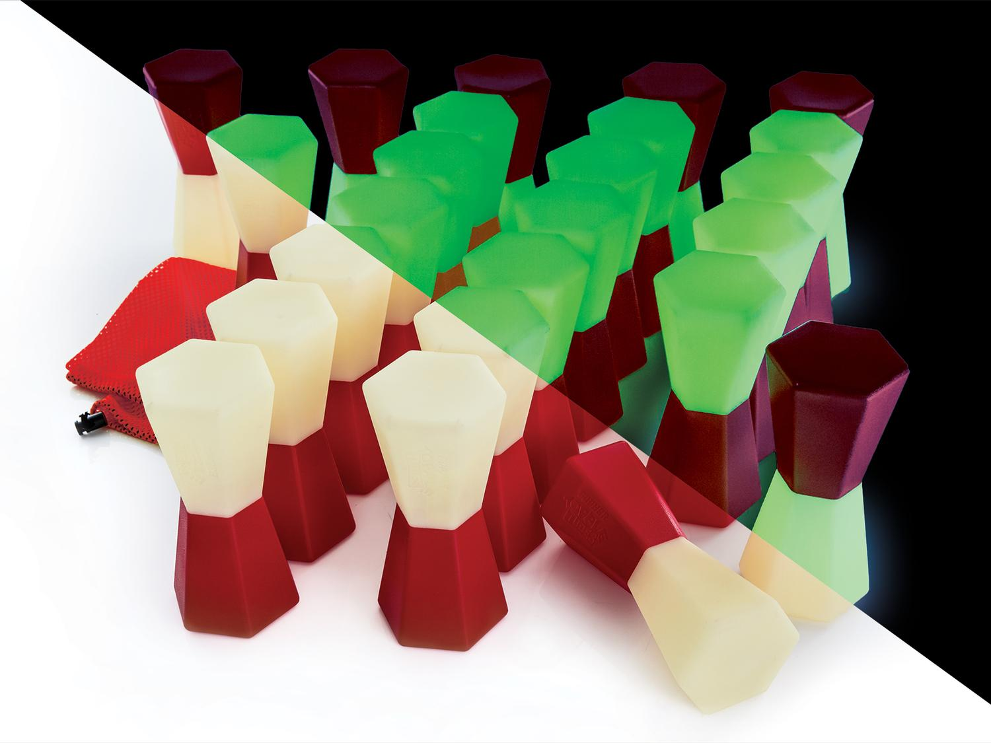
Toppletubes https://www.gophersport.com/search-unbxd?q=toppletubes

Slide 3
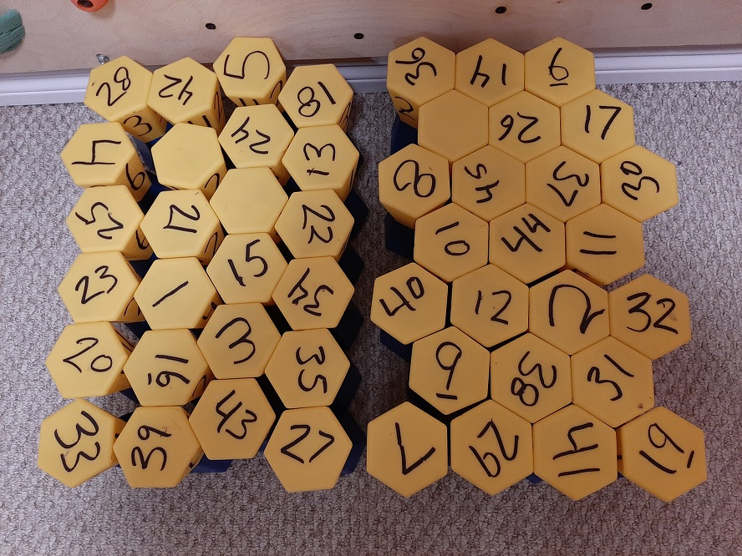
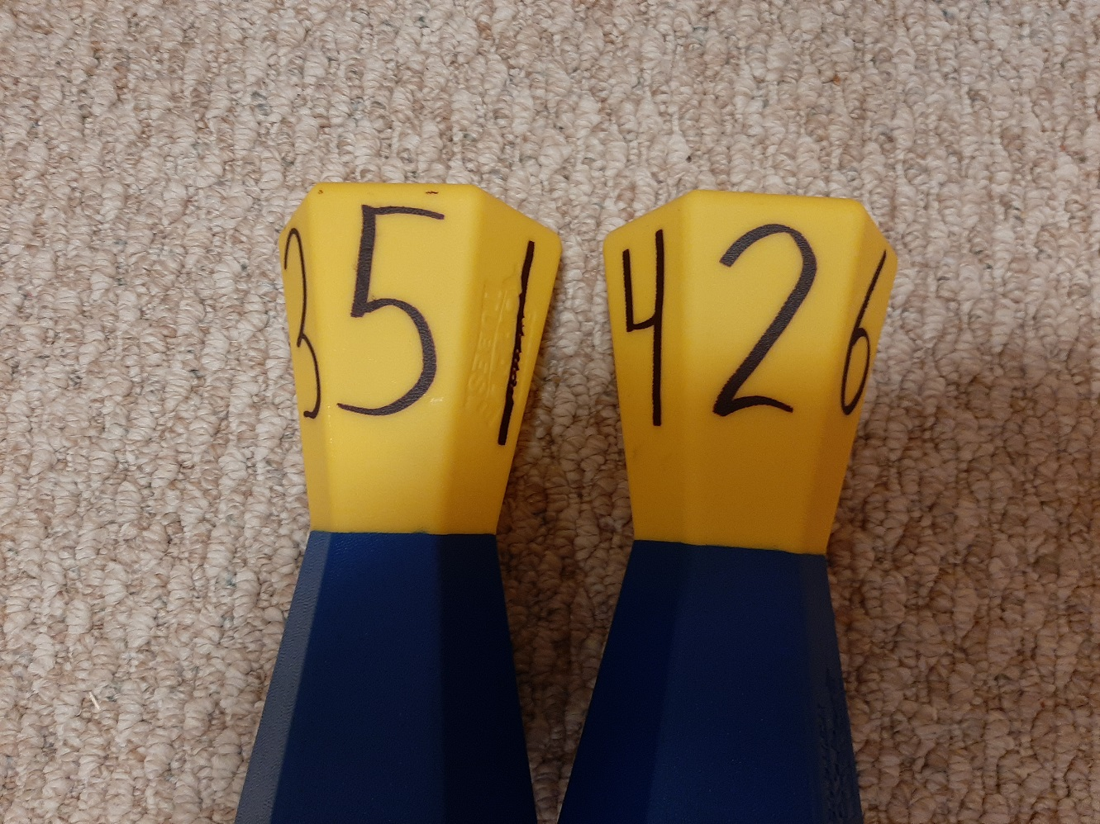
Numbering
Number all 48 on the yellow side with a black marker, with numbers 1-48
I mark about 10 of them with the numbers 1-6 around the edges
I put the number 1 on the side with the Gopher imprint (because any other number does not work well over that imprint), then a 6 on the opposite side
Then a 4 beside the 1 and a 3 on the opposite side of 4
Then a 5 on the other side of 1 with a 2 on the opposite side of 5

Slide 4
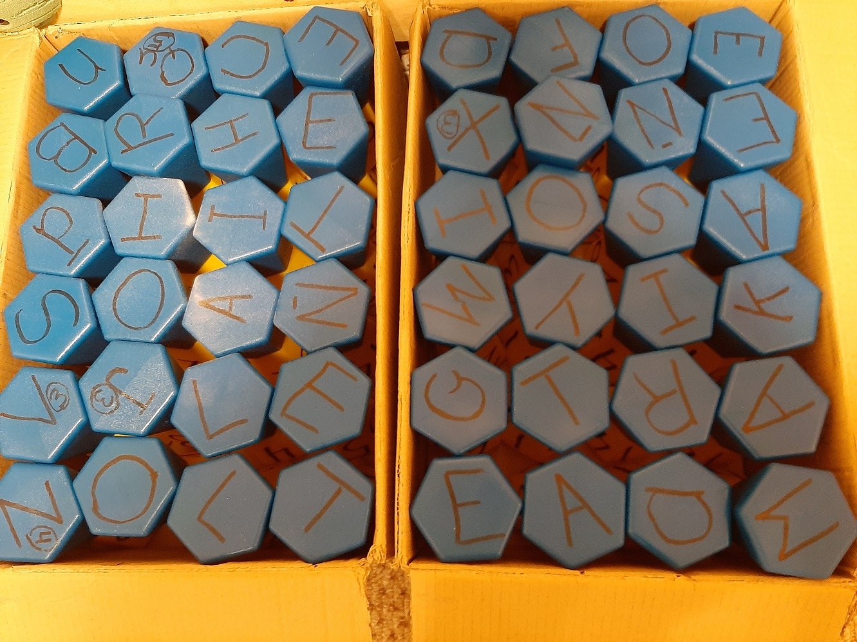
Lettering Two sets of ToppleTubes (48) lettered as following on the blue end of the ToppleTubes--number before the letter indicates how many ToppleTubes should have that number, and all letters are worth one (1) point unless otherwise noted:
4 x A 1 X B 1 C 2 D 6 E 1 F 1 G 1 H 4 I 1 J 3 points 1 K 2 L
1 M 3 N 4 O 1 P 1 Qu 5 points 2 R 2 S 3 T 1 U 1 V 3 points 1 W 1 X 3 points 1 Y 2 Z 4 points

Slide 5
Locomotor

Slide 6
Your Colour Up https://www.canadago4sport.com/Leadership/Your-Colour-Up

Slide 7
Your Colour Up with Feet https://www.canadago4sport.com/Leadership/Your-Colour-Up-With-Feet

Slide 8
Topple Three Up https://www.canadago4sport.com/Locomotor/Topple-Three-Up

Slide 9
Topple Four Up Dribble https://www.canadago4sport.com/Numeracy/Topple-Four-Up

Slide 10
Target Games

Slide 11
Seven Degree (use ToppleTubes instead of foam pins or water bottles) https://www.canadago4sport.com/Target1/Seven-Degree

Slide 12
Target Under Net https://www.canadago4sport.com/Target1/Mission-Target-Under-Net

Slide 13
Target Over Net https://www.canadago4sport.com/Target1/Mission-Target-Over-Net

Slide 14
Invasion Games

Slide 15
No Goalie Soccer (Use ToppleTubes instead of StrykN pins) https://www.canadago4sport.com/invasion1-1/No-Goalie-Indoor-Soccer
Sorry no video yet.

Slide 16
Pinned Down Team Handball (Use ToppleTubes instead of StrykN pins) https://www.canadago4sport.com/invasion1-1/Pinned-Down-Team-Handball
Sorry no video yet

Slide 17
Twin Ball StrykN https://www.canadago4sport.com/invasion1-1/Twin-Ball-Stryke
Sorry no video yet

Slide 18
Thin Pin Guard https://www.canadago4sport.com/Target1/Team-Thin-Pin-Guard

Slide 19
Safe or Dare Thin Pin Guard https://www.canadago4sport.com/invasion1/Safe-or-Dare-Thin-Pin-Guard

Slide 20
Strike/Field

Slide 21
Cricket Foam Ball (use 6 ToppleTubes instead of wickets) https://www.canadago4sport.com/strike/Cricket-Foamball

Slide 22
Kickit Cricket (use 6 ToppleTubes instead of wickets) https://www.canadago4sport.com/strike/Cricket-Kickit

Slide 23
Locomotor Tic Tac Toe

Slide 24
Topple Tic Tac https://www.canadago4sport.com/Numeracy/Topple-Tic-Tac

Slide 25
Topple Double Tic Tac https://www.canadago4sport.com/Numeracy/Topple-Double-Tic-Tac

Slide 26
Tic Tac Toe No Grid Instructions (Use ToppleTubes instead of Rubber Bars) https://www.canadago4sport.com/Numeracy/Tic-Tac-Toe--No-Grid-Instructions

Slide 27
Tic Tac Four in a Row https://www.canadago4sport.com/Numeracy/Tic-Toc-Four-in-a-Row

Slide 28
Tic Tac Double Four in a Row https://www.canadago4sport.com/Numeracy/Tic-Toc-Double-Four-in-a-Row

Slide 29
Number Sequence https://www.canadago4sport.com/Numeracy/Number-Sequence-Relay

Slide 30
Fitness

Slide 31
Pushup Tic Tac Toe (Use ToppleTubes instead of Bean Bags) https://www.canadago4sport.com/Numeracy/Tic-Tac-Toe%E2%80%94No-Grid-With-Push-Up

Slide 32
Topple Lunge https://www.canadago4sport.com/Warmups/Topple-Lunge

Slide 33
Numeracy

Slide 34
StrykN the Pins: Inhibitory Control https://www.canadago4sport.com/Numeracy/StrykeN-the-Pins

Slide 35
StrykN the Pins Over 50: Working Memory https://www.canadago4sport.com/Numeracy/StrykeN-the-Pins-to-Over-50

Slide 36
StrykN the Pins to Exactly 40: Cognitive Flexibility https://www.canadago4sport.com/Numeracy/StrykeN-the-Pins-to-Exactly-40

Slide 37
Topple a Specific Number https://www.canadago4sport.com/Numeracy/Topple-Specific-Number

Slide 38
Topple Numbers in Sequence https://www.canadago4sport.com/Numeracy/Topple-Tube-Number-Sequence

Slide 39
Literacy

Slide 40
Word Relay https://www.canadago4sport.com/Leadership/Word-Relay

Slide 41
Equipment
Item |  | Details | Quantity | Subtotal
ACTION! ToppleTubes Set - ACTION! ToppleTubes Set Item No: 58-259 Availability: In Stock | Price: Unit: | C$249.00 Set | 2 | C$498.00
Rainbow TuffSpots - Rainbow TuffSpots Item No: 93-025 Availability: In Stock | Price: Unit: | C$25.00 Set of 6 | 4 | C$100.00
Rainbow Soft-Stix Bats - Rainbow Set Item No: 42-105 Availability: In Stock | Price: Unit: | C$169.00 Set of 6 | 1 | C$169.00
Rainbow Low-Bounce/High-Density Uncoated-Foam Balls - Rainbow Low-Bounce/High-Density Uncoated-Foam Balls Item No: 41-939 Availability: In Stock | Price: Unit: | C$38.00 Set of 6 | 2 | C$76.00
Rainbow SofTex Soccer Balls - Rainbow SofTex Soccer Balls Item No: 71-524 Availability: In Stock | Price: Unit: | C$115.00 Set of 6 | 2 | C$230.00

Slide 42
Web Resources
Canadago4sport:
600+ game docs and 250+ game videos
www.canadago4sport.com
Gopher Sport:
Order from hundreds of equipment ideas.
https://www.gophersport.com/
Unconditional 100% satisfaction guarantee
Your satisfaction is our #1 concern! If you are not satisfied with any product you buy from us, we'll simply replace it or refund your money. No questions. No hassles. No exclusions. No kidding!

Slide 43
Pinterest and YouTube
Pinterest:
23 boards, and 600+ pins
Follow at https://www.pinterest.ca/canadago4sport/
YouTube:
330+ videos
Subscribe at https://www.youtube.com/c/canadago4sport/

Slide 44
Social Media and Further Questions
Twitter & Instagram:
Tuesdays (sometimes other days) posts
Follow at @canadago4sport
Love to hear from you:
JOHNBYL50@gmail.com

Slide 45
With thanks
To all of the wonderful people
who inspire each other
at conferences and other places!
To Gopher Sport
for their innovative products
and high quality equipment!

Slide 46
Download slides at:
https://www.canadago4sport.com/conferences-and-workshops

